Slide 1
USES of Minerals
See “Rocks and Minerals: What’s Their Use?” sheet

Slide 2
Uses of MINERALS
Sulfur
matches; fertilizer; sulfuric acid
Gypsum
drywall; plaster; cement
(Feldspar)
porcelain, ceramic glaze; pottery; china
Aluminum/Bauxite
cans; pots; planes; foil; deodorant; antacids
Copper
pennies (with zinc); wires; plumbing; cooking pots; alloys (brass and bronze)
Mica
paints, cosmetics; soap; electronics
Diamond
jewelry; drills; abrasives
Silver
coins; coating on film; mirrors; jewelry, tableware

Slide 3
More uses of MINERALS
Halite
table salt; food preservation
Graphite
pencil; lubricant; tennis racket
Fluorite
toothpaste; drinking water
Gold
fillings for teeth; jewelry; electronics; computers
Galena
lead (batteries for ex)
Quartz
glass; computer chips; paint; laundry detergent; watches; non-stick cooking surfaces
Talc
powder, ceramics; paint; paper; plastics; cosmetics
Emery (corundum)
nail files
Cinnabar
mercury

Slide 4
Uses of ROCKS
(Rock salt)
rock version of halite (salt); highway de-icing
Clay
bricks, pottery; paper
Granite
tomb stones; countertops; and some buildings
Coal
fossil fuel (energy)
rock that is burned to makes electricity

Slide 5
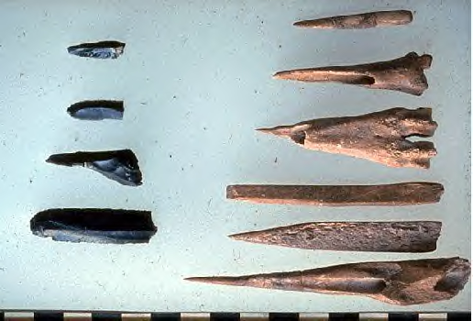
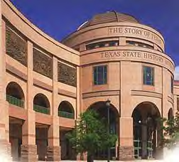
Uses of igneous rocks:
Tools
ex: (obsidian) used by Native Americans to make tools for cutting and scraping
Building materials
ex: granite
Cleaning and polishing
ex: pumice used to smooth feet

Slide 6
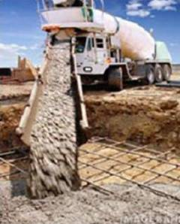
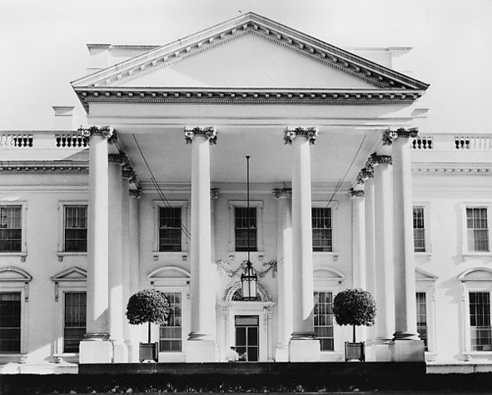
Uses of Sedimentary Rocks
Sandstone
flooring
concrete
building materials
ex: White House in D.C.
Limestone
building materials
making cement
chalk

Slide 7
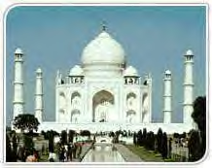
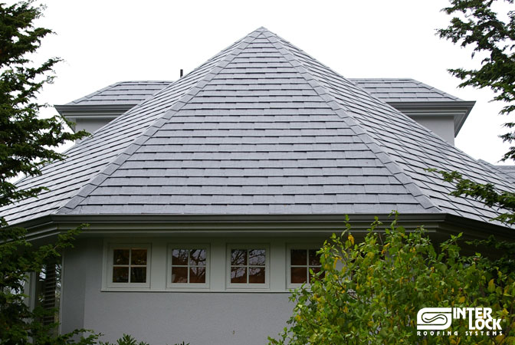
Uses of Metamorphic Rock
Marble
expensive buildings & floors
statues
furniture
(Taj Mahal in India)
Slate
flooring
roofing
outdoor walkways
chalkboards

Slide 8
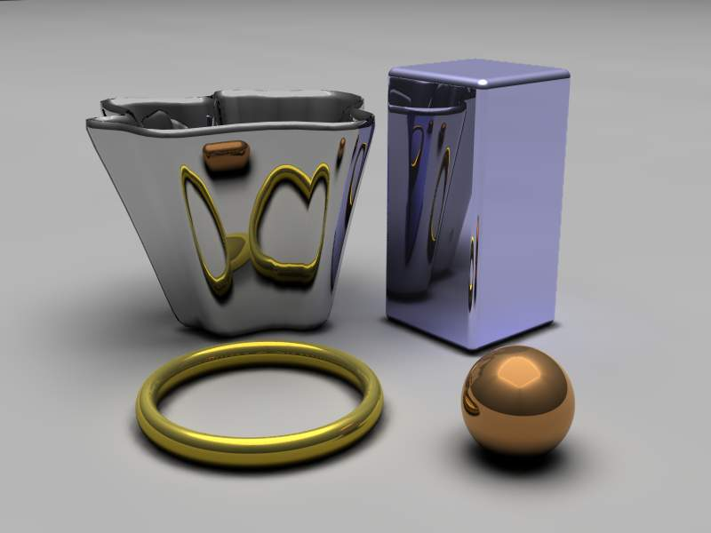
Some minerals are metals
aluminum, iron, copper, silver
stretched into wire
flattened into sheets
hammered or molded without breaking
steel (from iron ore) for framing

Slide 9
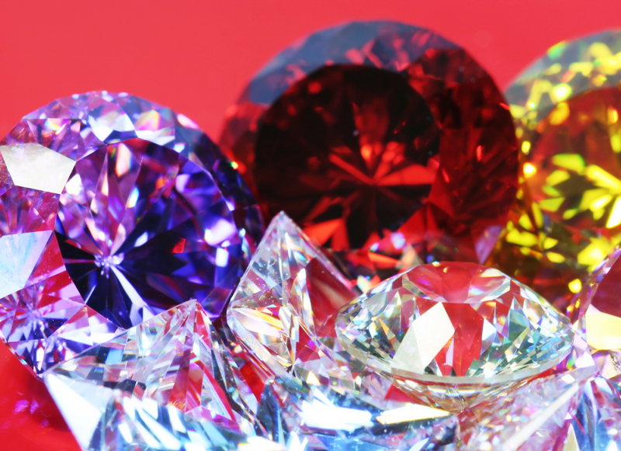
(enrich) GEMSTONES
Ex: rubies and sapphires
hard, colorful minerals with brilliant or glassy luster
rare
mainly used for jewelry and decorations

Slide 10
Review ch 3-3 USES
Observe common objects made of minerals. (website)

Slide 11
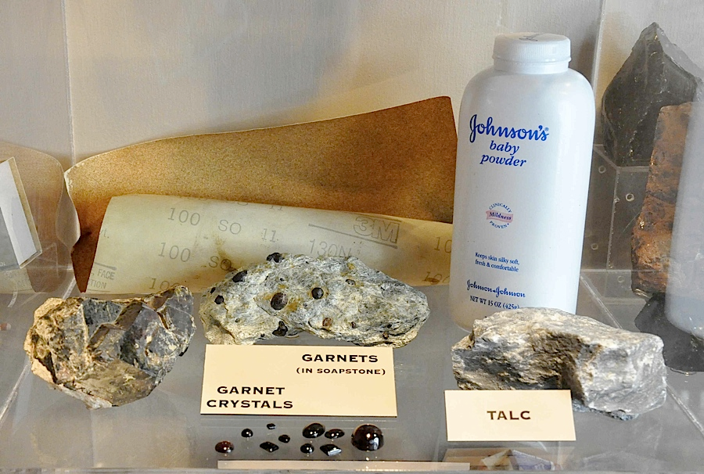
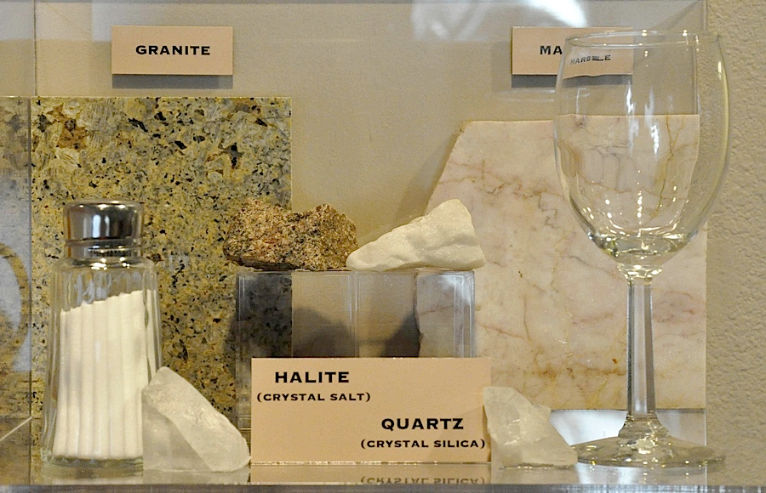
Now it’s time to do performance task #1…

