Slide 1
Soil Conservation (chapter 10, section 4)
mature soil takes THOUSANDS of years to form (so it’s nonrenewable), so it needs to be protected (conserved)

Slide 2
Why is soil so important?
1. Nutrients --Soil provides minerals and other nutrients for plants. All animals get their energy from plants.
2. Housing --Soil provides a place for animals to live.
3. Water Storage Without soil to hold water, plants would not get the moisture or the nutrients they need.

Slide 3
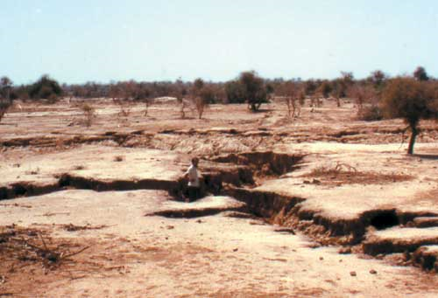
Human Activity that increase EROSION
1. logging
2. mining
3. construction
4. farming

Slide 4
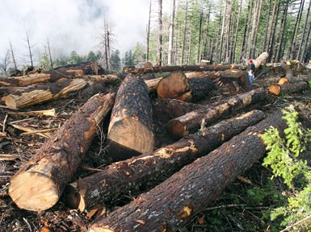
1--Logging
Trees cut down to build homes and furniture, and to make paper
clear-cutting (all trees cut down in an area)—roots decay and there’s nothing to hold the soil, so it washes away

Slide 5
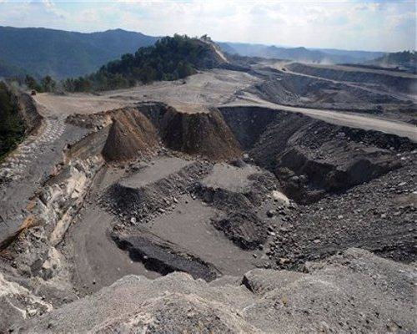
2--Mining
to get natural resources like minerals
erosion of soil speeds up
mining companies must “reclaim” the area when done

Slide 6
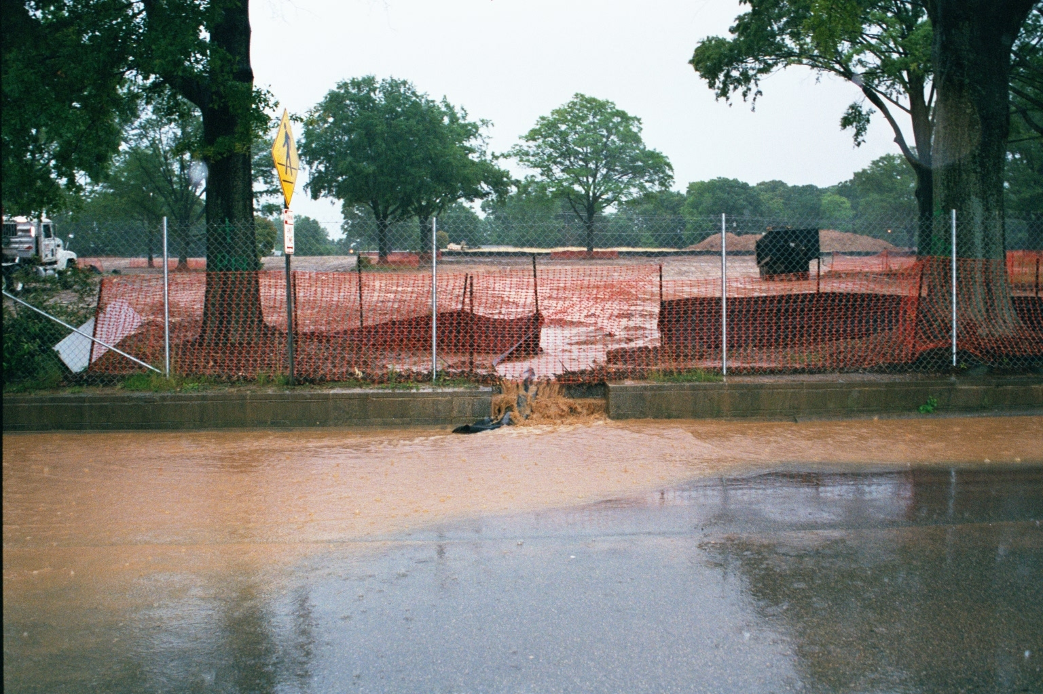
3--Construction
building roads, buildings, and communities
plants removed, so erosion speeds up

Slide 7
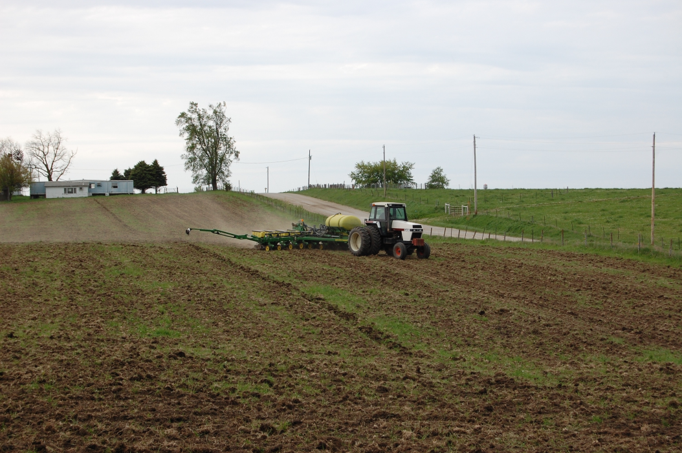
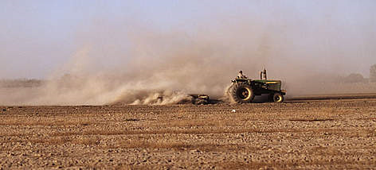
4--Over Farming

Slide 8
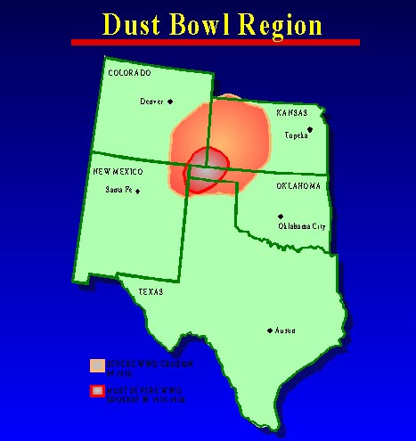
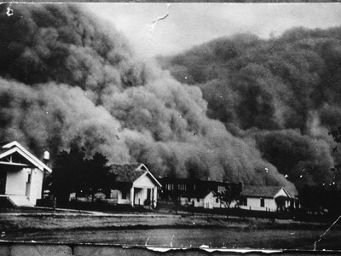
(enrich) Poor farming practices…
Dust Bowl
1930-1937
Colorado, Kansas, Oklahoma, New Mexico, and Texas
began as a severe drought and poor farming practices

Slide 9
Review
Weathering
…breaks down the rocks into smaller pieces (helps to make the soil)
Erosion
…moves the sediment/soil
We don’t want the soil to move, so what do we do?????

Slide 10
reduce soil erosion by…
1. more plants (wind breakers)-- slows down wind/water erosion and hold in soil
2. contour plowing
3. terracing
4. no-till farming
5. cover crop
6. crop rotation

Slide 11
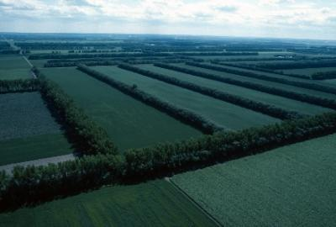
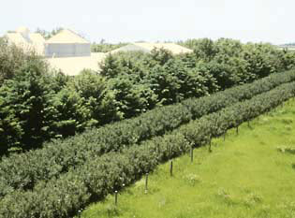
(1) Wind Breakers— slows down the wind

Slide 12
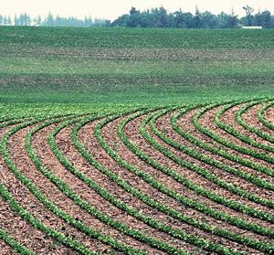
(2) Contour Plowing– slows down water erosion (for gentle hills)
Direction of water flow

Slide 13
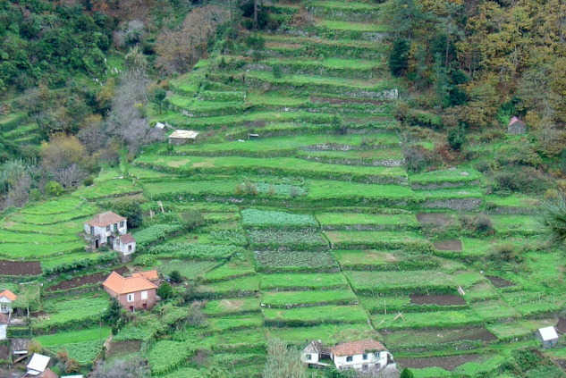
(3) Terracing– for steep hills (makes STEPS to slow down the water)

Slide 14
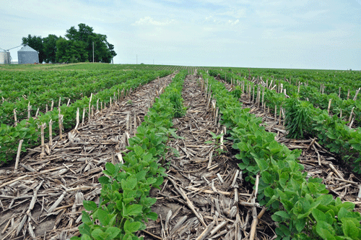
(4) No-till Farming – leave old stalks/roots to slow down runoff (don’t plow between harvest and replanting time)

Slide 15
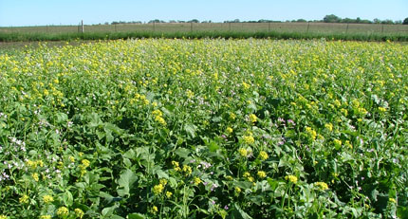
(5) Crop Cover– planted between harvests to restore nutrients and prevent wind/water erosion

Slide 16
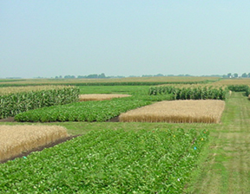
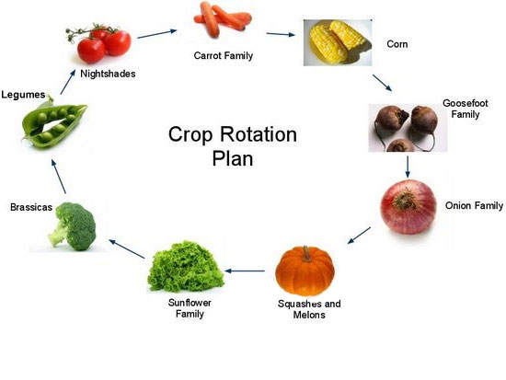
(6) Crop Rotation– plant different crops each year (helps replenish nutrients to soil)

Slide 17
Which human activity can help prevent soil erosion?
A. planting cover crops and employing contour plowing methods
B. strip mining and deforestation
C. building cities and highways
D. growing crops and burning fossil fuels

Slide 18
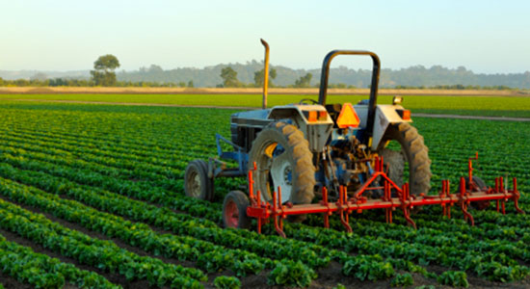
It’s time to do PT #6…

