Slide 1
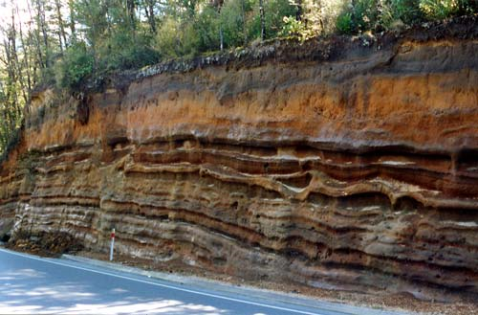
Layers of Soil

Slide 2
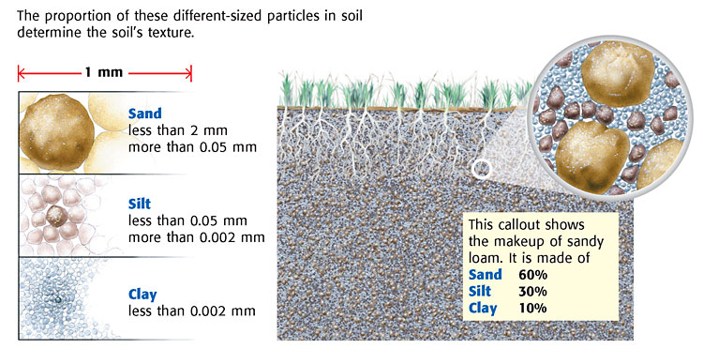
SOIL Texture
the size of the sediment particles
Largest particle
Smallest particle

Slide 3
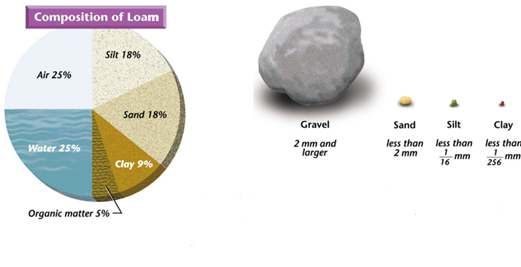
Loam (best soil)
LOAM—if you mix of all types of sediment
---- for best growth

Slide 4
Questions
Soil is made up of
  A. only weathered rock.
  B. only organic matter (humus).
  C. weathered rock and organic matter.
  D. only animals and plants.

Slide 5
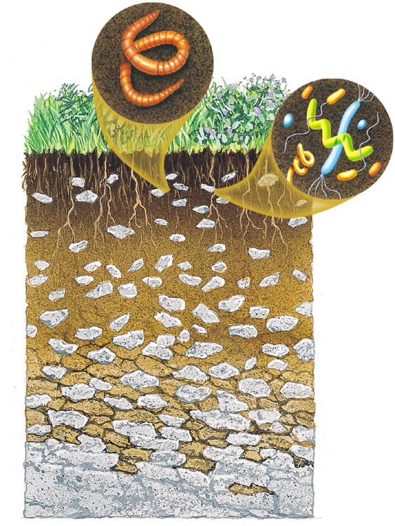
Soil layers
Earthworms
Soil microorganisms

Slide 6
Soil
Earthworms
Litter
Soil microorganisms

Slide 7
Soil
Earthworms
Litter
Soil microorganisms
Topsoil

Slide 8
Soil
Earthworms
Litter
Soil microorganisms
Topsoil
Subsoil

Slide 9
Soil Layers
Earthworms
Litter
Soil microorganisms
Topsoil
Subsoil
Bedrock

Slide 10
Soil profile
(soil horizons)
topsoil contains humus (rich in nutrients because it contains decayed organic material)
solid rock under all the soil is called “bedrock,” or “unweathered parent rock”
Bedrock

Slide 11
From top to bottom, what are the horizons of soil?
>>>topsoil, subsoil, weathered parent rock, bedrock/unweathered parent rock (or horizon A, B, C, bedrock)
Which of the following contains organic materials?
  A. unweathered rock
  B. grass
  C. water
  D. air

Slide 12
Last question…
The component of soil that is made up of decayed organic material is called ___.
>>humus

Slide 13
(enrich) Let’s try some soil math…
Suppose it takes 500 years to form 2 cm of new soil without erosion. If a farmer needs at least 35 cm of soil to plant a particular crop, how many years will the farmer need to wait before planting his or her crop?
8,750 years!!!

Slide 14
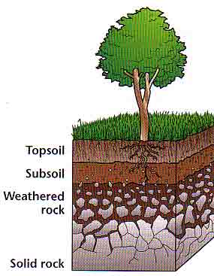
It’s time to do PT #7…

