Slide 1
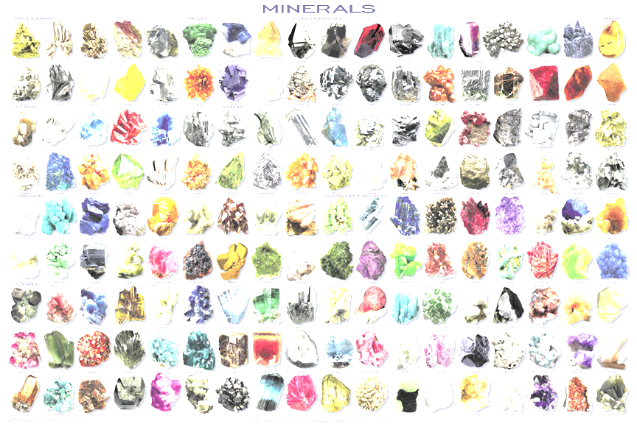
Chapter 3, section 2
How to identify a mineral…

Slide 2
Questions for review…
Which of the following definitions best describes a MINERAL?
a. a substance that cannot be separated or broken down into simpler substances by chemical reactions
b. a substance made up of atoms of two or more different elements joined by chemical bonds
c. a naturally formed inorganic solid that has a definite crystalline structure
d. a solid whose atoms, ions, or molecules are arranged in a definite pattern

Slide 3
Identifying Minerals
These minerals are similar in color. How are they different?
What mineral is being passed around?
Look at the chemical formulas for:
gold (Au), pyrite (FeS₂), and chalcopyrite (CuFeS₂)

Slide 4
8 ways to test the identify of a mineral
1--hardness
2--color
3--streak color
4--luster
5--density
6--crystal structure
7--cleavage/fracture
8--special properties

Slide 5
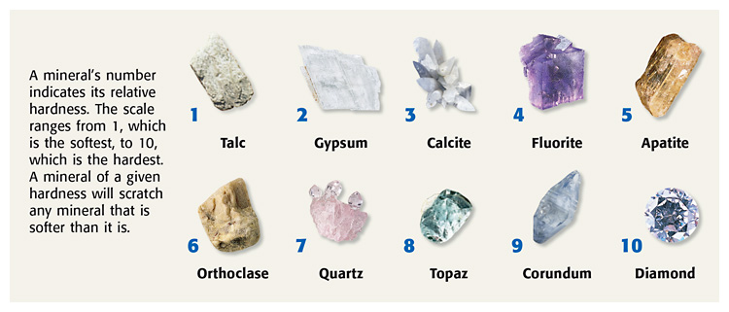
Hardness
how easy is it to scratch the mineral?
Moh’s scale
1812 by Friedrich Mohs
1 (talc) - 10 scale (diamond)
common substances:
fingernail=2.5
penny=3-3.5
glass=5.5-6
steel=5-5.5
streak plate= 6.5-7.5

Slide 6
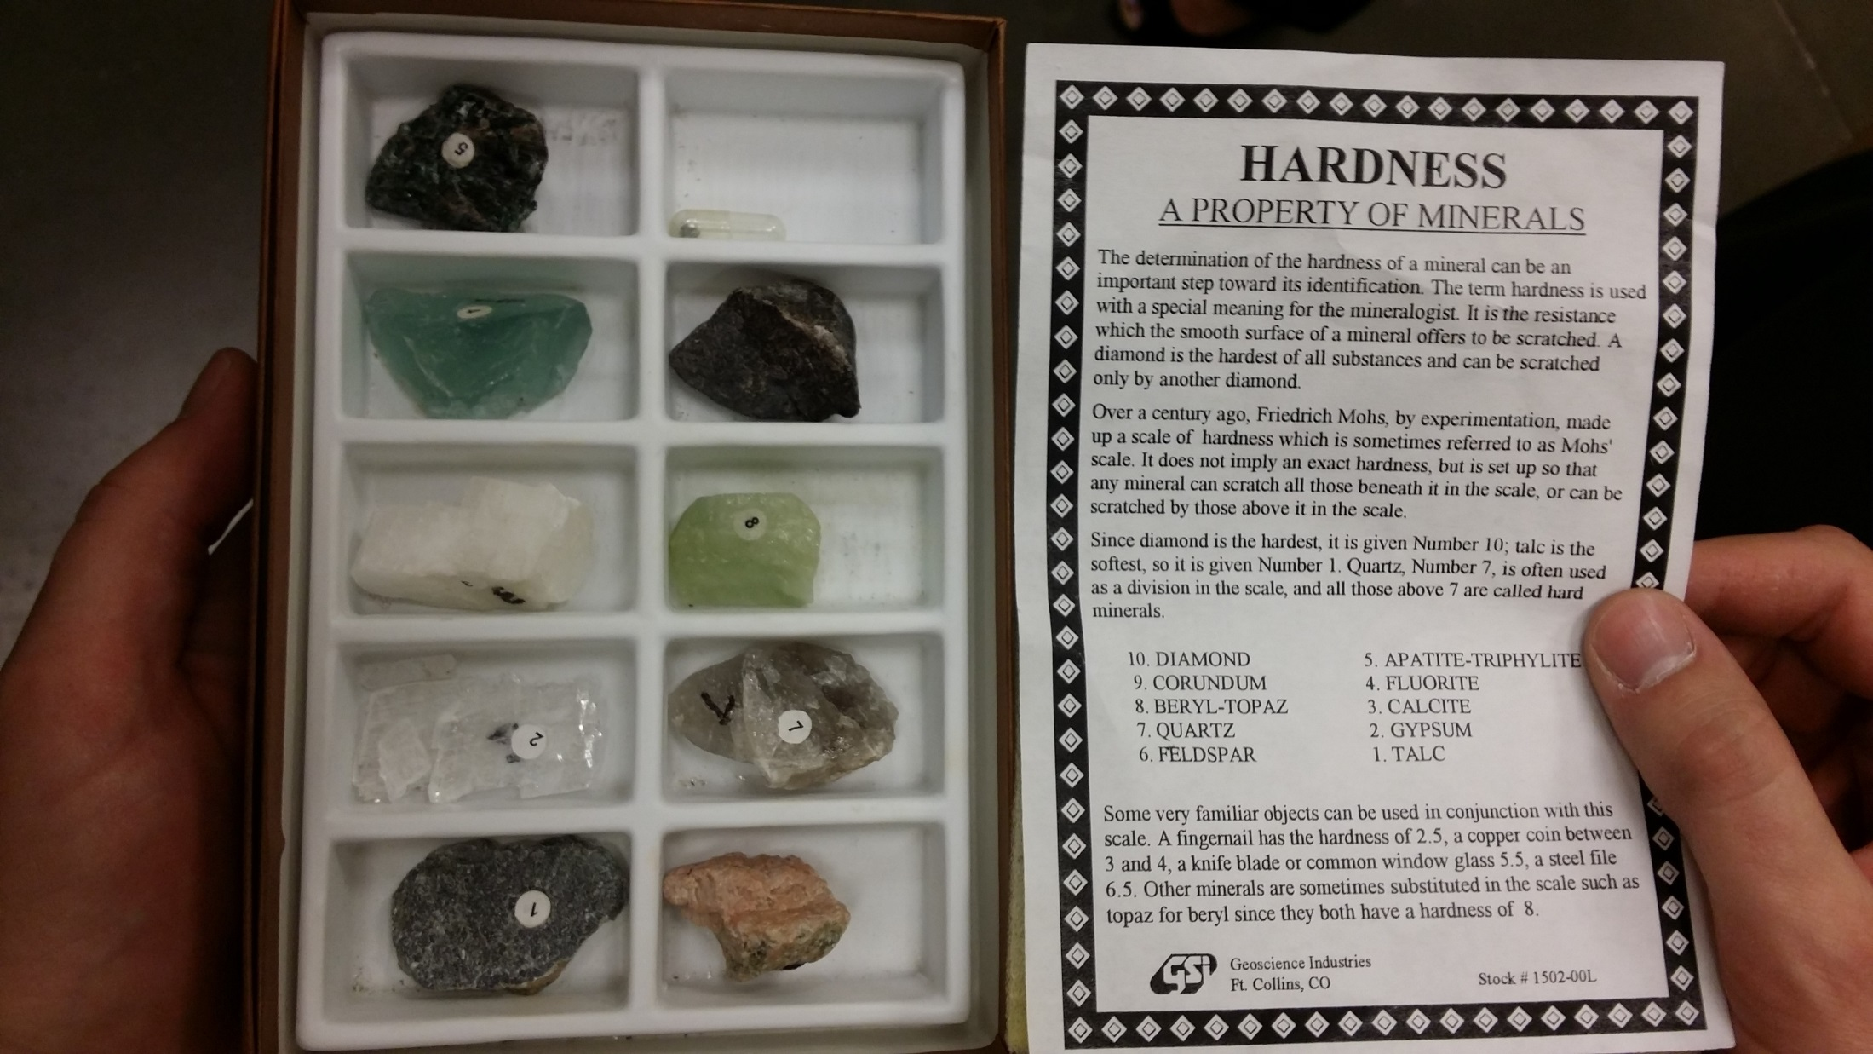

Slide 7
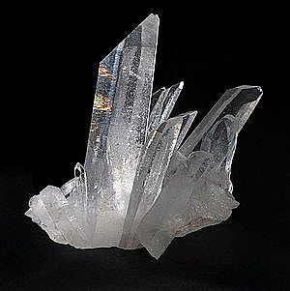
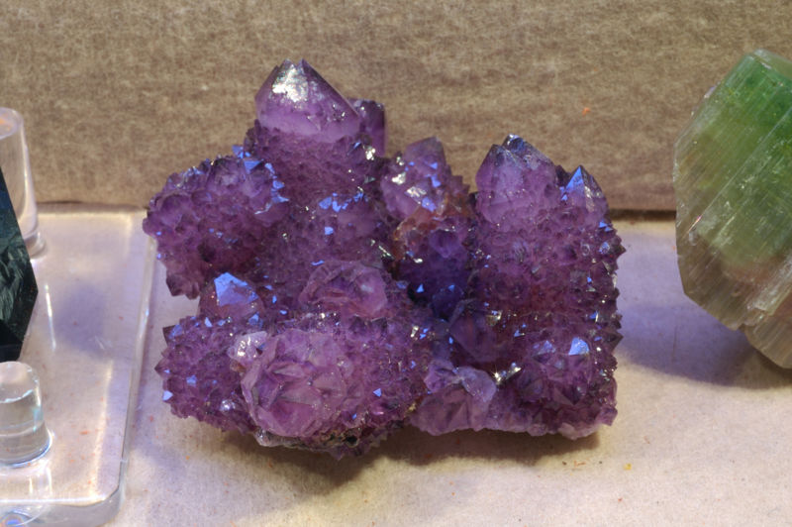
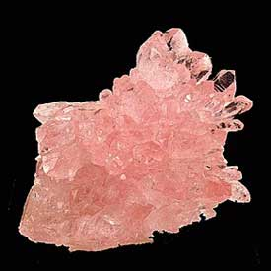
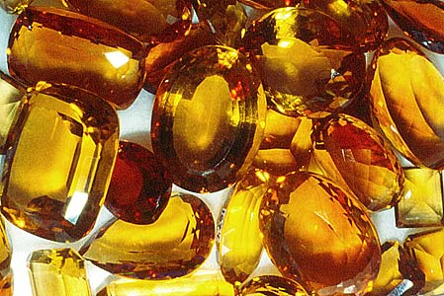
Colors of QUARTZ

Slide 8
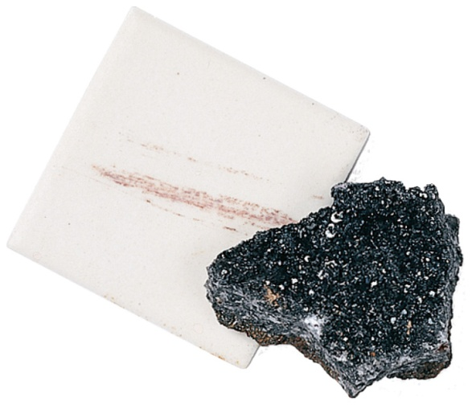
Two colors
Color
easy but not reliable
color may change over time
some minerals have MANY colors (like quartz)--due to impurities
many minerals have the same color
Streak Color--practice
more reliable than regular color
color of its powder
use streak plate (unglazed tile)
examples:
pyrite=black
gold=golden, yellow

Slide 9
Luster
how a mineral reflects light from its surface
1. metallic (shiny)
2. nonmetallic: glassy, dull, earthy, waxy, pearly
Density
mass/volume
remains the same (no matter the specimen size)
also called “heft”
may use “specific gravity” (same as density, but no units)

Slide 10
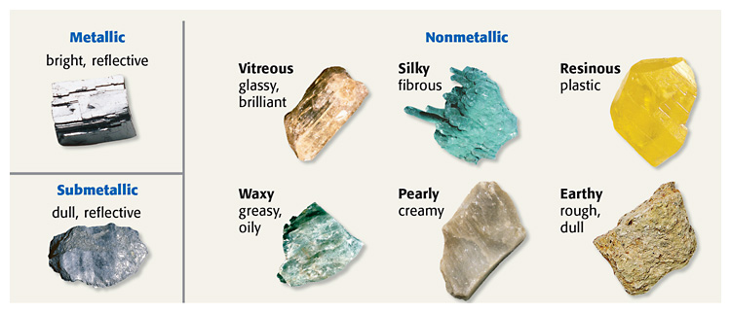
Types of luster

Slide 11
Crystal System
Example: cubic-
Example: hexagonal
Cleavage/Fracture (paper towel demo)
how a mineral BREAKS
1. Cleavage=smooth break
2. Fracture=irregular break—rough, jagged, or curved (most minerals have fracture)
quartz=curved, shell-like surface
copper and iron=hacky fracture (forms jagged points)

Slide 12
Special Properties
Fluorescence (glow under UV light)--scheelite
magnetic--magnitite
radioactive--uraninite
fizzes (gives off CO₂) in acid– calcite (demo)
Very malleable (easy to shape)--gold
earthy odor--clay
soapy feeling--talc
feels greasy--graphite
double refraction--optical calcite

Slide 13
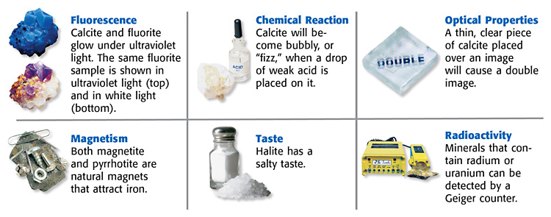
Special Properties:

Slide 15
Mystery mineral game:
Pick a mineral from pp. 800-801
other classmates must ask yes/no questions to determine the identity of the mystery mineral (like “20 Questions”)

Slide 16
LAB: What mineral do you have?
Find color and streak color
What is the luster?
Find the hardness (a range)
Find density (use water displacement for volume)—could use “heft”
AFTER 2-4 tests are completed, try to identify the mineral, then...
Bring the mineral to your teacher when finished to see if you are correct and to get another mineral to identify.

Slide 17
Which mineral can be identified by tasting?
halite (salt)
What is the difference between a mineral and a rock?
Minerals are elements or compounds.
*Rocks are mixtures (or minerals).
Minerals that contain one or more elements combined with silicon and oxygen are called _________ {enrich}
silicates

Slide 18
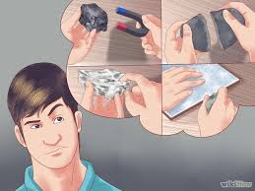
Now it’s time to do performance task #6…

