Slide 1
Day #4
Astronomy—Solar System Intro

Slide 2
Review vocab from days 2-3, then quiz
theory
Geocentric model/theory
Heliocentric model/theory
Big Bang
universe
galaxy
solar system
Milky Way
spiral
galaxy
Local Group

Slide 3
Review Questions
Which object is the largest: Earth, the sun, the Milky Way Galaxy, supergiant star?
>>the Milky Way Galaxy
Where in the Milky Way Galaxy is the solar system found?
>>in an outer arm
A light year is a unit of _________.
>>distance

Slide 4
Define, describe, OR sketch the following words for today…
Use pages 582, 644, 646-647, 660
inner planet
outer planet
AC also read pages:
583-588
star
solar system
terrestrial
planet
satellite

Slide 5
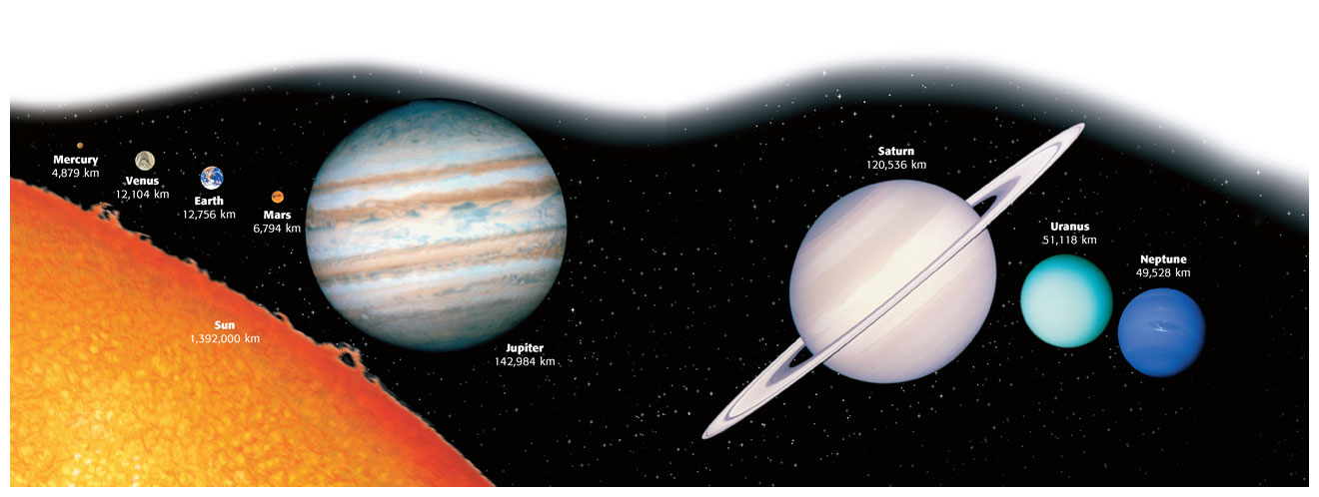
Our Solar System (includes the sun, 8 planets and their moons, asteroids, comets, meteoroids & other smaller objects)

Slide 6
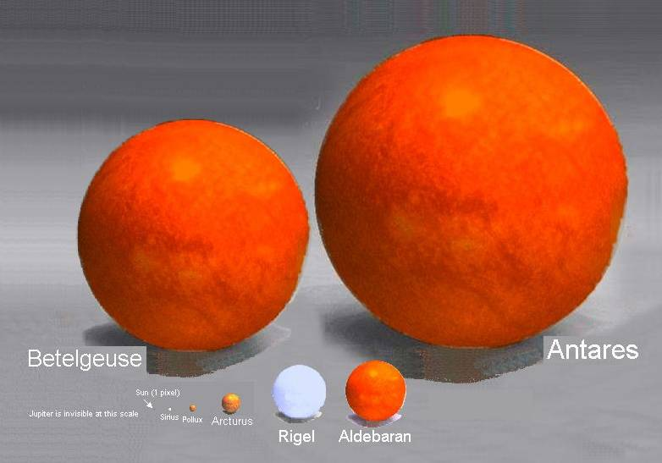
SUPERGIANTS
(on Orion’s shoulder)
GIANTS

Slide 7
Our star, THE SUN
yellow
middle-aged
medium-sized
surface temperature of about 6000°C
medium brightness

Slide 8
Planets—make a double bubble
Inner Planets
also called terrestrial planets
small, dense and rocky
no rings
Mercury
Venus
Earth
Mars
Outer Planets
also called gas giants
all have moons
all have at least one ring
Jupiter
Saturn
Uranus
Neptune

Slide 9
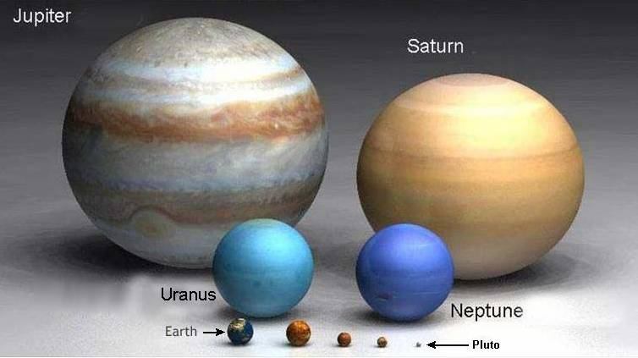
Relative size of the planets

Slide 10
Brainpops—as time permits
Black Holes
Life Cycle of Stars
Outer Solar System
Constellations

