Slide 1

Bring Your Own Device
East Cobb Middle School

Slide 2
Why BYOD? Why Now?
CCSD believes that 21st Century instruction is necessary for 21st century learning.
Common Core Standards require:
  Rigorous instruction
  Personalized academic experiences
  Fostering innovation and creativity
  Embracing emerging technologies

Slide 3
What is the D in BYOD?
For the purposes of BYOD, “Device” means a privately owned wireless and/or portable electronic piece of equipment that includes laptops, netbooks, tablets/slates, iPod Touches, cell and smart phones.

Slide 4
What are our goals for BYOD?
Promote higher order thinking, creativity and other 21st century skills
Increase student engagement
Promote greater collaboration (between teachers/students/parents)
Improve student access to technology/digital resources

Slide 5
Goals
Integrate technology seamlessly into the curriculum
Increase project based learning activities
Raise achievement levels in core content areas
Model good digital citizenship

Slide 6
Classroom Regulations & Expectations
When will we use them?
Students will…
  In the classroom setting
  Under teacher direction
  Not for calls, texts, or social media
  For instructional purposes only
  Consequences will be applied if rules are not followed!
Keep phones and other devices on silent at school
NOT record audio or video, or take photographs of students or staff for any reason whatsoever without express written consent from the teacher and individuals to be recorded
NOT use headphones/ear buds unless instructed by a teacher.
Comply with teacher requests to shut down their devices and put them away

Slide 7
Device Use
Are students required to bring a device?
No, students will be given other options.
Can parents/guardians call or text students while they are at school?
No, to get a message to a student, call the front office. For students to contact parents, they must get a pass to the front office.
Only the school Wi-Fi network will be used.
This connection has the same filters students use with school-owned technology.
Other networks cannot be accessed during the school day.

Slide 8
How do students access the BYOD network?
Students will be given specific instructions as to how to access the school network. Students are not allowed to access outside internet sources.
Settings
Network
Wi-Fi
CCSD (password: cobb2019 if needed)

Slide 9
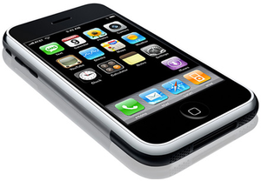
Non-BYOD Times
Lunchtime
Standardized Testing Days
Teacher Specified Times
Hallways/Class Changes
Some Connections Classes
Substitute Days
Restroom Breaks

Slide 10
Housekeeping
Students are responsible for the security and operation of their own devices
Students should record the serial # of their device
CCSD is not financially responsible for lost/stolen devices
Technical support will not be available at school
Charging of devices must take place at home or at teacher discretion
Devices may be confiscated for inappropriate use

Slide 11
Equity
BYOD is being integrated into our classrooms to enhance our students’ education.
Alternatives to using personal devices will be included in activities requiring their use. Those alternatives could include: classroom desktops, laptop carts, iPad carts, pencil and paper tasks and group work.

Slide 12
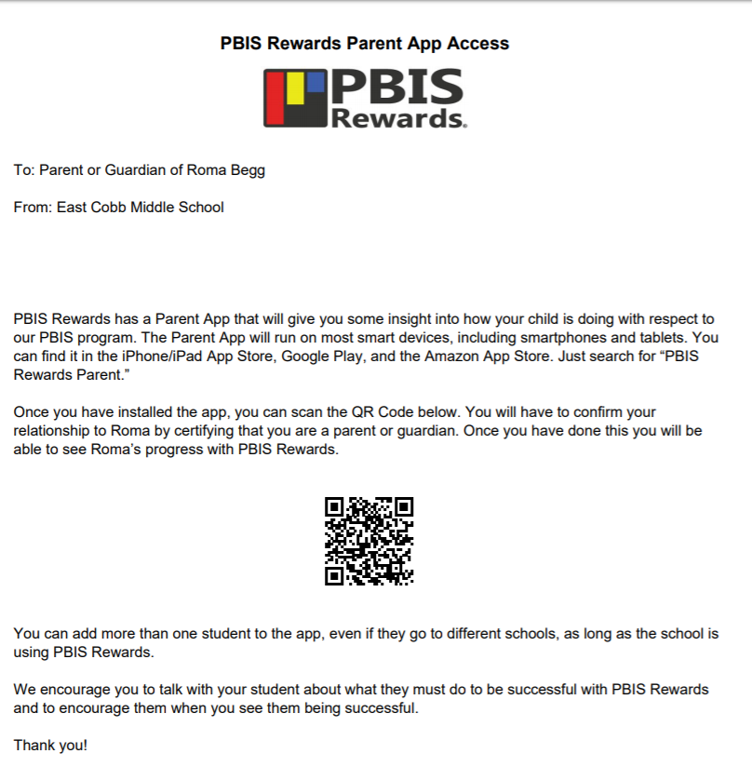
PBIS
Your parents received this letter at Open House.

Slide 13
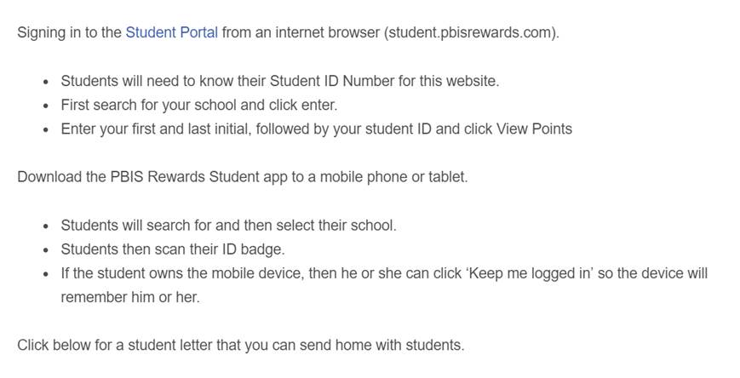
PBIS Student Portal
It is now time to explore the new PBIS app.
If you have your own device AND a BYOD on file, you may log in using the QR code your teacher can access for you.
If you do not have BYOD clearance, please listen to your teacher’s overview of the program and how he/she will use the features throughout the year.

