Slide 1
Chapter 15-1a The Atmosphere BIG IDEA: Earth’s atmosphere is a mixture of gases that moves heat and allows life to exist on Earth.

Slide 2
Purposes of our atmosphere:
breathing (oxygen)– (You can survive for a few days without food or water but less than 5 minutes without the oxygen)
protects us from harmful solar rays (like UV and gamma)
warmth (traps heat)
water/water vapor
protection from most
meteoroids

Slide 3
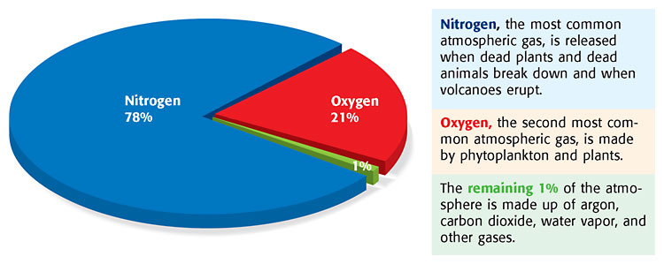
What makes up air?

Slide 4
What makes up DRY air?
78% nitrogen--used to make protein
21% oxygen (from photosynthesis)—processes that use oxygen:
cellular respiration (plants and animals)
oxidation (like rust, tarnish)
combustion (burning)
--1% other gases (argon,
carbon dioxide, other)

Slide 5
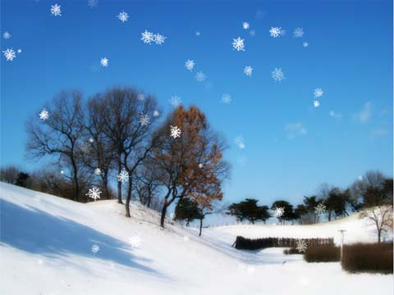
Air also contains
human pollution (smog, etc)
natural pollution: dust, volcanic ash, sea salt, dirt, pollen, smoke from forest fires
water vapor--amount varies 0-4% (humidity)—invisible gas
liquid water (cloud droplets and rain)
solid water (ice and snow)

Slide 6
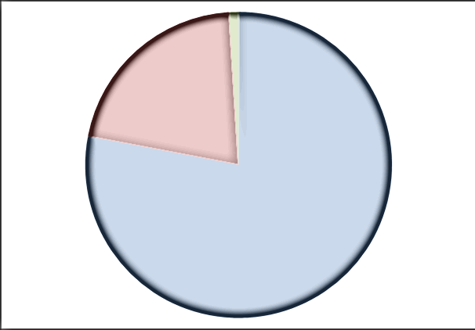
Questions
Air is about _____% nitrogen and ____% oxygen.
>>>78, 21

Slide 7
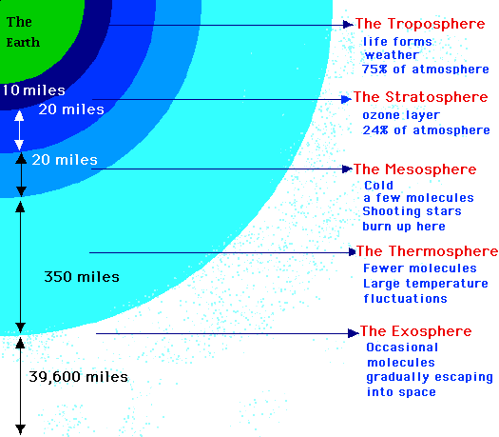
Performance Task Part 2

