Slide 1
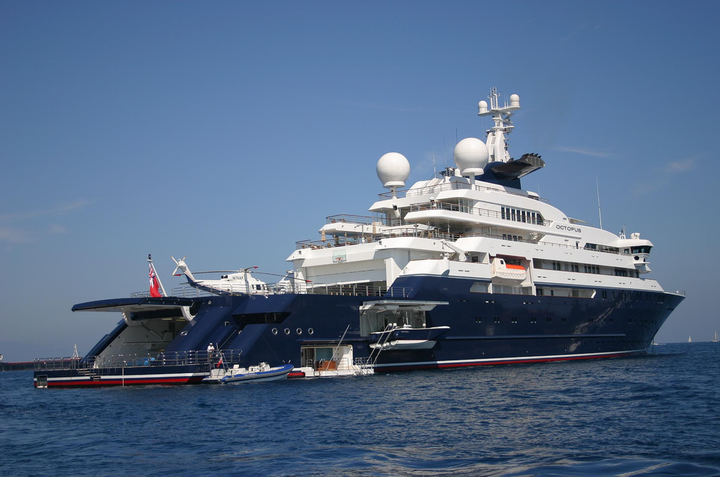
Chapter 13-1: Exploring the Oceans

Slide 2
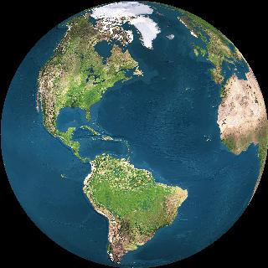
Oceans cover _____% of Earth’s surface (all water =75%)
71

Slide 3
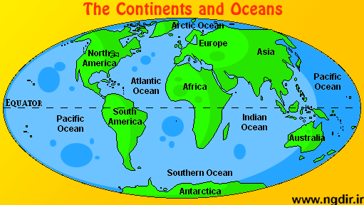
5 oceans
smallest
Largest & deepest
NEW

Slide 4
Make a BAR graph showing the AREA (size) of the 5 oceans
Pacific 156,000,000 km²
Southern 20,000,000 km²
Atlantic 77,000,000 km²
Indian 69,000,000 km²
Arctic 14,000,000 km²

Slide 5
Make another BAR graph that shows the DEPTH of the oceans
Pacific 4.3 km
Southern 4.0 km
Atlantic 3.3 km
Indian 3.9 km
Arctic 1.0 km
What is the AVERAGE depth of all of the oceans?
3.3 km

Slide 6
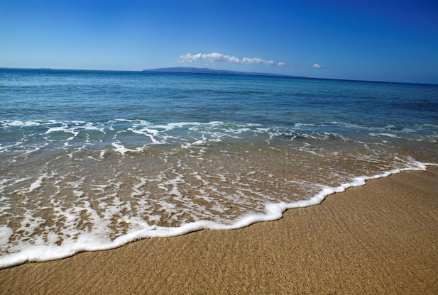
What is the depth of SEA LEVEL?
0 (zero) km

Slide 7
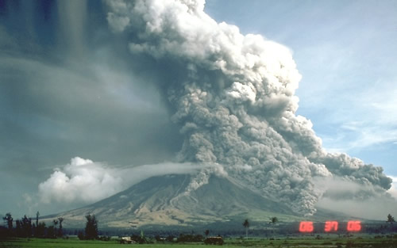
How did oceans form?
Billions of years ago, volcanoes gave off water vapor, which cooled and condensed into clouds, then it rained
(some moisture may be from comets)

Slide 8
Salinity (amount of dissolved solids in the water)
salts added to oceans due to erosion of rivers/streams
fresh=no salt
brackish=some salt

Slide 9
Where will you find saltier water?
saltier in hotter and drier climate (more evaporation)– lower salinity if it’s cooler more rain, and at the mouth of a river
higher salinity if there is little movement of water (no currents to mix the water)

Slide 10
Dissolved salts in the ocean:
55% chlorine
31% sodium
14% (other
(mostly magnesium*, sulfur, potassium, and calcium)
so main salt is NaCl

Slide 11
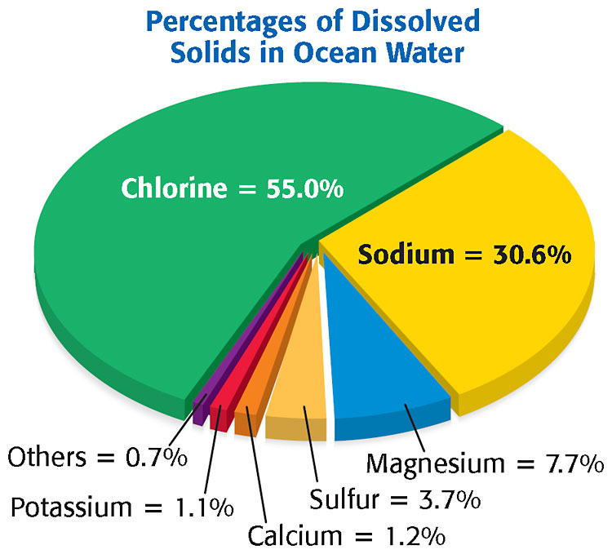
Main ocean salt
is sodium chloride
(NaCl)

Slide 12
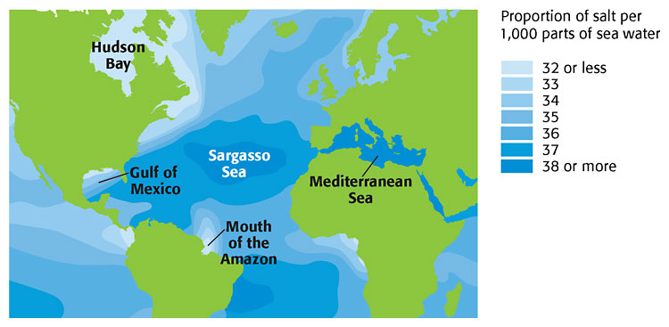
Salinity varies (average=3.5%)

Slide 13
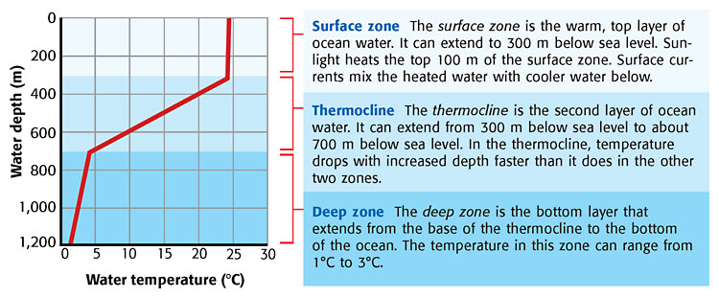
Vertical Temperature Zone {enrich}

Slide 14
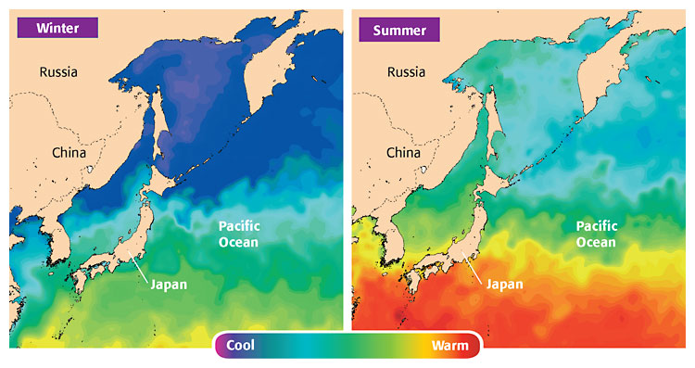
Sea Surface Temperatures (varies with season and latitude) --range from 1ºC near the poles to about 24 ºC near the equator--

Slide 15
Questions
Why does coastal water in areas that have hotter, drier climates typically have a higher salinity than coastal water in cooler, more humid areas does?
hot/dry areas have more evaporation
What is the order of Earth’s 5 oceans from largest to smallest?
…Pacific, Atlantic, Indian, (Southern), Arctic

Slide 16
Questions
Which continents border the Atlantic Ocean?
--North America, South America, Europe, and Africa
Which substance do fish need to live and take in from water that you take in from air?
--oxygen

Slide 17
Review Questions
About how much of Earth’s surface is covered by water?
>>70-75%
From largest to smallest, the amounts of water on Earth are (choices: liquid surface fresh water, solid fresh water, salt water, ground water).
>>>salt water, solid fresh water (ice), ground water, liquid surface fresh water
For a family of four, what indoor use of water consumes the MOST water per day?
>>flushing toilets (then bathing)

Slide 18
An astronaut viewed Earth from space. Which of the following did she observe?
A.Earth has seven main oceans that are distinctly different.
B.Earth has equal amounts of ocean and land on its surface.
C.Ocean water covers about 71 percent of Earth’s surface.
D.Half of the water on Earth is in the Earth’s oceans.

Slide 19
_______________ is the most abundant dissolved solid in ocean water.
sodium chloride
What change in water occurs in the atmosphere at the condensation stage of the water cycle?
A.gas to liquid
B.liquid to solid
C.liquid to gas
D.solid to liquid

Slide 20
Which of the following affects the ocean’s salinity?
A. Fresh water added by rivers
B. Currents
C. Evaporation
D. All of the above

Slide 21
The largest ocean is the
A. Indian Ocean.
B. Arctic Ocean.
C. Pacific Ocean.
D. Atlantic Ocean.

Slide 22
The ocean water off the coast of Maine, in the United States, is not as salty as the ocean water off the coast of Morocco, in Northern Africa. Which of the following factors could be responsible for this difference in salinity?
A.climate
B.marine life
C.ocean pollution
D.deep ocean currents

Slide 23
ENRICH: The top layer of ocean water that extents to about 300 meters below sea level is called the
A. deep zone.
B. surface zone.
C. Gulf Stream.
D. thermocline.

