Slide 1
Air Mass (visual organizer)
large body of air where temperature and moisture are similar throughout
moist (m=maritime) or dry (c=continental)
warm (T=tropical) or cold (P=polar)
4 types of air masses: mT, mP, cT, cP

Slide 2
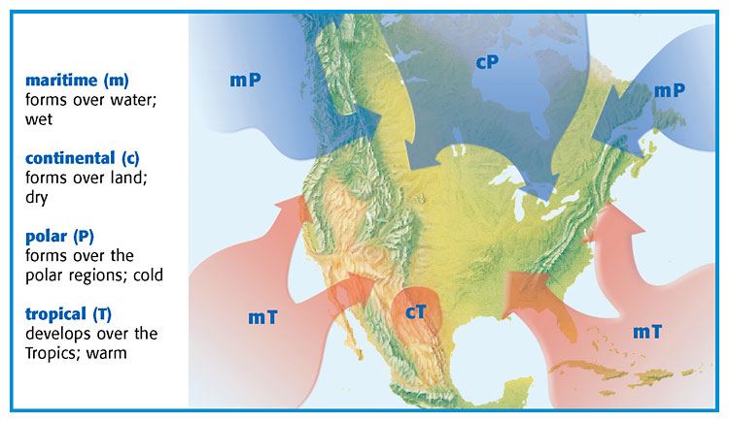
4 types of air masses

Slide 3
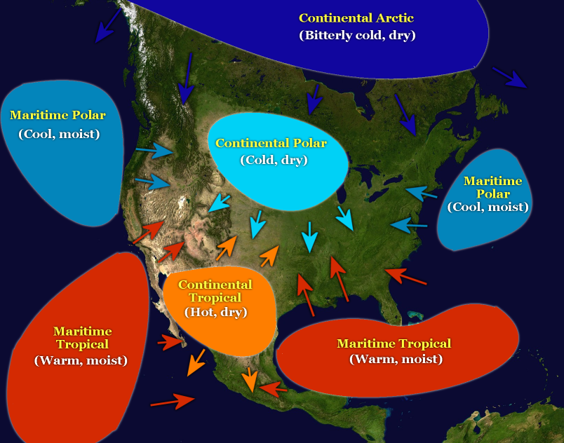
Performance Task 8

Slide 4
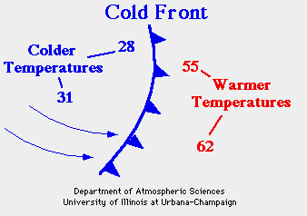
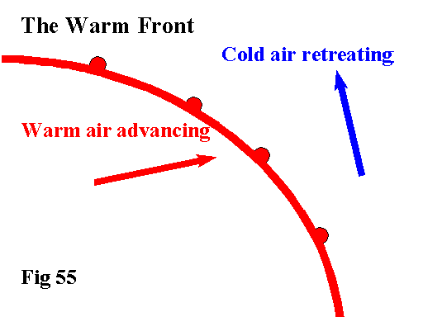
4 types of FRONTS —where 2 air masses meet (do not mix well due to different densities)
cold front
cold air moves under warm air and pushes the warm air up
can move quickly and bring thunderstorms
brings cooler air
warm front
warm air moves over colder/denser air
usually brings drizzle
followed by warm temperatures

Slide 5
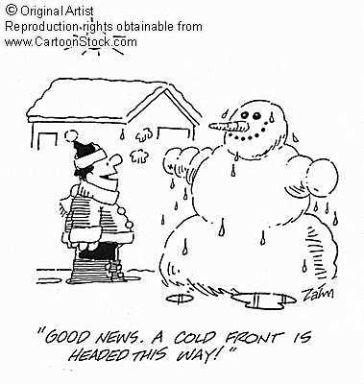

Slide 6
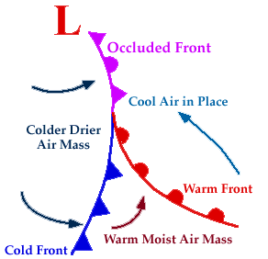
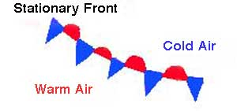
4 types of FRONTS —continued
occluded front
warm air mass trapped between 2 colder air masses
brings cooler temperatures and lots of precip
stationary front
often brings many days of cloudy, wet weather
could lead to floods

Slide 8
Cold Front (animated website)
Warm Front (animated website)

Slide 9
Math Skills {enrich}
A cold front is moving toward the town of La Porte at 35 km/h. The front is 200 km away from La Porte.
How long will it take the front to get to La Porte?
5.7 hours
Meteorologists compare a new weather map with one that is 24 hours old.

Slide 10
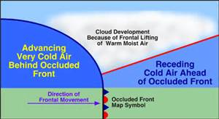
Performance Task Part 9

