Slide 1
Erosion and Deposition

Slide 2
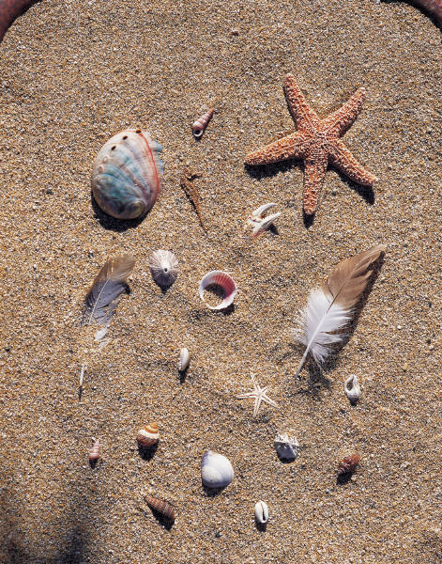
Review: Sediment
Sediment is small, solid particles of rocks or organisms.
Ex: pieces of rocks, minerals, shells, sand, mud, gravel, clay

Slide 3

Review…
Sediments are created when rocks are weathered (broken down)
Then the sediments are moved by wind, water, ice, or gravity (erosion)
BUT…
Eventually the wind, water, ice, or gravity slows down or stops (runs out of energy)

Slide 4
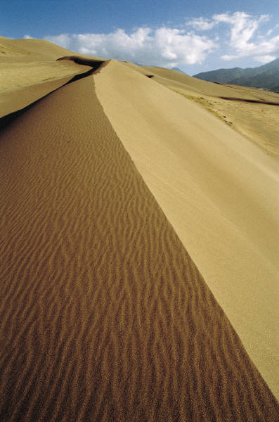
Deposition
When the sediment being carried is dropped (or deposited) in a new area, it is called deposition.
Deposition can create new landforms
(constructive force).

Slide 5


CHECK-UP
Choose one of the following for each example:
A.) Erosion
B.) Deposition
A
a river carrying sand
dropping sediment in a new location
a glacier picking up a rock in it’s path
a beach is formed
how a sand dune is created
how sediment is moved
sand being carried by the wind in a sandstorm.
B

Slide 6
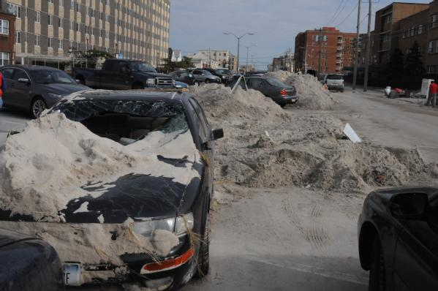
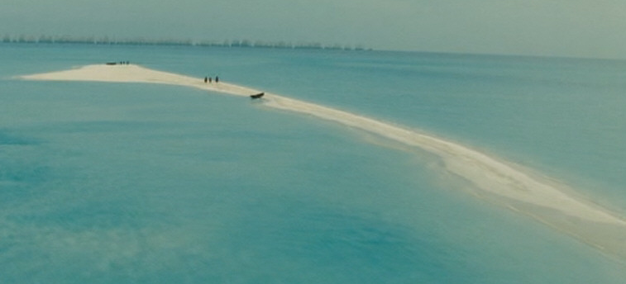
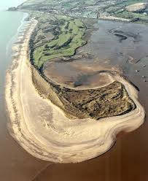
Landforms created by deposition
1. Beaches
2. Sandbar (may
become a barrier island)
3. Barrier spit

Slide 7
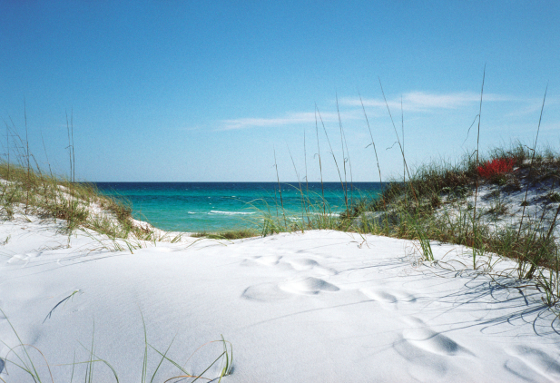
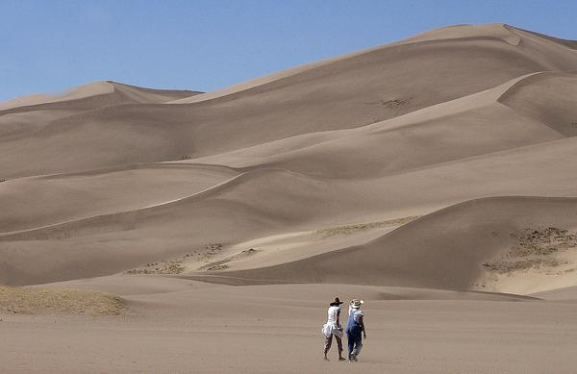
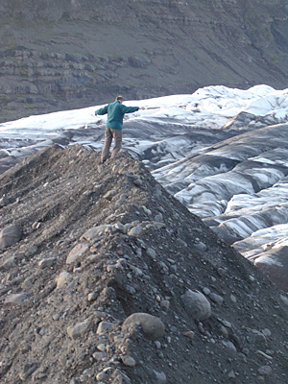
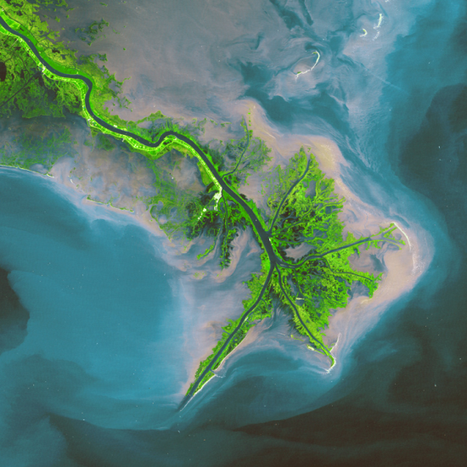
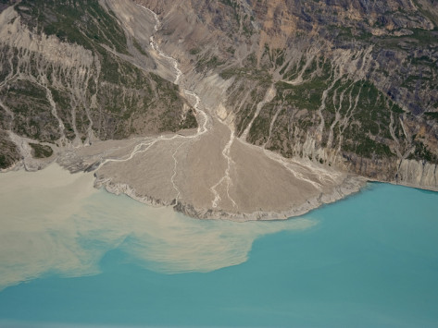
4. Dunes
5. Till deposits
(from glaciers)
6. Delta
(from rivers)
7. Alluvial fan
(from mountain)

Slide 8
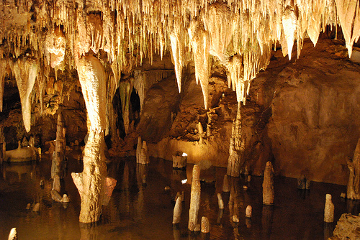
8. Inside caves
a. Stalactites
b. Stalagmites

