Slide 1
Midterm Overview
Now that the dust has settled, how did you do?

Slide 2
Most missed questions
1. What temperature must it be in order for metamorphism to start?
10 degrees Celsius
100 degrees Celsius
800 degrees Celsius
180 degrees Celsius

Slide 3
Most missed questions
2. A Kit Kat bar contains layers, which represent ____________ in a clastic sedimentary rock.
Foliation
Strata
Stratification
Non-foliation

Slide 4
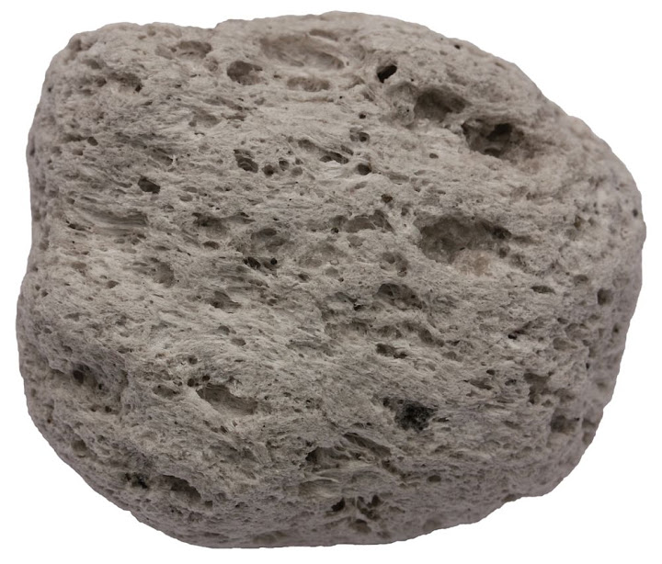
Most missed questions
3. What type of rock is this?
extrusive
Intrusive
Clastic
foliated

Slide 5
Most missed questions
4. What is an example of an organic sedimentary rock?
limestone
Sandstone
Rock salt
pumice

Slide 6
Most missed questions
5. Sandstone has layers so James said it was foliated, Is he correct? Why or why not?
Yes, foliated means layers formed underwater
Yes, foliated means grains are arranged in bands, so layers and bands are the same
No, sandstone is not metamorphic. Sandstone is clastic
No, it would be fine-grained because it has bands

Slide 7
Most missed questions
6. What is the difference between sand, silt, and clay?
Their texture
Their size and sand is the smallest
Their size and clay is the smallest
Their origin

Slide 8
Most missed questions
7. How is soil formed?
Erosion of sediments
Weathering of rocks and minerals
Compaction and cementation
Mixing of all the ingredients needed over time

Slide 9
Most missed questions
8. What forms at the Mid-Atlantic Ridge?
Volcanoes, caused by a divergent boundary
Volcanoes, caused by a transform boundary
A rift valley, caused by a convergent boundary
A trench, caused by a convergent boundary

Slide 10
Most missed questions
9. What is the difference between hail and sleet?
Hail is frozen when it hits the ground, sleet is not
Sleet is frozen ice pellets, hail is liquid
Hail forms in thunderstorms, while sleet happens in the winter months
Sleet happens in the summer, while hail happens mostly in the winter months

Slide 11
Most missed questions
10. A watershed is a region of land ____________________.
Where rainwater accumulates
That is drained by a river system
Where the river water from tributaries accumulates
Where the water table extends above the Earth’s surface

Slide 12
Most missed questions
11. Which of the following describes an aquifer’s ability to allow water to flow through?
Recharge zone
Porosity
Permeability
Geology

Slide 13
Most missed questions
12. Which of the following is NOT a characteristic of a mineral?
Organic
Solid
Natural
Crystalline structure/shape

Slide 14
Most missed questions
13. Which is the best way to determine the hardness of a mineral?
Use a streak plate to scratch the mineral
Determine where the rock was formed
Use known minerals from the Mohs scale
Crush it to see if it can dissolve in acids

