Slide 1
Ms. Dudek Science
6th Grade Earth Science
OPEN HOUSE

Slide 2
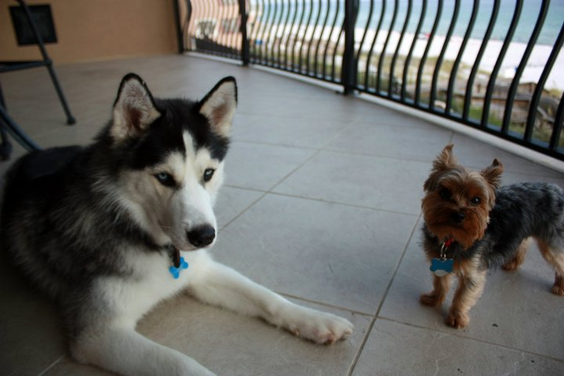
About Ms. Dudek
Grew up in Gwinnett County
Bachelor’s and Master’s at Georgia State University
Studying for Specialist from KSU
Live in Druid Hills
Been teaching for four years
BIG fan of Falcons and Braves

Slide 3
What does my child go through?
Do Now
Mini-Lesson/Re-cap
Activity
Group work
Last Call closing questions
HW given

Slide 4
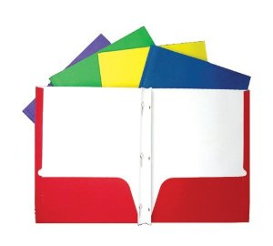
Expectations
Must be prepared: 7 folders with brads needed!
Give a hand/praise
Is that clear??? CRYSTAL
Easy Peezy?? Lemon Squeezy

Slide 5
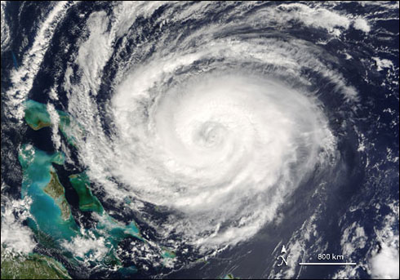
What will we be learning?
Earth Science! 4 main branches:
Geology
Hydrology
Meteorology
Astronomy

Slide 6
What will we be learning?
Rocks, Minerals, Safety
Weathering, Erosion, Soil
Dynamic Earth
Water on Earth
Climate and Weather
Earth, Moon and Sun
Solar System and Universe

Slide 7
Homework
Always have out on desk
Reminders will be up on the blog
Will be graded!
Should be expected EVERY NIGHT!
FLIPPED CLASSROOM ☺

Slide 8
Having Trouble?
Help Sessions: Every Tuesday Morning starting with September 8th
Starts at 8:15, cannot show up late
Extra credit given only a couple times per year
Make sure work is turned in on time
BLOG BLOG BLOG!

Slide 9
Communication
Email is the best! Brittany.dudek@cobbk12.org
Blog
Blog
Blog

Slide 10
Want to help?
If your career involves anything we learning about, come see us!
If you want to help out with a lab, come see us!
If you just want to be with your child during the day, come see us!
Door is always open!

Slide 11
Ms. Dudek Math
6th Grade Math
OPEN HOUSE

Slide 12
About Ms. Dudek
Grew up in Gwinnett County
Bachelor’s and Master’s at Georgia State University
Studying for Specialist from KSU
Live in Druid Hills
Been teaching for four years
BIG fan of Falcons and Braves

Slide 13
What does my child go through?
Do Now
Lesson with notes in MSG
Activity/Computer Lab
Group work
Last Call closing questions
HW given

Slide 14
Expectations
Must be prepared: MSG AND TEXTBOOK
Pencil is a MUST!
Give a hand/praise
Is that clear??? CRYSTAL
Easy Peezy?? Lemon Squeezy

Slide 15
What will we be learning?
Number system: decimals and fractions
Ratios and Proportions
Expressions
Equations
Area, Nets, Surface Area, Volume
Data and Measures of Center
Negative Numbers and Coordinate Plane

Slide 16
Having Trouble?
Help Sessions: Every Thursday Morning starting with September 10th
Starts at 8:15, cannot show up late
Extra credit given only a couple times per year
Make sure work is turned in on time
BLOG BLOG BLOG

Slide 17
Communication
Email is the best! Brittany.dudek@cobbk12.org
Blog
Blog
Blog

