Slide 1
Ms. Dudek Science
6th Grade Earth Science
OPEN HOUSE

Slide 2
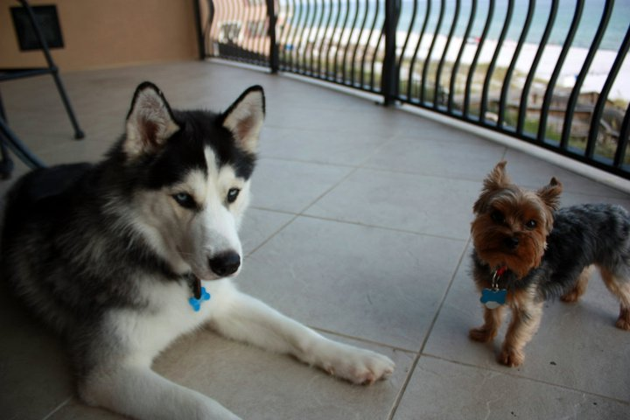
About Ms. Dudek
Grew up in Gwinnett County
Bachelor’s and Master’s at Georgia State University
Specialist from KSU
Live in Morningside (Atlanta)
Been teaching for six years
BIG fan of Falcons and Braves

Slide 3
What does my child go through?
Do Now
Mini-Lesson/Re-cap
Activity
Group work
Last Call closing questions
HW given

Slide 4
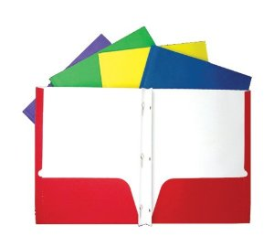
Expectations
Must be prepared: 8 folders with brads needed!
Book for homeroom
Late grades are in full effect!
Is that clear??? CRYSTAL
Easy Peezy?? Lemon Squeezy
AC: MUST MAINTAIN an 80% or higher!

Slide 5
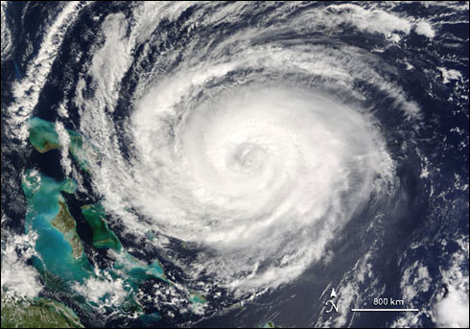
What will we be learning?
Earth Science! 4 main branches:
Geology
Hydrology
Meteorology
Astronomy

Slide 6
What will we be learning?
Rocks, Minerals, Safety
Weathering, Erosion, Soil
Dynamic Earth
Water on Earth
Climate and Weather
Earth, Moon and Sun
Solar System and Universe

Slide 7
Homework
Always have out on desk
Reminders will be up on the blog
Will be graded!
Should be expected EVERY NIGHT!
FLIPPED CLASSROOM ☺

Slide 8
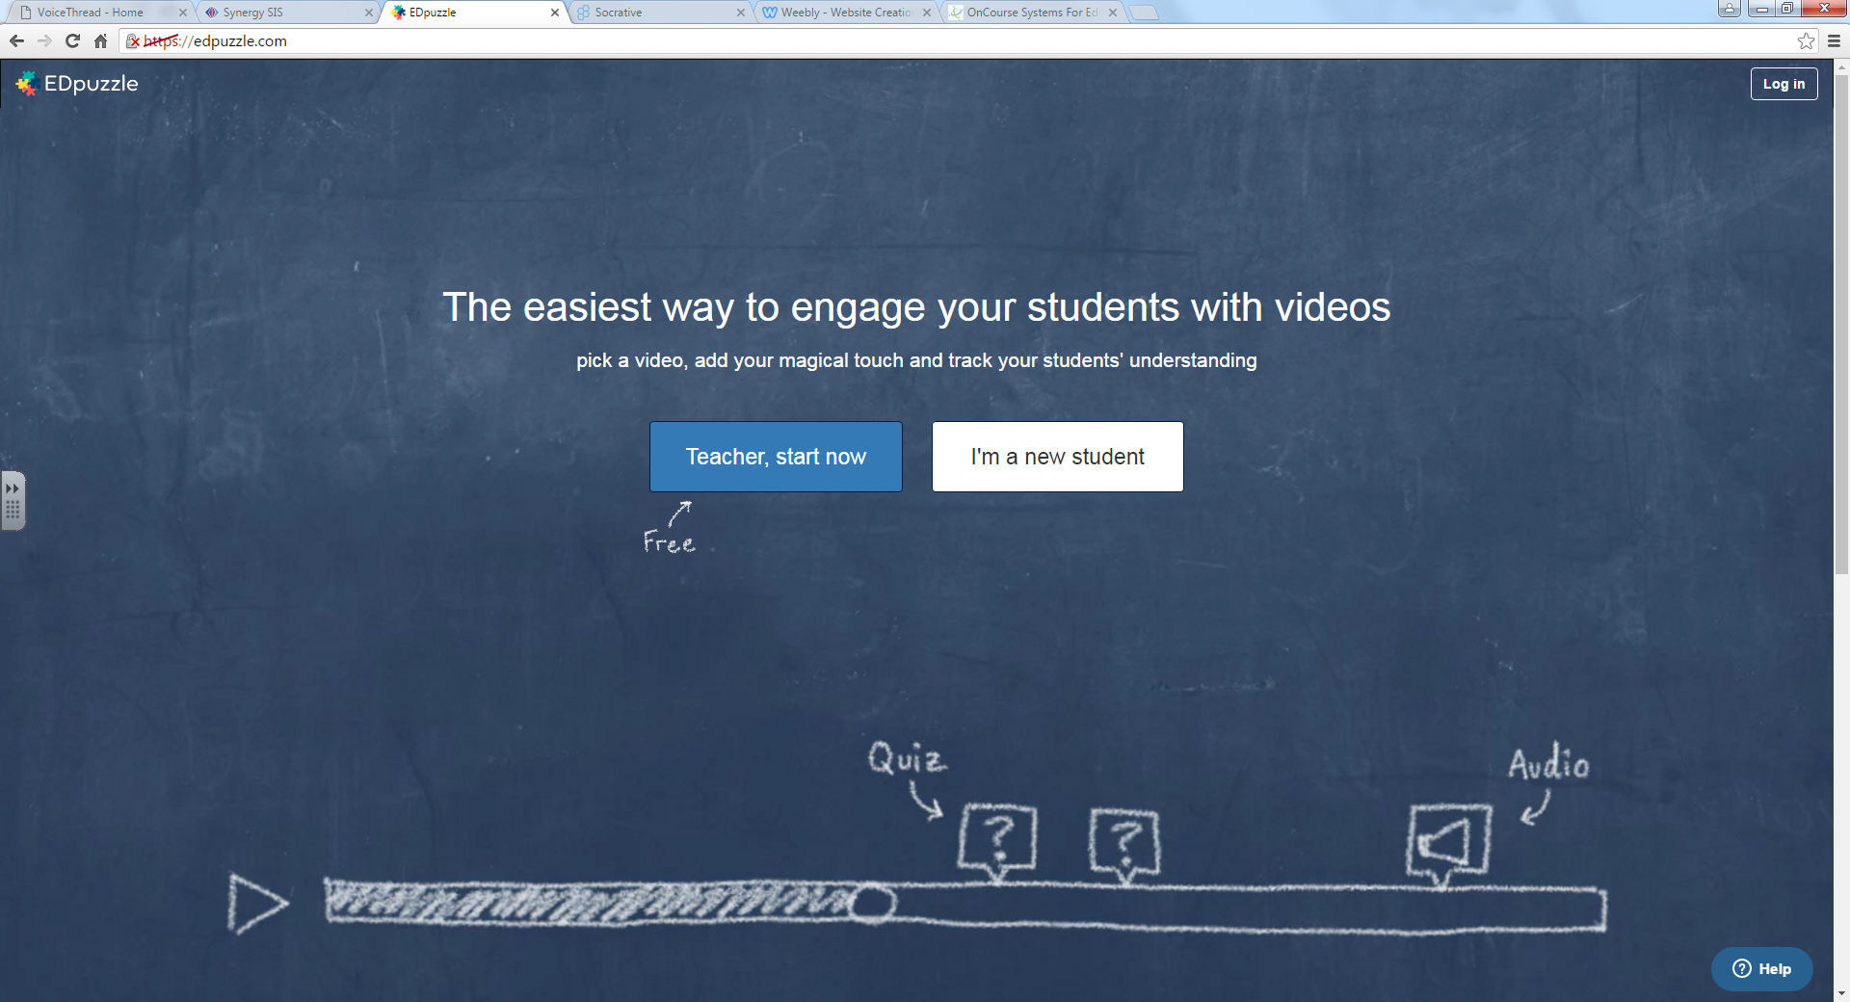
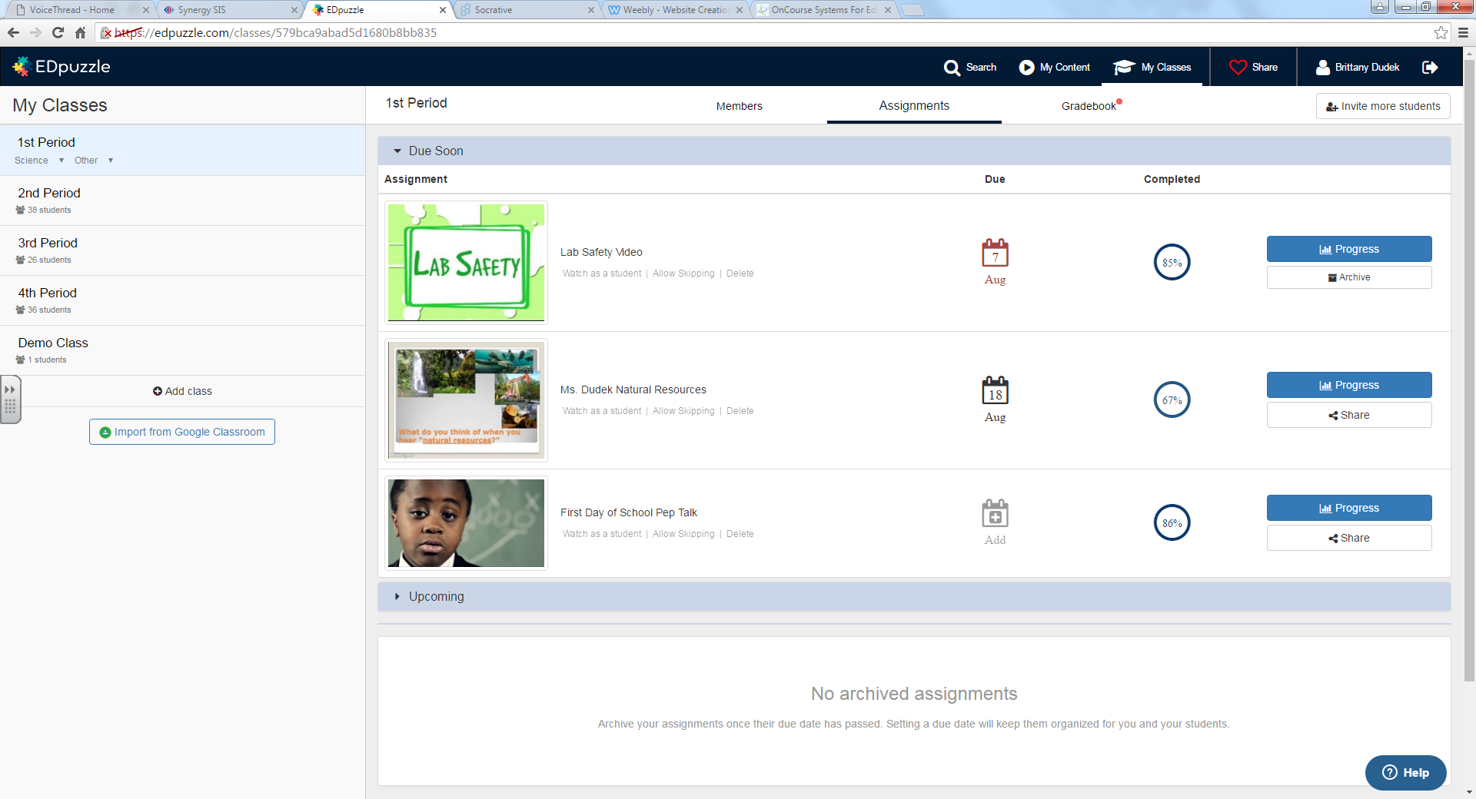
EdPuzzle
1st Period: wuenjew
2nd period: reutohe
3rd period: paphuna
4th period: zugigoh
Try Firefox, Internet Explorer, Chrome, Apple Store App, Android Market App. ONE SHOULD WORK!
Your student should have signed up by now
If your student has forgotten their username
and/or their password, EMAIL ME! I will reset their
password to student number.
If your student cannot access the video, have them come in early!

Slide 9
Having Trouble?
Help Sessions: Every Tuesday Morning starting with September 8th
Starts at 8:15, cannot show up late
Extra credit given only a couple times per year
Make sure work is turned in on time
BLOG BLOG BLOG!

Slide 10
Communication
Email is the best! Brittany.dudek@cobbk12.org
Blog
Blog
Blog

Slide 11
Want to help?
If your career involves anything we learning about, come see us!
If you want to help out with a lab, come see us!
If you just want to be with your child during the day, come see us!
Door is always open!

Slide 12
Have a great evening!

Slide 13
Ms. Dudek Math
6th Grade Math
OPEN HOUSE

Slide 14
About Ms. Dudek
Grew up in Gwinnett County
Bachelor’s and Master’s at Georgia State University
Studying for Specialist from KSU
Live in Druid Hills
Been teaching for four years
BIG fan of Falcons and Braves

Slide 15
What does my child go through?
Do Now
Lesson with notes in MSG
Activity/Computer Lab
Group work
Last Call closing questions
HW given

Slide 16
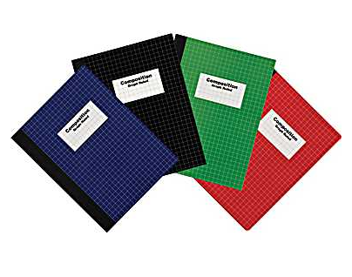
Expectations
Must be prepared: MSG AND TEXTBOOK
Pencil is a MUST!
Give a hand/praise
Is that clear??? CRYSTAL
Easy Peezy?? Lemon Squeezy

Slide 17
What will we be learning?
Number system: decimals and fractions
Ratios and Proportions
Expressions
Equations
Area, Nets, Surface Area, Volume
Data and Measures of Center
Negative Numbers and Coordinate Plane

Slide 18
Having Trouble?
Help Sessions: Every Thursday Morning starting with September 10th
Starts at 8:15, cannot show up late
Extra credit given only a couple times per year
Make sure work is turned in on time
BLOG BLOG BLOG

Slide 19
Communication
Email is the best! Brittany.dudek@cobbk12.org
Blog
Blog
Blog

