Slide 1
Warm Up – Wednesday, December 16 copy and solve
5) Is m=3.2 a solution to the equation m+.08=4?

Slide 2
Today’s Learning Target
I can solve one-step equations.
What can I do to prepare for tomorrow’s Unit 4 test over equations?

Slide 3
Remember!
Work out each problem on your paper.
SHOW ALL steps.
When you choose your answer, hold up your PLICKER card with your answer’s side UP.
DO NOT CALL OUT YOUR ANSWER!

Slide 4
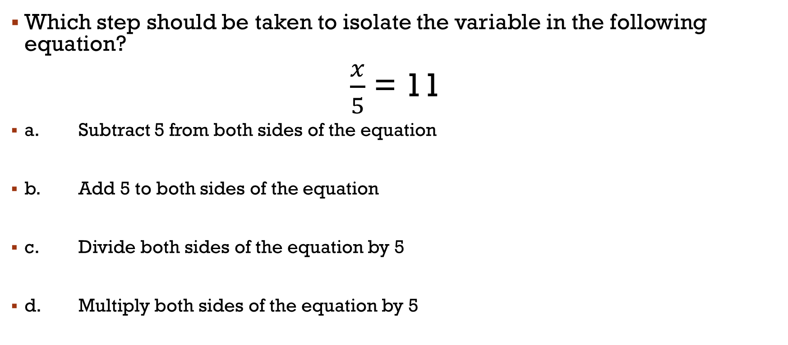
#1
Which step should be taken to isolate the variable in the following equation?
$\frac{x}{5}$ = 11
a. Subtract 5 from both sides of the equation
b. Add 5 to both sides of the equation
c. Divide both sides of the equation by 5
d. Multiply both sides of the equation by 5

Slide 5

#2
What is the value of a in the following equation?
$$\frac{a}{4}=12$$
a. 3
b. 12
c. 48
d. 8

Slide 6
#3
What is the value of j in the following equation?
j – 67 = 125
a. 58
b. 192
c. 125
d. 252

Slide 7
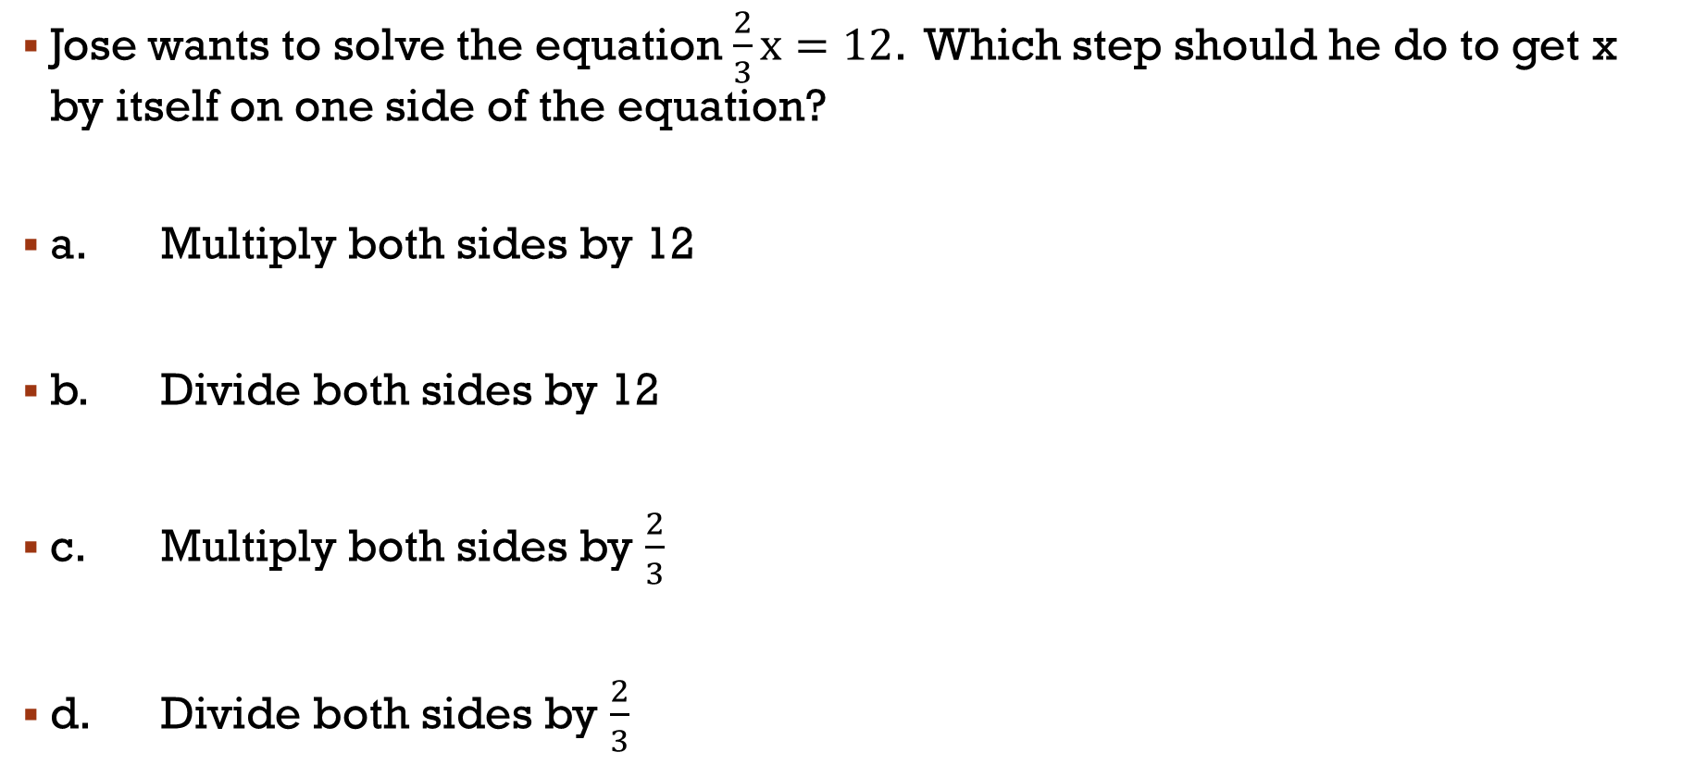
#4
Jose wants to solve the equation $\frac{2}{3}x=12$. Which step should he do to get x by itself on one side of the equation?
a. Multiply both sides by 12
b. Divide both sides by 12
c. Multiply both sides by $\frac{2}{3}$
d. Divide both sides by $\frac{2}{3}$

Slide 8
#5
Sam’s basketball team scored 34 points in its last game. Sam scored 12 of the points. Which equation could be used to determine the number of points p scored by Sam’s teammates?
a. p – 12 = 34
b. 12p = 34
c. p + 12 = 34
d. $\frac{12}{p}$= 34

Slide 9
#6
Savannah and two friends went to Taco Bell for lunch. They decided to split their bill evenly. If they each paid $15, which equation would represent the cost of their bill?
a. 3x = 15
b. x + 3 = 15
c. 15 – x = 3
d. $\frac{x}{3}$ =15

Slide 10
#7
Which solution makes the equation true?
x - 3.5 = 16
a. 3.5
b. 19.5
c. 12.5
d. 56

Slide 11
#8
24 = x - 9 for x = 16
A. True
B. False
C. Neither A or B

Slide 12
#9
Julia paid $100 for 4 shirts. Each shirt was the same price. Which shows the equation that represents the situation and the price of each shirt?
a. x + 4 = 100; $96
b. x – 4 = 100; $104
c. $\frac{x}{4}$ = 100; $400
d. 4x = 100 ; $25

Slide 13
#10
Nerdy Ned made a mistake. Find it!
18 + x = 24
18 + x = 24
-18 +18
x = 42
a. He should have added 18 to both sides.
He should have subtracted 18 from both sides.
He should have divided both sides by 18.

Slide 14
#11
Which is the solution to 2x = 142
a. 71
b. 284
c. 142
d. 140

Slide 15
#12
An art teacher bought 18 canvases of equal price. She spent a total of $54. The equation 18c = 54 can be used to find c, the price of each canvas in dollars. What was the price of each canvas?
a. $3
b. $4
c. $54
d. $972

Slide 16
#13
Last week Molly worked 42 hours in 4 days. Which equation could Molly use to find the average number of hours she worked each day?
a. $\frac{h}{4}$ = 42
b. 4h = 42
c. $\frac{h}{42}$ = 4
d. 42h = 4

Slide 17

#14
$16= \frac{k}{4}$ for k = 4
A. True
B. False
C. Not enough information

Slide 18

#15
Which value makes the equation below true?
$\frac{d}{6}$ = 5.2
a. 5.2
b. 11.2
c. 31.2
d. 6

Slide 19
#16
Which problem situation matches the equation 2x = 24 ?
A. Jamie sold 24 newspaper subscriptions each month for 2 months. What is x, the total number of newspaper subscriptions that Jamie sold in 1 month?
B. Brenna cycled a total of 24 miles this month. She cycled 2 miles less this month than last month. What is x, the number of miles Brenna cycled last month?
C. Carrie had x dollars, and she doubled that amount by selling pencils at the Locker Stocker. Now, she has $24. How much did she start with?
D. Sara bought 2 ride tickets and x game tickets. How many game tickets did she buy if she bought 24 tickets in all?

Slide 20
Closing – What have you learned so far in Unit 4?
Test is TOMORROW!!
Study the BLUE pages in your MSG and review all notes/homework and our last quiz over equations.

