Slide 1
Water Pollution and Conservation

Slide 2
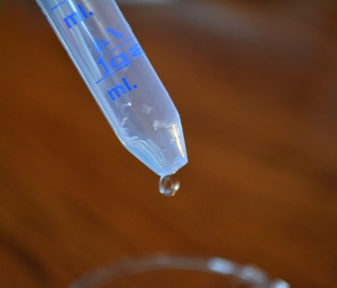
Fill a liter (1000 ml) beaker with water. This represents all the water on Earth.
Use an eyedropper to remove one single drop of water (0.003 ml).
This drop represents the clean, fresh water that is not polluted and is available for use.
Why must this drop be managed properly?

Slide 3
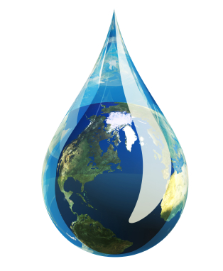
This single drop actually represents a large volume of water on Earth.
If all the fresh clean water on Earth were distributed equally among 5 billion people, there would be 2.18 million gallons or 8.4 million liters per person.

Slide 4
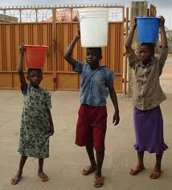
However, for some, water may appear to be plentiful while for others it is scarce. Why? (Geography, climate, and weather affect its distribution).
Availability of water is also affected by agriculture, industry, and domestic use.

Slide 5
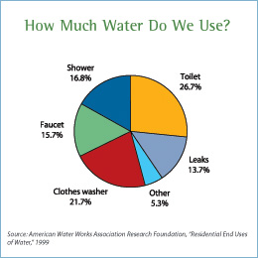
Average U. S. household uses 107,000 gallons of water per year.
United States has the world’s highest per capita use of water.
Indoor water use in U.S.

Slide 6
Total water use in U.S.

Slide 7
Contamination of the water supply from:
sewage
from the increasing number of septic tanks
farm wastes
inadequate or broken sewer systems
highway salt
acid rain
fertilizers and pesticides (runoff)
eroded soil
chemical leaks (industry)
thermal pollution (hot water)
non-point source pollution (is of unknown origin)

Slide 8
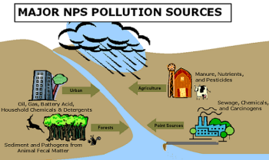
Non-point pollutants (40-50% of the water pollutants) include:
spots of toxic oil that leaks from cars on to driveways, streets, and parking lots
fertilizers used on lawns and gardens
herbicides and pesticides used around homes
yard clippings
pet wastes

Slide 9
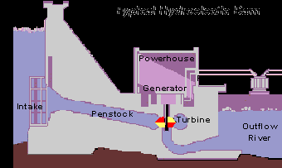
Hydroelectric Power
About 10% of power in U.S. comes from moving water (19% worldwide)
Advantages?
Disadvantages?
Power plants of Georgia

Slide 11
When is the best time to water a lawn?
A. 2pm in the afternoon
B. 6pm in the evening
C. 5am in the morning

Slide 12
What do we call efforts by industries and homes to use less water?
A. Conservation
B. Recycling
C. Pollution
D. Waste

