Slide 1
FIND A PARTNER
WITHOUT OPENING YOUR EGG, find someone who you think has the same thing in their egg as you do, then sit together (there may be up to 3 other people who have the same thing as you!)

Slide 2
FIND A PARTNER
Were you right?
Did you find it difficult?
How is this like Science?

Slide 3
Who are you?
Read the question on your egg to your neighbors and answer it yourself.
Ask your neighbors the same question

Slide 4
Mrs. Dudek Williams
6th grade Earth Science

Slide 5
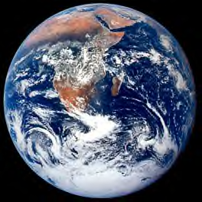
Welcome to middle school☺
Welcome to Earth Science☺
Mrs. Dudek Williams

Slide 6
Year Long Assignment
Think of an idea to change the world – then put it into ACTION
https://www.youtube.com/watch?v=4z7gDsSKUmU
How do you want to be remembered?

Slide 7
Class Project
PLARN: https://youtu.be/yr_WHW_tGSE
We will need large crochet hooks
TONS of plastic bags will need to be donated throughout the year

Slide 8
6th grade expectations and questions???????????
Do you know your bus number and lane? (Write this in your agenda!!)
Do you know where your next class is and how to get there?
Do you know your lunch number (6-7 digits)?

Slide 9
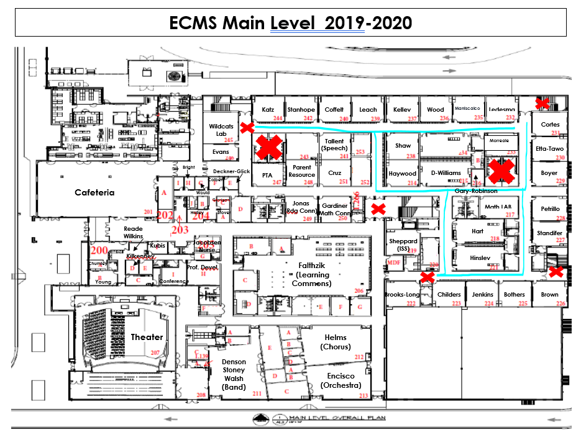
Transitions

Slide 10
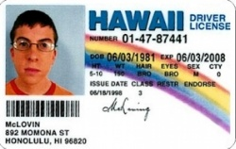
Hall Passes
It is important that you ALWAYS have a pass in the hallway
Think of it like your driver’s license.
Sign out using bathroom pass form
Tardy sign in using tardy form (starting next Monday)

Slide 11
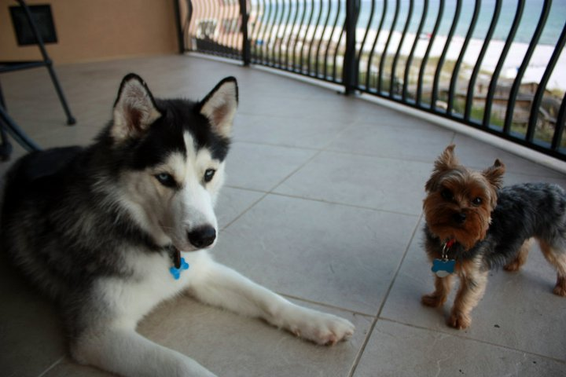


Who is Mrs. DWills?
Grew up in Gwinnett Co.
Bachelor’s from Georgia State
Masters degree in Mathematics
Specialist degree in Curriculum
Teaching for 8 years
Lives in Atlanta with her doggie, Riley and husband Cory
LOVES the Falcons, Dawgs and Braves!

Slide 12
Syllabus: Let the games begin
Make sure you get it signed and returned ASAP!!

Slide 13
Do Now
Write your FIRST and LAST name on the lined side of your index card
Write three words describing how you would like to be remembered when you leave 6th grade ON THE BLANK SIDE
Write a goal you’d like to achieve by the end of 6th grade on the LINED SIDE
Color it, decorate it with pictures :)
DON’T SHARE IT WITH YOUR NEIGHBORS
  Example: Ms. Dudek #inspiring #thoughtprovoking #challenging

Slide 14
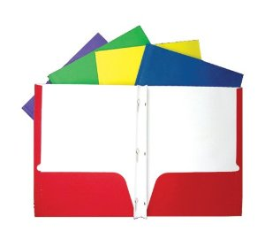
Supplies needed ASAP:
Notebook with brads and pockets
Something to write with (black or blue pen and/or pencil/eraser
Notebook paper

Slide 15
Now what’s different
Mrs. Dwill’s science class is ‘flipped’
You WILL need access to internet EVERY night
If you have any issues, you will have the opportunity to tell Mrs. DWills later this week.
www.edpuzzle.com
HOUSE POINTS!!!!

Slide 16
1st assignment
www.edpuzzle.com
Make your own account! Username and password should be your student number
Make sure you get the join code for your period from the board

Slide 17
Some rules for you!
1st offense: Warning
2nd offense: Re-Focus Form/Detention/Citation
3rd offense: Silent Lunch
4th offense: Call home
5th offense: Referral

Slide 18
Class Rules
You decide!
In your group, come up with three rules you’d like the class to follow this year.

Slide 19
House Points!
See poster above the board
Vote: have your group come up with a House Name for this period (it will be used ALL YEAR LONG!)

Slide 20
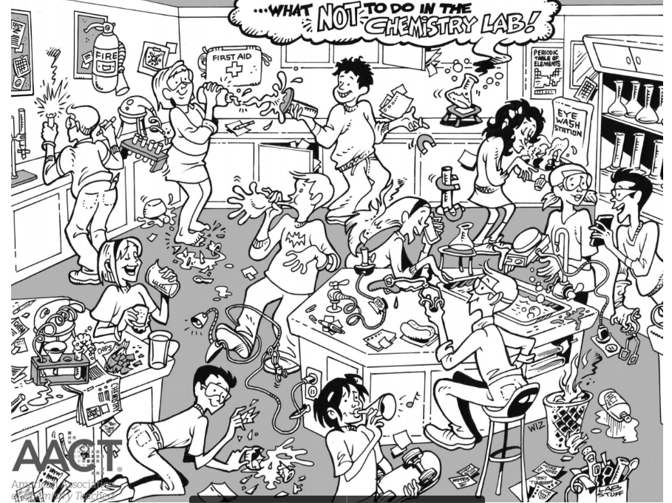
DO NOW
Identify the unsafe behaviors in the chemistry lab. In your Do Now Journal, or on a separate piece of paper, make a list of each safety infraction that is found and explain why it is an unsafe behavior in the lab.

Slide 21
Quick Reminders
Make sure you have turned in your GREEN syllabus
Make sure you have turned in your PINK flipped classroom
Make sure you have turned in your YELLOW lab safety sheet
Edpuzzle videos were due TODAY
Circle Map is due TOMORROW
Tomorrow we have our first lab!!

Slide 22
Lab Safety
Contract!! Make sure it is turned in by now
https://www.youtube.com/watch?v=BRDApYgvDqQ&feature=youtu.be
https://binged.it/2vuAucR

Slide 23
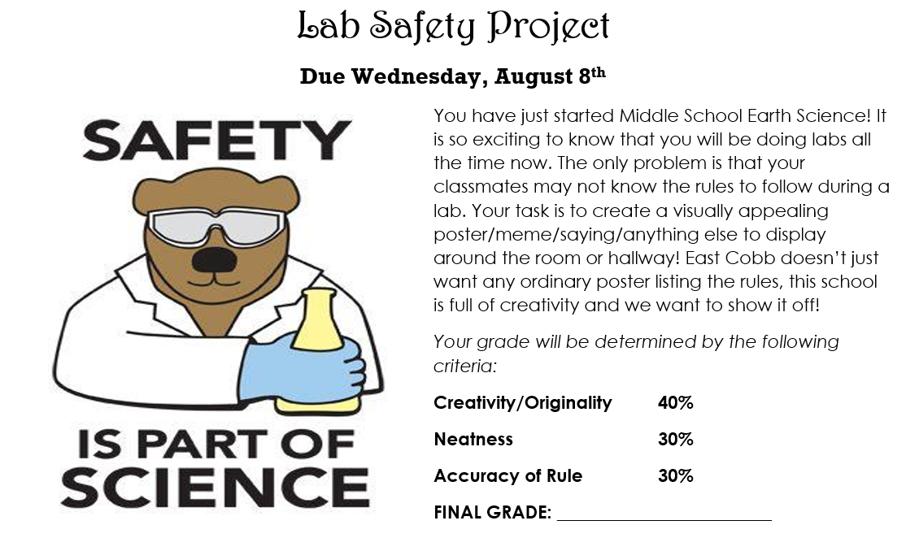
Lab Safety Project

Slide 24
Let’s look briefly at our website/blog:
--check daily for homework, classwork, extra help, due dates, usernames/passwords, and extra credit

Slide 25

Circle Map
Make a colorful circle map about you! You must include AT LEAST 30 things about yourself.
Yes 30
Yes, actually 30 not 29

Slide 26
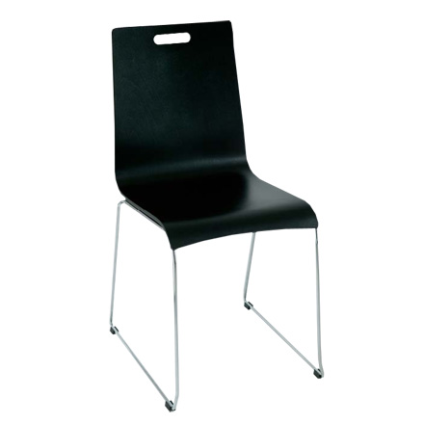
BIG RULES!!
Respect Effort Pride
Be sure to push in your chair EVERY day, and pick up the trash.
Again, Be respectful

Slide 27
Maintain Culture
Give 100%
Give Praise or a Hand when asked
Comprende? Comprondo?
No Distractions
Bathroom procedures/Pencil sharpening
Transition and Lunch procedures

Slide 28
How to be Awesome
Arrival and Exit Procedures
  Hold on to trash until end of class
Sense of Urgency
Turn in ALL work on time
  1 day late: Highest grade 90%
  If homework in locker, still late
  No locker during class
Communication
***Each teacher may have different expectations

Slide 29
Bathroom Procedures
You will get restroom passes to put in your agenda
Bathroom is only to be used 5 mins after class has started, when the teacher is not speaking, and not within 5 mins of leaving class
The only time you can use the bathroom during transitions is during homeroom, or during locker break between 3rd and 4th period
You CANNOT use the restroom in between periods during transitions. Will result in an automatic SILENT LUNCH!

Slide 30
Safety
Fire Drills: Immediately get up, push in your chair and head out to LANE 10 in the back parking lot. Line up on the white line in a single file line and wait for Mrs. DWills to get out there if she isn’t already.
All drills are SILENT! If you cannot follow the rules during an emergency drill, it will result in at least one day of SILENT LUNCH.

Slide 31
Circle Map: Frames of Reference
So what so why?
Point of View
Sources

Slide 32
Do Now
Have your circle map out on your desk for Mrs. Dwills to check
Come up with an idea to CHANGE THE WORLD!!
  1. Come up with a problem that you see that you feel strongly about
  2. Come up with one solution that you think would work
  3. Now come up with two other solutions that may work too

Slide 33
Quick Reminders
Make sure you have turned in your GREEN syllabus
Make sure you have turned in your PINK flipped classroom
Make sure you have turned in your YELLOW lab safety sheet
Edpuzzle video one was due MONDAY
Lab Safety Project is due MONDAY
Circle Map should be turned in today

Slide 34
Stations
If you have turned in your Lab Safety Contract
You will complete the toothpick lab then complete the back of your lab sheet for practice
If you have NOT turned in your Lab Safety Contract
You will complete the Hogwarts practice and Lab Equipment practice
If you finish, you may complete a phone hologram lab ☺

Slide 35
In conclusion…
https://www.youtube.com/watch?v=AWtRadR4zYM

Slide 36
Do Now
1. What do you think the most important lab safety rule is? Why?
2. What rule do you think is going to be hardest for you to follow? Why?
3. What sort of rules do you think we should have for using technology at school? Try to come up with at least 5
4. What are you looking forward to most in 6th grade?

Slide 37
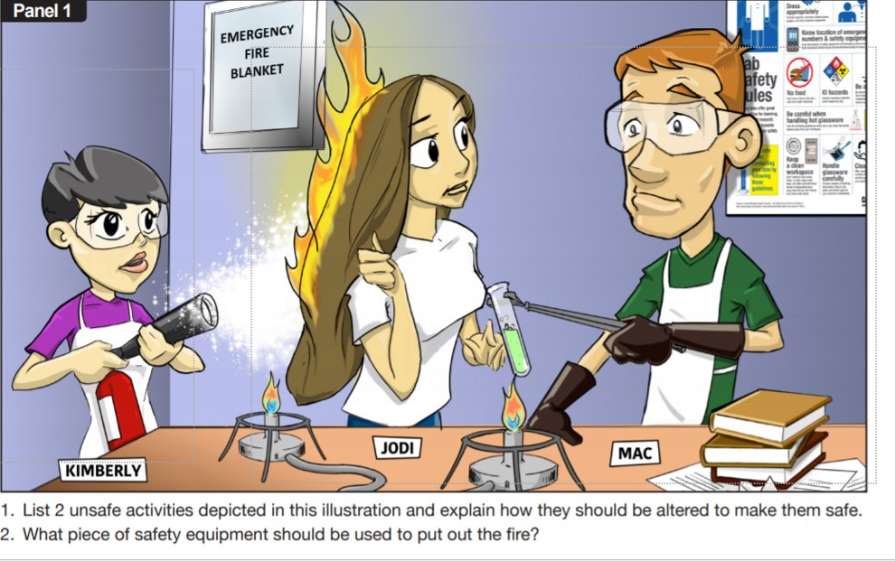

Slide 38
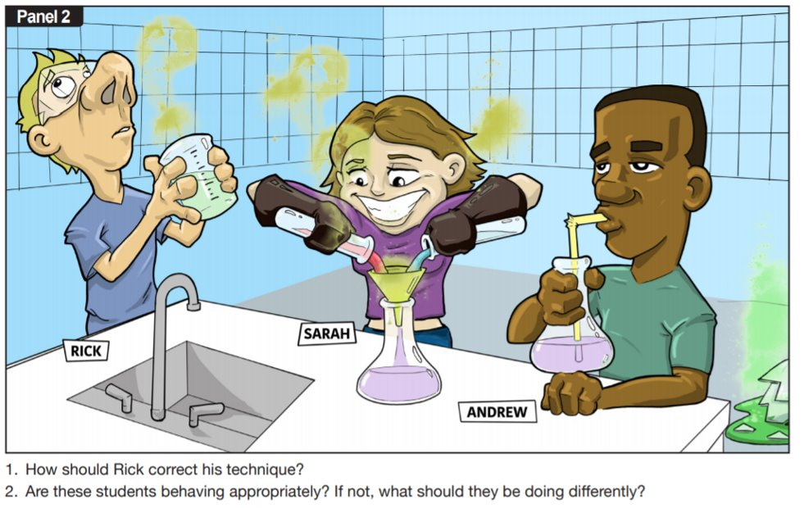

Slide 39
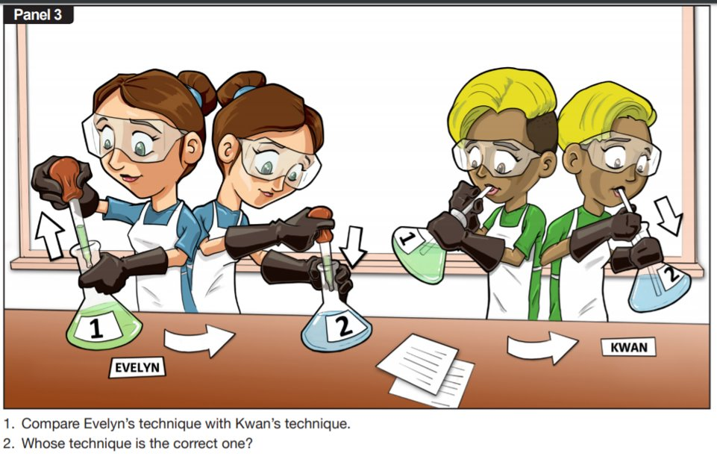

Slide 40
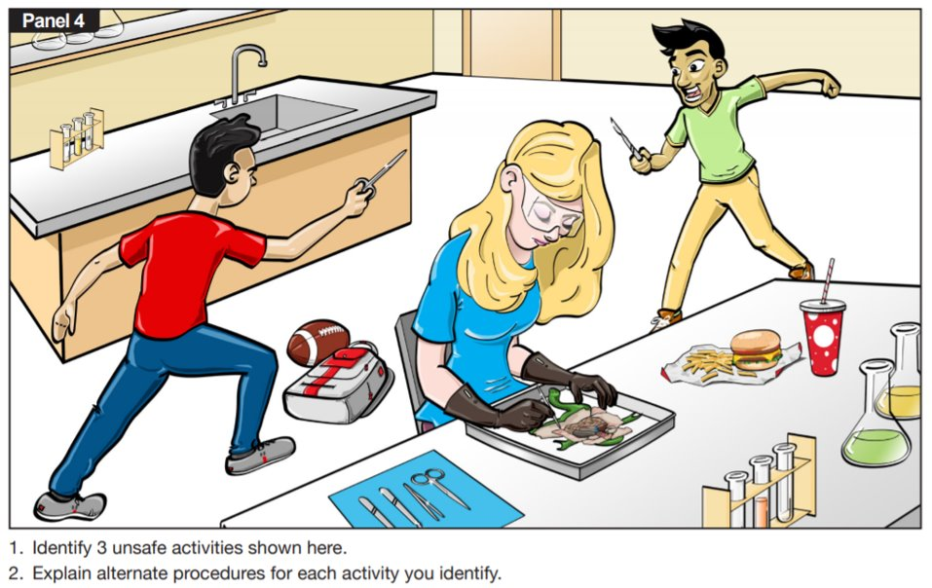

Slide 41
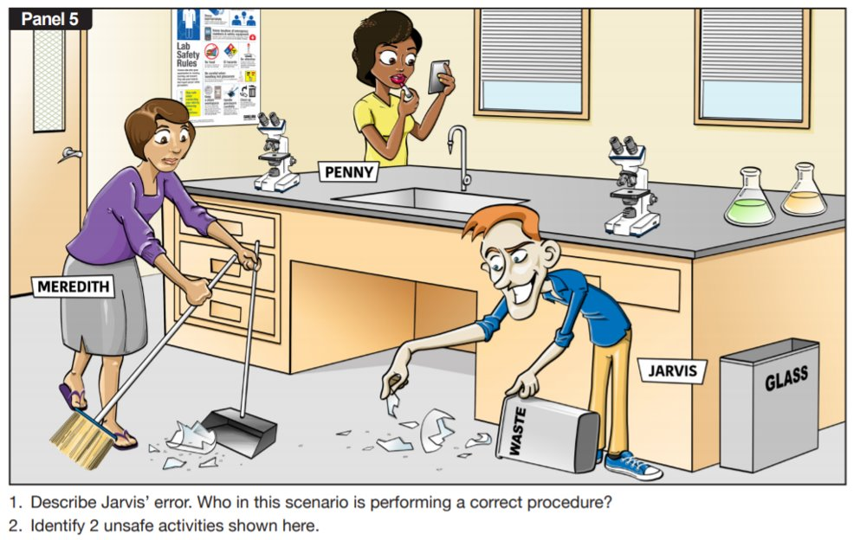

Slide 42
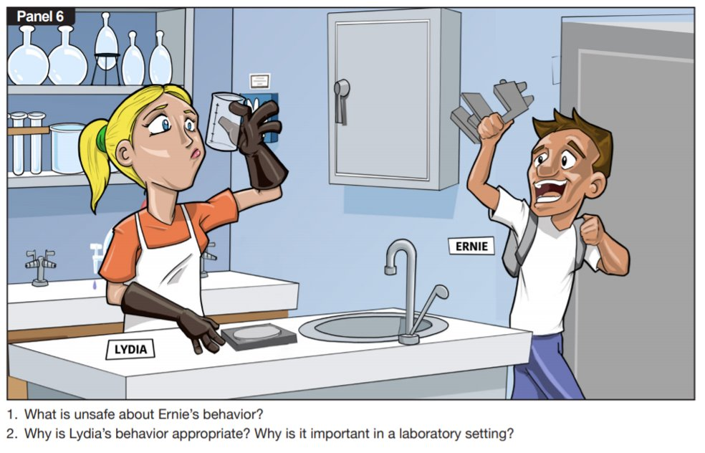

Slide 43
Lab Safety Quiz
Go to www.Socrative.com (or click on the Socrative app)
Click on ‘student login’
Room Name: MrsDwills (doesn’t matter if it is capitalized or not)

Slide 44
Do Now
Have your Lab Safety Scientist out on your desk
When can you use your locker?
When can you use the restroom?
When you use the restroom, what must you have with you?
What do you think a triple beam balance is? What do you think it’s used for?
THINK: What is different between the metric and customary systems?

Slide 45
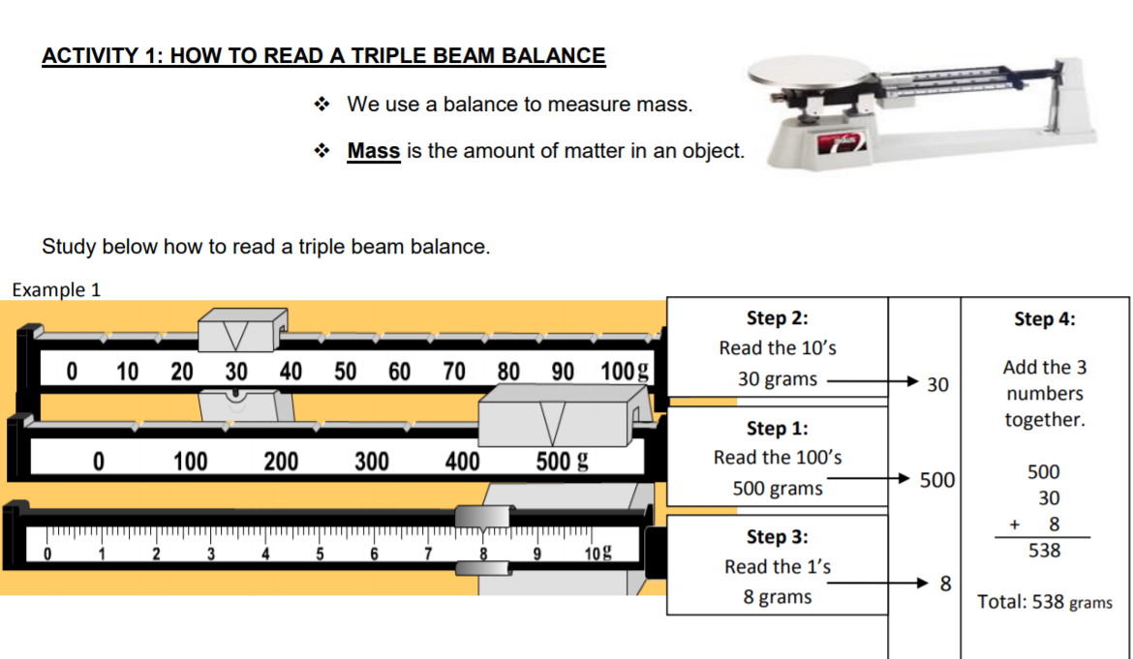

Slide 46
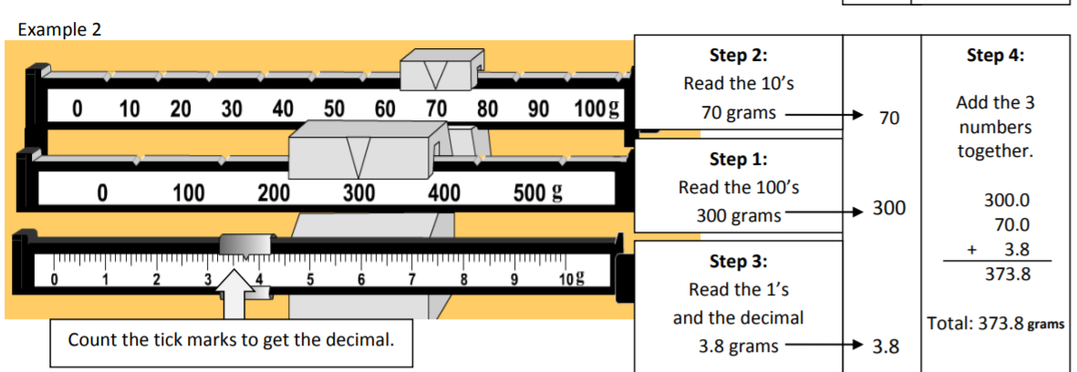

Slide 47
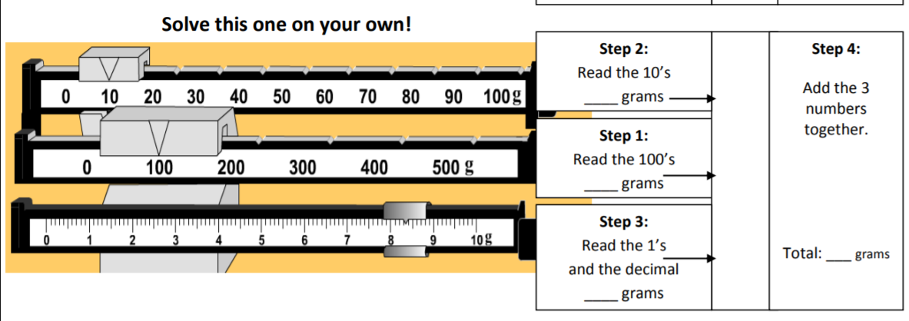

Slide 48
Do Now 8.9.19
Pick up a copy of this week’s article from the side table
What did you find interesting or surprising in this week’s article?
What topics relate to what we have learned in class?
What section(s) would you like to do further research on? Why?
Count your neighbor’s “Do Nows”, they should have 5! (8/5, 8/6, 8/7, 8/8, 8/9)

Slide 49
Do Now 8.12.19
What did you do over the weekend?
Now take what you did over the weekend and condense it to ONE word (only ONE!!)
Name at least 5 other people in this class except yourself (without talking to anyone)
Write down your neighbor’s favorite food (without talking to them)
What do you think the purpose of pre-tests are?
Did you complete your edpuzzles from last week? If so, make sure your work is in your science folder.

Slide 50
Astronomy Pre-test Unit 1
Go to irespond
Session Name: brittany.dudek
Take the astronomy pre-test
Log out and put your iPad away. Make sure you plug it in
Grab your bubble gum lab from the front counter

Slide 51
Do Now 8.13.19
If you have a COMPLETED Bubble Gum Lab, place it on the counter up front
What did you already know on the SGM pre-test?
What did you not know on the SGM pre-test?
Now that you have taken, the SGM, what are you most excited about in 6th grade Science to learn?
What is an important rule in the Cafeteria that you might want to remember?

Slide 52
Do Now 8.14.19
If you didn’t turn in your bubble gum lab, turn it into the front now!
What do you think is going to be your biggest challenge this year?
What days are Science Tutoring sessions held?
Why do you need 9 folders for the year in Science?
What is occurring tomorrow evening at East Cobb Middle?
If you’re in here during a fire drill, where do you go and where do we line up and wait for Mrs. Dwills?

Slide 53
Do Now 8.15.19
Writing Wednesday (even though it’s Thursday):
Write a letter to your future self for the last day of school. What do you want them to know? What do you hope to accomplish by then? What are you currently excited about? What are you curious about?

Slide 54
Do Now 8.16.19
Pick up a copy of this week’s article from the side table
Have your vocab out on your desk for Mrs. Dwills to check
What did you find interesting or surprising in this week’s article?
What topic(s) relate to what we have learned in class?
What section(s) would you like to do further research on? Why?
Count your neighbor’s “Do Nows”, make sure they have their writing Wednesday (8/12, 8/13, 8/14, 8/15, 8/16)

Slide 55
Do Now 8.19.19
After looking at the vocabulary for Unit 1, what are you most excited to learn more about?
Explain heliocentric and geocentric theories in your own words.
Draw a picture of each model in your ‘Do Now’ journal.
Explain the big bang theory in your own words
Be sure to write your homework in your agenda for today!
When you are done, grab a copy of the notes from the front desk and turn in your Origin of the Solar System Performance Task (from Friday)

Slide 56
Do Now 8.20.19
What is the main difference between Geocentric and Heliocentric?
Why do you think people believed in theories that were completely incorrect during early cultures?
What is the name of the galaxy that we live in?
Why is it important to use Science and Engineering practices instead of “thought” and “wisdom”?
Be sure to write your homework in your agenda for today!
When you are done, grab a copy of the notes from the front desk

Slide 57
Reminders
Unit 1 Vocab was due FRIDAY (if you still need to turn it in because it doesn’t have my initials on it, turn it into the IN boxes)
Origins of the Solar System (Play-Dough lab) was due yesterday
We’ve had 3 edpuzzles so far. The 4th is due TOMORROW

Slide 58
Do Now 8.21.19
What are the three types of galaxies?
What determines the shape of a galaxy?
Order the following from BIGGEST to SMALLEST: Plant Cell, The Universe, Atlanta, Milky Way Galaxy, Solar System, Earth, Jupiter
Explain redshift in your own words
Writing Wednesday: Create your own story about how the universe and our solar system were formed
Be sure to write down the HOMEWORK in your agenda

Slide 59
Do Now 8.22.19
Why is gravity important?
Does Earth just need gravity in order to stay in orbit? Explain
How can gravity decrease between the Sun and Earth? List the ways
Do you think Mercury has more or less gravity than the Earth? Explain
Be sure to write down your homework in your agenda

Slide 60
Do Now 8.23.19
Pick up a copy of this week’s article from the side table
What did you find interesting or surprising?
What topic(s) relate to what we have learned in class?
What section(s) would you like to do further research on? Why?
Count your neighbor’s Do Nows and put the number on their paper (they should have 5!)
Turn in your Virtual Lab sheet from yesterday if you haven’t already

Slide 61
Do Now 8.26.19
Explain how to increase gravity on a planet.
If we moved Earth closer to the Sun, what would change?
Compare Neptune’s year with Earth’s year. Which is longer, which is shorter and why?
Compare Venus’ gravity with Jupiter’s gravity. Which is stronger, which is weaker and why?
Be sure to write down your homework in your agenda!
Turn in your Gravity and Orbit lab sheet to the front counter if you did not turn it in last week
http://joshworth.com/dev/pixelspace/pixelspace_solarsystem.html

Slide 62
Do Now 8.27.19
List the planets in order starting from the Sun
What are the requirements for being a gas giant?
Why is Venus the hottest planet?
Which planets have no moons?
Thinking Tuesday: Is there gravity in space? Explain.
Write down your homework ☺
https://www.youtube.com/watch?v=qnzquEOMLGU

Slide 63
Do Now 8.28.19
Pick up a copy of the sheet for today on the front counter and put your name on it!
Leave everything else packed. You will need to bring a pencil and a clipboard along with your sheet.

Slide 64
Do Now 8.29.19
Have your ‘Stepping into the Solar System’ sheet on your desk
What is the difference between heliocentric and geocentric? Draw a picture of each to show your understanding
What is the difference between gravity and inertia?
What is a theory?
What is a piece of evidence that supports the Big Bang Theory?
Grab a copy of the notes from the front counter

Slide 65
Do Now 8.30.19
Pick up a copy of this week’s article from the side table
What did you find interesting or surprising?
What topic(s) relate to what we have learned in class?
What section(s) would you like to do further research on? Why?
Count your neighbor’s Do Nows and put the number on their paper (they should have 4!)
1st and 3rd Period: Have your comic strip out on your desk with your name on it

Slide 66
Do Now 9.3.19
What is the difference between meteors, meteoroids, and meteorites?
What are Saturn’s rings made of?
Uranus is different from most planets because why?
Aside from Earth, which other inner planet had water on its surface?
Order the planets from biggest to smallest

Slide 67
Do Now 8.28.18
Make a double bubble comparing and contrasting the inner and outer planets
Where is the Kuiper Belt located?
What do you think the difference is between an asteroid and a meteoroid?
What do you think the difference is between a meteor and a meteorite?

Slide 68
Do Now 9.4.19
1. Make a double bubble comparing and contrasting the inner and outer planets
2. What do you still need help with in Unit 1?
3. What makes Earth able to sustain life? Try to list as many characteristics as you can.
4. What are you going to do this evening to prepare for the test tomorrow?

Slide 69
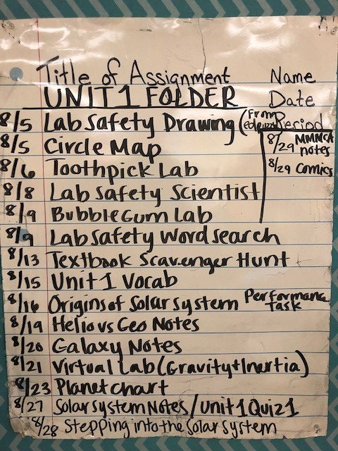
Do Now 9.5.19
Write down any last minute questions you have before we take the test.
Get out your science folder and make sure it is organized. If you are missing something, that is okay. Skip it and go on to the next one.
Be ready to turn in your folder that should have your FIRST AND LAST NAME on the front along with ‘Unit 1’. Sharpies are on the front counter if you need them
Have your planet booklet out and ready

Slide 70
Do Now 9.6.19
Pick up a copy of this week’s article from the side table
What did you find interesting or surprising?
What topic(s) relate to what we have learned in class?
What section(s) would you like to do further research on? Why?
Count your neighbor’s Do Nows and put the number on their paper (they should have 3 or 4!)
Turn in your completed word search to your period’s IN box to get house points

Slide 71
Test Analysis then Rem./Enrich.
Look at the analysis sheet to see what questions you got wrong. You will need to correct them on the back of your page.
Your test score can be calculated. Each question was worth 2.8 points.
Fill in the front and back of your sheet. Remember you have to explain why the correct answer is correct.
Once you are done with your analysis, turn in your sheet and copy of the test.
IF you received over an 80%, you will complete enrichment. If you received below an 80% you will complete remediation in order to retake your test Monday

Slide 72
Do Now 9.9.19
Turn in your Math Connections (enrichment) sheet to your period’s IN box. If you have remediation KEEP IT!
What do you think you did well on in Unit 1?
What do you think you had difficulty with in Unit 1?
Now that you have finished a Unit in 6th grade Science, what do you think you’ll do differently in Unit 2?

Slide 73
Do Now 9.10.19
Have your vocabulary out on your desk for Mrs. Dwills to check
1. Name the moon phases starting with ‘new moon’ (hint: there are 8)
2. Why do you think we have seasons?
3. What vocabulary term did you have the hardest time with?
4. What are you looking forward to in Unit 2 since you have already previewed the vocabulary?

Slide 74
2nd and 4th period
Go to www.explorelearning.com and click on 'login' at the top right side of the screen.
You will need to log in using the following information:
Username: 6BScience
Password: ecms
Click on ‘Class 1’
Click on ‘Seasons: Earth, Moon, and Sun’ and complete your Gizmo sheet. You may work with a partner as long as you are silent while others are retaking their test.
This is your ticket out the door!

Slide 75
Do Now 9.11.19
If you didn’t turn in your Vocab yesterday, turn it in to Mrs. Dwills desk
Writing Wednesday: Write a story about a trip to explore either the North Pole or the South Pole. Describe conditions such as the amount of sunlight and the temperature, and include an explanation for why those conditions exist.

Slide 76
Do Now 9.16.19
So the tilt of the Earth causes seasons… so when do we have summer? Explain why.
What causes a day on Earth?
What causes a year on Earth?
If we experience Summer in June in the United States, what do you think Australians experience in June? Explain. Draw a picture if you need to
Grab your seasons chart from the back of the room and make sure it is filled in.

Slide 77
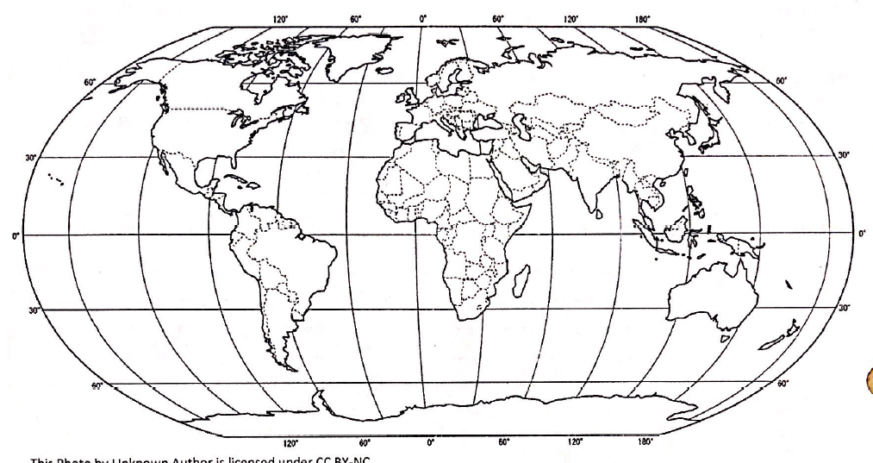
Do Now 9.17.19
Get out your graphs and your Seasons lab sheet. Complete the analysis questions on the back
Conclusion: What affects the temperature of an area the most? Use R.A.C.E (restate the question, answer, cite the evidence, explain the evidence) to write your conclusion. DO THIS ON A SEPARATE SHEET OF PAPER.
          A C
                Q
                M
When you are done, turn it in to get your next assignment

Slide 78
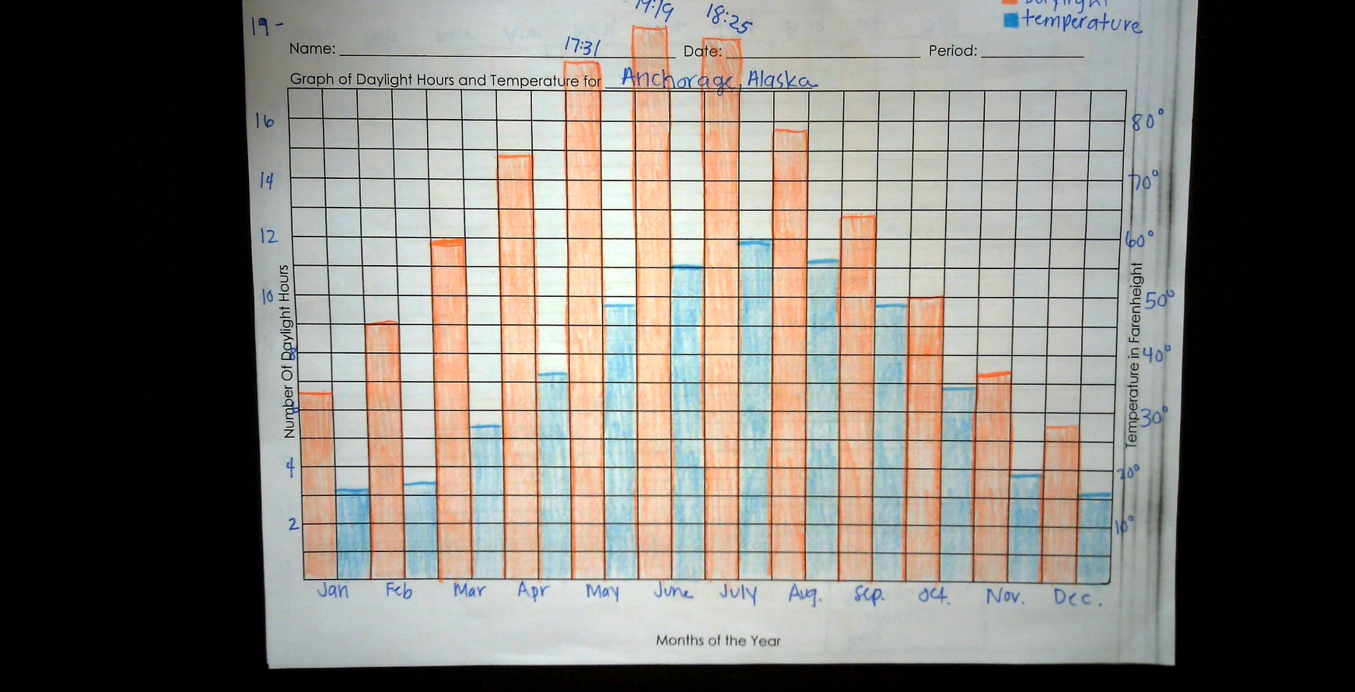
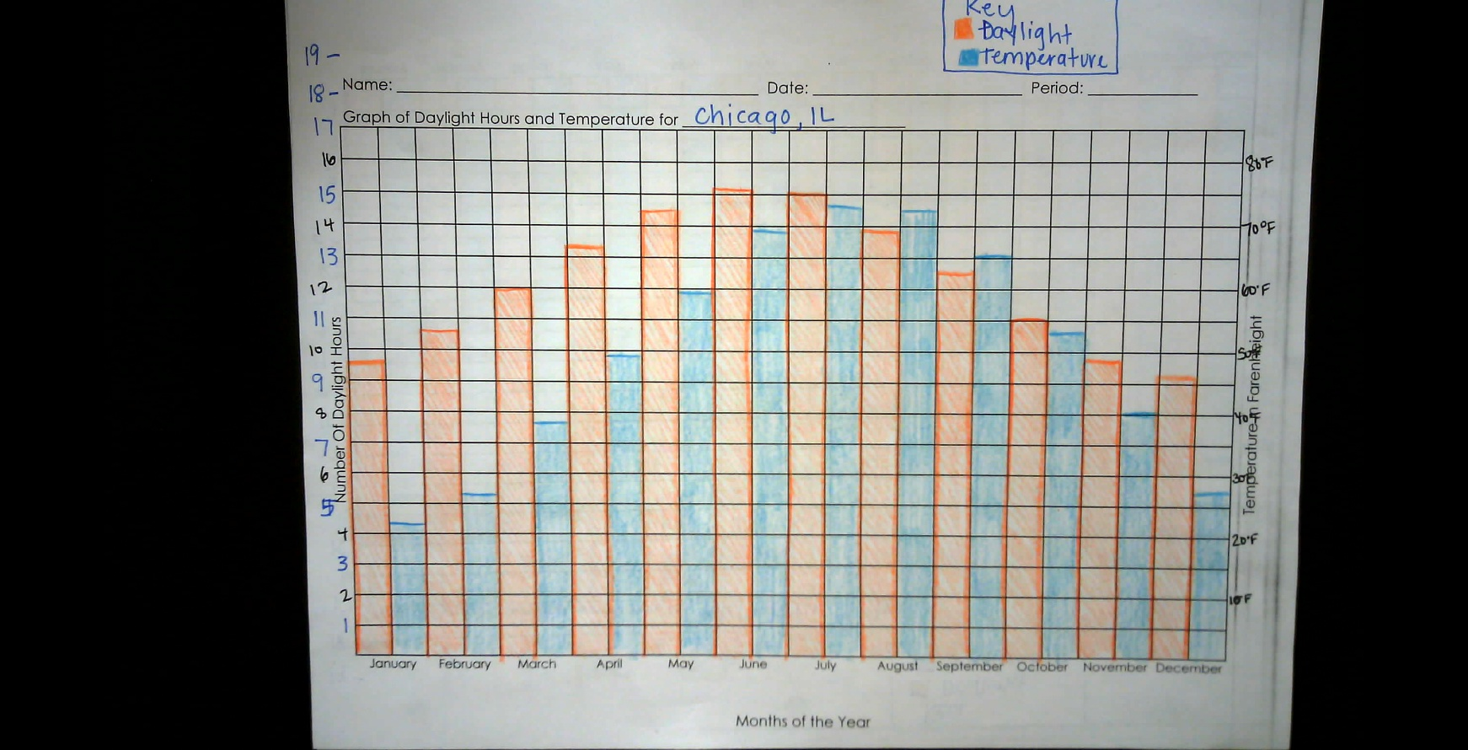
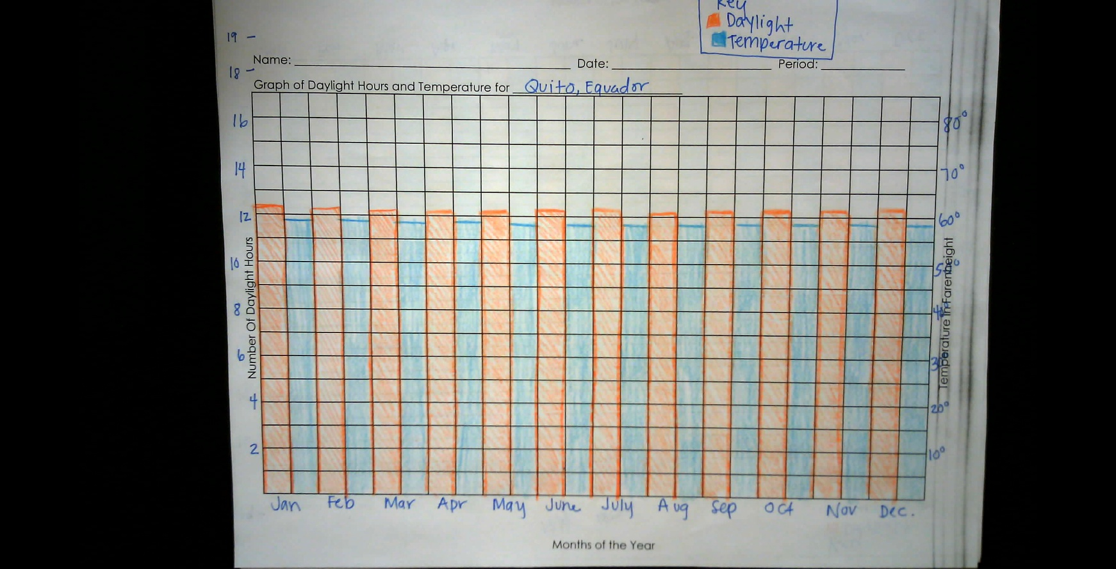
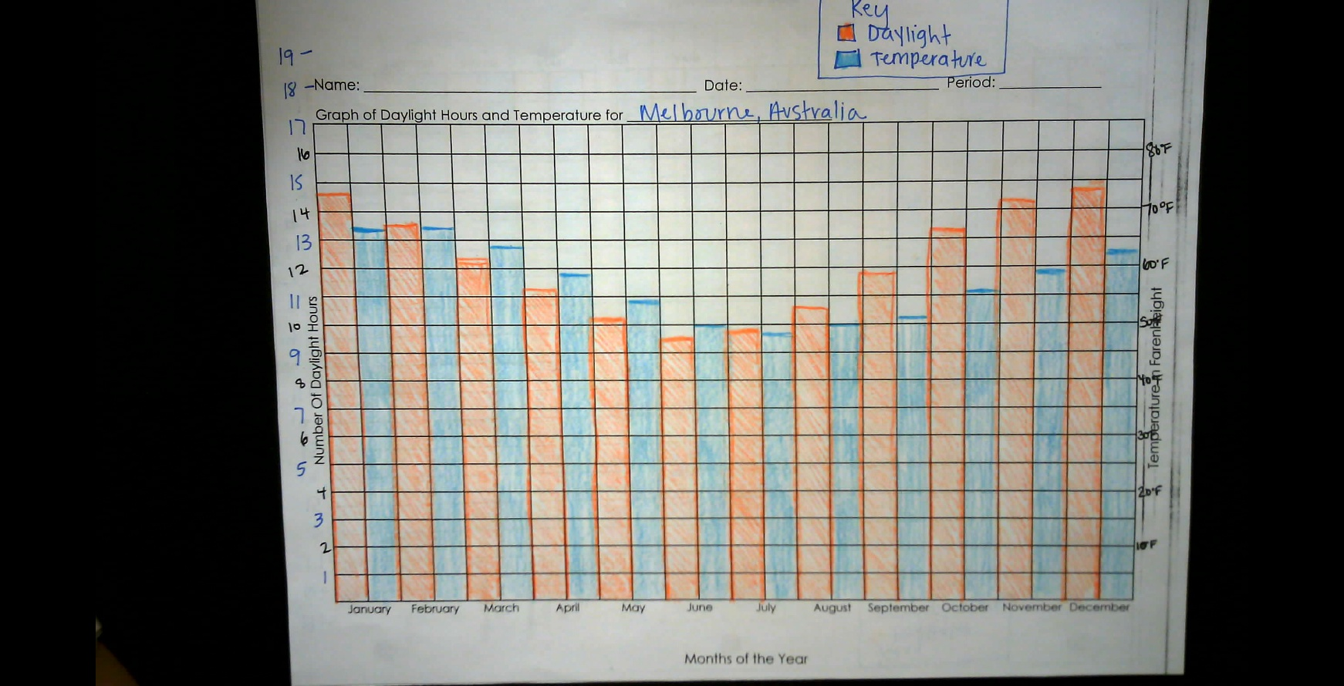
Do Now 9.17.19

Slide 79
Do Now 9.18.19
Writing Wednesday: Your family decides they are moving across the world! Choose one of the following cities below to move to and describe their seasons, and what you expect to experience when you move (daylight, seasons, temperature)
Paris, France 48.8 degrees NORTH
Cape Town, South Africa 33.9 degrees SOUTH
Moscow, Russia 55.7 degrees NORTH
Singapore, Malaysia 1.4 degrees NORTH
***Decide what months would be best to use solar panels in your new country in order to power your new home

Slide 80
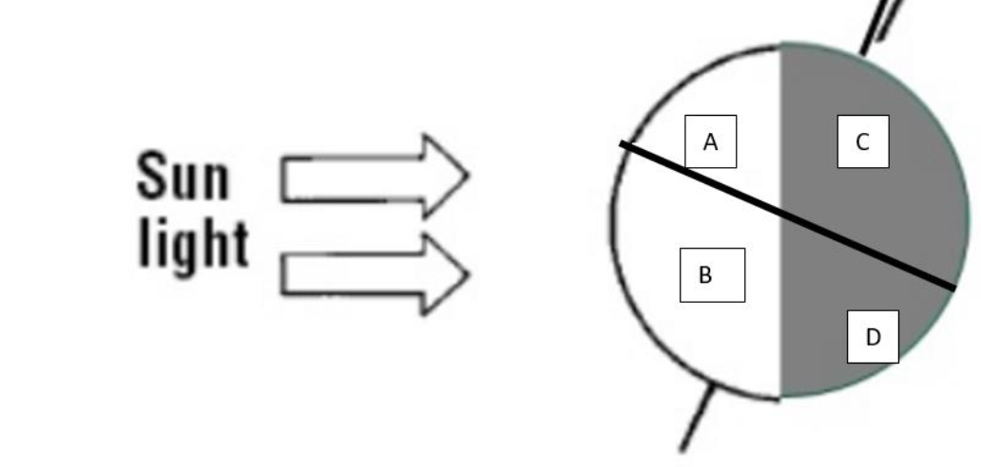
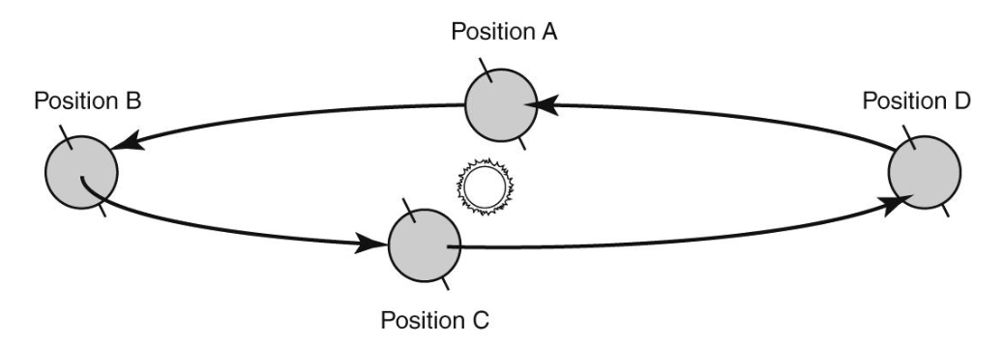
Do Now 9.19.19
Which two letters represent winter? Explain
2. The tilt of Earth at four different times throughout the year is shown in the diagram. At which point would the United States receive the fewest hours of daylight?
3. Why do we see different phases of the moon throughout the month?
4. Draw a picture showing how you think the sun, moon and earth are aligned for NEW MOON to be seen
*Are you keeping up with your moon calendar?? Be sure to write it in your agenda to remind yourself

Slide 81
Do Now 9.20.19
Grab an article from the side table
What did you find interesting or surprising in this week’s article?
What topic(s) relate to what we have learned in class?
What section(s) would you like to do further research on and why?
Count your neighbor’s “Do Nows” (They should have 4)

Slide 82
Do Now 9.17.18
Get an ipad from the cart and log into iRespond.
Brittany.dudek then student number as your PIN
Answer the 5 questions then log out. Give your iPad to someone else if they do not have one. Put it back when you are done.
2. Turn in your Moon Lab/Practice sheet from Friday to Mrs. Dwills chair
3. Pick up a copy of the notes from the front counter and put your name on it

Slide 83
iRespond Questions
The northern hemisphere receives more solar energy during one half of the year than it does during the other half of the year. Which of the following happens during the year to explain this?
  The angle that Earth is tilted on its axis changes
  The amount of energy that is produced by the sun changes
  The distance of the Northern Hemisphere from the sun changes
  The angle at which sunlight reaches the Northern Hemisphere changes

Slide 84
iRespond Questions
2. A diagram of the Earth’s orbit was shown in iRespond.
Which of these choices best defines the orbit of Earth?
a. the position in space of Earth at a certain time
b. the distance from the sun to Earth at any point
c. The spin of Earth on its axis as it moves forward
d. the path Earth travels as it revolves around the sun

Slide 85
iRespond Questions
3. Which of the following is a common characteristic of winter compared to summer?
a. noon sun lower in the sky
b. higher daytime temperatures
c. more daily hours of sunlight
d. longer days and shorter nights

Slide 86
iRespond Questions
4. The rotation of Earth on its axis causes every location on the surface of Earth to move as Earth turns. In which direction does each location move?
a. from west to east
b. from east to west.
c. from south to north
d. from north to south

Slide 87
iRespond Questions
5. Which of the following best describes the term season?
a. The time it takes earth to complete one full rotation on its axis
b. the time it takes Earth to complete one revolution around the sun
c. a time of year that is characterized by constantly changing weather conditions
d. a specific time of the year that is characterized by recurring weather conditions

Slide 88
Do Now 9.30.19
Have your Oreo Lab Sheet out on your desk
Create a double bubble comparing and contrasting solar and lunar eclipses
Why does a solar eclipse rarely happen?
What is the difference between a penumbra and an umbra when talking about eclipses?
When do spring and neap tides happen? (hint: look at your vocabulary)
Mrs. Dwills was on the lake on Saturday and driving a boat at night back from dinner. It was SO dark she had to use cell phones to see where the boat was going. Why was it so dark?
*Write your homework in your agenda
*Reminder: Bring empty toilet paper rolls to Mrs. Brown’s room this week if you have any

Slide 89
Do Now 10.1.19
What causes seasons? Explain how this works.
What is tidal range? (hint: look at your vocab)
What is the main difference between Spring and Neap tides?
Draw a picture of 4 different phases of the moon. Switch with your neighbor and have them write down what they think each phase is.

Slide 90
Gizmo
Go to www.explorelearning.com
Username: 6BScience
Password: ecms
Click on ‘Class 1’
Click on ‘Tides’ then ‘Launch’

Slide 91
Do Now 10.2.19
How many high tides do we have a day? How many low tides?
How often do Spring and Neap Tide occur?
If the United States is having Fall, what season is happening in Brazil?
When is the Fall equinox? What does this mean?
What items are you going to use to study for tomorrow’s test?

Slide 92
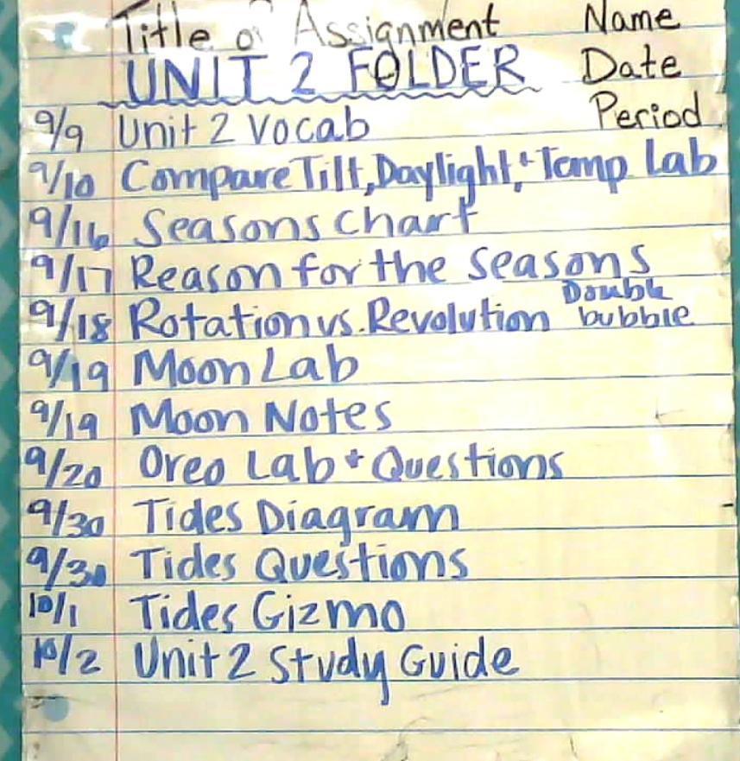
Do Now 10.3.19
Write down any last minute questions you have before we take the test.
Get out your science folder and make sure it is organized. If you are missing something, that is okay. Skip it and go on to the next one.
Be ready to turn in your folder that should have your FIRST AND LAST NAME on the front along with ‘Unit 2’. Sharpies are on the front counter if you need them

Slide 93
Do Now 10.4.19
Grab an article from the side table for this week
What did you find interesting or surprising?
What topics relate to what we have learned in class?
What section(s) would you like to do further research on? Why?
Count your neighbor’s Do Nows, they should have 4!
Turn in your completed word search into your period’s IN box for house points
*Write down your homework in your agenda

Slide 94
After Test Analysis
Continued Enrichment Unit 2: Your challenge is to name NASA’s next Mars rover. Submit your rover name and a short essay (maximum 150 words) to explain the reasons for your selected name. It may NOT be your name. The Mars 2020 rover will seek signs of past microbial life, collect surface samples as the first leg of a potential Mars Sample Return campaign, and test technologies to produce oxygen from the Martian atmosphere to prepare for future human missions.

Slide 95
Do Now 10.7.19
Have your completed MOON CALENDAR out on your desk
Think back to the Unit 2 Test on Thursday, what do you think you struggled with?
Name one thing you did over the weekend to better yourself for school?
What is one goal you have for October?
Our next Unit is over Meteorology, what do you think that means?
If you have remediation, have it ready and completed on your desk. If you have enrichment (math connections), turn it into your period’s IN box
*Be sure to write your HW down in your agenda

Slide 96
Unit 3 Vocab
Sea breeze p. 282
Land breeze p. 282
Trade Winds p. 279
Polar Easterlies p. 279
Prevailing Westerlies p. 279
Barometer: an instrument that measures air pressure
Anemometer: An instrument that measures wind speed
CFC’s: a chemical used as a propellant in aerosol cans that depletes the ozone layer.

Slide 97
Do Now 10.2.18
Turn in your ENRICHMENT to Mrs. Dwills chair. Hold onto your remediation if that is what you were to complete.
Now that you have taken a look at your test corrections from Unit 2, what confusions did you have in Unit 2?
Now that you have taken the Unit 3 Pre-test, what are you looking forward to most in the next unit?
Why do we see different phases of the moon each night?
Make a double bubble comparing and contrasting Solar and Lunar Eclipses

Slide 98
Do Now 10.8.19
Have your Vocabulary out on your desk for Mrs. Dwills to check
What vocabulary terms did you already know on your list?
What term gave you the hardest time?
What gases make up the air we breathe?
How do you think the air we have on Earth stays on Earth and doesn’t float away?
Remember to regularly check your REP Points. Most students received points today because they watched their Edpuzzle on time.

Slide 99
Do Now 10.9.19
Have your atmosphere practice sheet out on your desk from yesterday
Besides nitrogen, oxygen, carbon dioxide and argon, what else is in our air?
Why is our atmosphere important?
How does Earth still have an atmosphere?
What is the greenhouse effect?

Slide 100
Layers of Atmosphere foldable
Troposphere: layer closest to Earth’s surface which extends from the surface to altitudes of 8 (N & S poles) – 15 (equator) km. Layer in which Earth’s weather occurs
Stratosphere: layer directly above troposphere which extends to about 50 km and contains the OZONE LAYER which protects Earth from ultraviolet (UV) rays that can kill plants, animals and cause skin cancer in humans.
Mesosphere: beginning at 50 km and ending around 80 km, this layer protects Earth’s surface from being hit by most meteoroids, which burn up from friction with the atmosphere
Thermosphere: divided into two layers
  Ionosphere: lower layer of the thermosphere which begins at 80 km and extends to about 500 km and contains ions, or charged particles allowing radio waves to bounce off and auroras to occur
  Exosphere: outer layer of thermosphere

Slide 101
Do Now 10.10.19
The atmosphere is divided into 4 main layers. Which one contains the most mass? Why?
Atmospheres in our solar system are different for each planet. If a planet had a THICK atmosphere, what would you expect the temperature and gravity to be like? (Cold, Hot, Strong, Weak)
Out of the following choices, which molecules would trap the MOST heat? Why?
  Oxygen
  Nitrogen
  Carbon dioxide
  Ozone Layer (three oxygen atoms)
What do you think humans do that speed up Global Warming?
How do we get more greenhouse gases into our atmosphere? Is this good or bad?

Slide 102
Quiz
WRITE THESE AT THE BOTTOM OF YOUR QUIZ
8. The (troposphere, thermosphere) is where most clouds are present and weather occurs.
9. Ozone is (made, destroyed) by pollutants called CFC’s.
10. Name one reason why our atmosphere is important:
*When you are done, turn in your quiz, grab a double bubble and use your textbook to help you fill it in.

Slide 103
Do Now 10.11.19
Grab an article from Mrs. Dwills Chair, return it when you are done
What did you find interesting or surprising in this week’s article?
What topic(s) relate to what we have learned in class?
What section(s) would you like to do further research on? Why?
Count your neighbor’s Do Nows (They should have 5!)
Have your double bubble out on your desk for Mrs. Dwills to check

Slide 104
Do Now 10.14.19
After heat is radiated from the Sun, where does it go after?
Explain how convection works in a lava lamp.
Why do you think the “heart” of all weather is HEAT?
Name the four layers of the atmosphere starting from the bottom. Which ones get warmer the higher you go in altitude?

Slide 105
p. 260 Unit 4 Lesson 2
P. 260 # 1-3
P. 262 # 5
P. 264 # 8
P. 265 # 9
P. 266 # 11
P. 267 # 12
P. 268 # 14
P. 270 # 17-18
P. 271 # 1-13

Slide 106
Do Now 10.15.19
Have your heat transfer foldable out on your desk
Why is our atmosphere important? (Try not to look at previous Do Nows)
How is conduction different than convection?
Besides the atmosphere, where else do you think convection occurs?
Pick up a Lab sheet from the front counter and read through the first page. Get ready to make your hypothesis!

Slide 107
Sand and Water Lab
Hypothesis:
If heat is placed on both the sand and water for the same time, then the ____________ will heat up faster because _____________.
If the heat is taken off both the sand and water at the same time, then the _____________ will cool down faster because ________________.

Slide 108
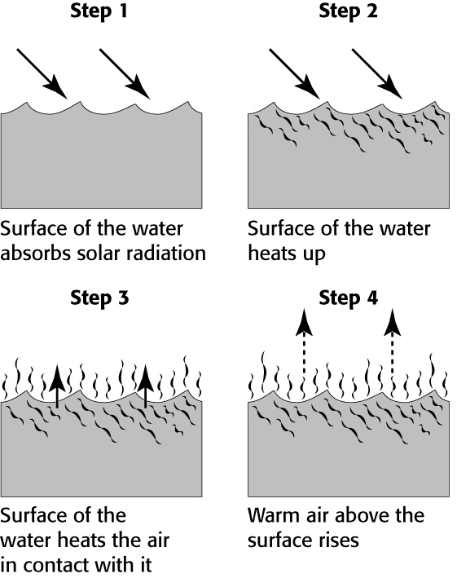
Do Now 10.16.19
As water is heated by the sun, it becomes less dense and rises. What causes the decrease in the density of warming water?
Leanne created the following diagram to show the process that warms the air above a lake. She decided to label each step with the energy transfer that is happening. Which step represents CONDUCTION?
As altitude increases, what happens to the
pressure of the air? Why?
4. What happens when two objects of
different temperatures touch? How does the
temperature change? (Hot particles move
to cold, or cold particles move to warm)

Slide 109
Do Now 10.17.19
Which substance has higher specific heat: sand or water? Explain.
What is the difference between a coastal and inland region? Give an example of each.
Which object would you expect to be warmer during the day: the beach, or the ocean?
Which object would you expect to be warmer during the night: the beach or the ocean?
Remember: you have a WINDS EDPUZZLE due tomorrow!

Slide 110
Do Now 10.18.19
Grab this week’s article from Mrs. Dwills chair
What did you find interesting or surprising in this week’s article?
What topic(s) relate to what we have learned about in class?
What section(s) would you like to do further research on? Why?
Count your neighbor’s Do Nows (they should have 5!)
Have your Land and Water Sheet out on our desk for Mrs. Dwills to check

Slide 111
Do Now 10.22.19
Draw a picture of a land breeze. Be sure to include arrows, high and low pressure, and if it is day or night.
Draw a picture of a sea breeze. Be sure to include arrows, high and low pressure, and if it is day or night.
Make a double bubble comparing and contrasting Land and Sea Breezes.
How do you think land and sea breezes effect the overall climate of an area?
Points for completing the edpuzzle on time will be added today! Good job guys ☺

Slide 112
Do Now 10.23.19
What global wind is located between 60 degrees and 30 degrees latitude?
If the world stopped spinning, how would winds be effected?
What three things effect air pressure (look at your study jams from yesterday if you cannot remember)?
Why does air rise over the land at the beach during the day?
Compare and contrast high and low pressure systems? (You don’t need to make a double bubble, but you need at least two differences and two similarities)

Slide 113
Do Now 10.24.19
The air above the Earth’s surface is at different temperatures. What is responsible for the difference in temperature?
What is the jet stream and where is it located? How do you think this influences weather?
Because of the Coriolis effect, how to winds tend to move in the northern hemisphere? How is this different in the southern hemisphere?
How would you describe the winds near the equator?

Slide 114
Do Now 10.25.19
Grab an article from the side table for this week
What did you find interesting or surprising in this week’s article?
What topic(s) relate to what we have learned in class?
What section would you like to do further research on? Why?
Count your neighbor’s ‘Do Now’s’ (they should have 4!)

Slide 115
Do Now 10.28.19
If we were able to survive on another planet, what would it’s atmosphere have to be composed of?
A pot is on the stove and the handle is heated. What type of heat transfer is happening?
Name the four main layers of the atmosphere and describe each in one word
Throw back: Order the planets from biggest to smallest ☺

Slide 116
Weather Maps and Predictions
Read p. 322-335 in textbook and complete the following:
P. 323 # 1-3
P. 324 # 5-6
P. 326 # 10-11
P. 328 # 14-16
P. 329 #17-18
P. 330 #19
P. 332 # 20
P. 333 # 21-22
P. 334 # 23-27
P. 335 # 1-10

Slide 117
Do Now 10.29.19
Have your air pressure lab out on your desk for Mrs. Dwills to check
What is the difference between a warm and a cold front?
Where do continental tropical air masses originate from?
Air always moves from _______ pressure to ______ pressure.
Yesterday was extremely foggy in the morning. How would you describe the air pressure?
If a cold front moves in and it is below 32 degrees Fahrenheit, what will most likely happen?
What always happens at a front?

Slide 118
Storm Project Examples
https://weather.com/news/news/2018-10-16-mexico-beach-home-survives-hurricane-michael
https://youtu.be/jbm1KWgYul4

Slide 119
Do Now 10.30.19
Have your storm planning sheet out on your desk
Which type of heat transfer do you think is most important? Why?
A barometer measures air pressure. Imagine that the barometer in Miami is falling. What does this indicate about the weather?
Condensation is part of the water cycle. During condensation, water vapor cools and changes from a gas to a liquid. What happens when this process occurs near Earth’s surface?
What global winds are located 30 degrees N latitude and 30 degrees S latitude?
Why do weather systems usually move from west to east across the United States?

Slide 120
Tuesday Brain Teaser
Brain Teaser
A number has 5 digits.
The first and the third digits are the same, all others are different.
The highest digit is 7 and the lowest is 1.
The third digit is twice as much as the fourth.
The second digit is higher than the fifth.
The sum of the five digits is 23.

Slide 121
Answer
67631 ☺

Slide 122

Do Now 10.31.19
Make a diagram of a land breeze WITHOUT looking back at your notes
Make a diagram of a sea breeze WITHOUT looking back at your notes
What is air made of?
What is the purpose of the ozone layer?
WRITING WEDNESDAY (on a Thursday): Write a story starting with the following: “Today the sun burned out…”
This Photo by Unknown Author is licensed under CC BY-SA-NC

Slide 123
Do Now 11.1.19
4th period: have your storm planning sheet out on your desk. Once you have this on your desk, grab a laptop.
Group 4 & 5: grab from Cart B
Group 1, 2 & 3: grab from Cart A

Slide 124
Do Now 11.1.19
Pick up this week’s article from the side table
What did you find interesting or surprising?
What topic(s) relate to what we have learned in class?
What section(s) would you like to do further research on? Why?
Count your neighbor’s “Do Nows” (They should have 5!)

Slide 125
SOLAR OVEN TESTING
Grab a “gimme s’more proportions/solar oven testing” sheet from the FRONT counter.
Grab a clipboard from the BIG cabinet
Have a writing utensil on your desk
Sit with your group and have your solar oven on your desk
We are leaving at 1:40 to head out to LANE 13 (so be ready!)

Slide 126
Do Now 11.4.19
What type of air pressure is associated with tornadoes? Hurricanes? Blizzards? Thunderstorms?
Why do we have wind?
What type of air masses are needed for a cold front?
What type of front do you think causes a blizzard? What about a hurricane?

Slide 127
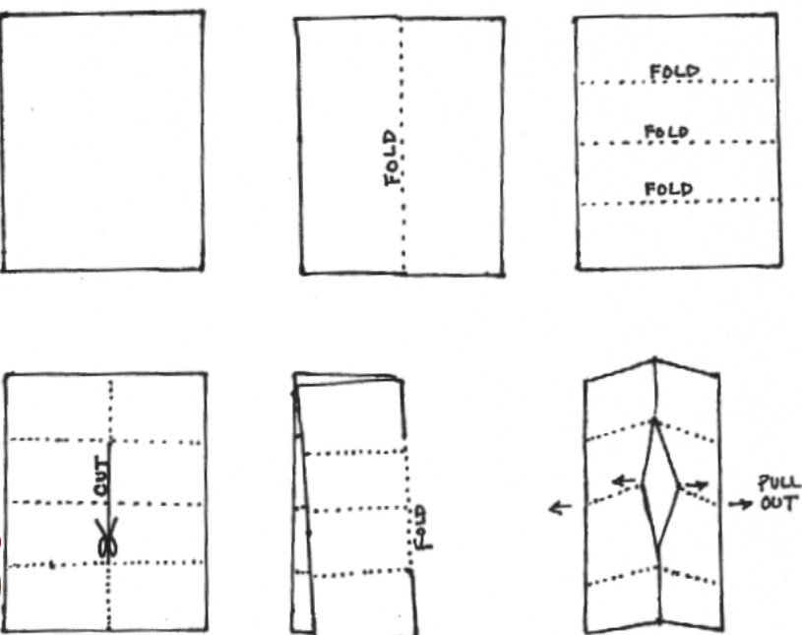
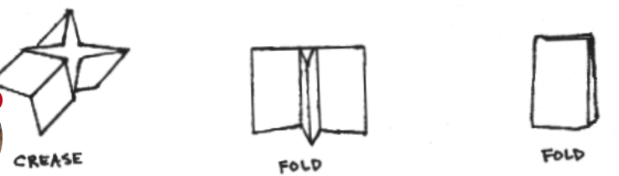
STORM BOOK

Slide 128
STORM BOOK
HURRICANES, TORNADOES, THUNDERSTORMS, BLIZZARDS
For each storm you will need the following:
  Causes (how it forms)
  Effects
  Air masses and fronts
  Where it happens the most
  Interesting Facts

Slide 129
Do Now 11.6.19
What is an air mass?
What two air masses do you think we experience the most in Atlanta?
The jet stream is formed by two air masses colliding. What kind of air masses do you think they are?
It’s getting colder outside, why do you think that is happening?
Why do winds tend to curve?
How is distance away from the equator and temperature related?

Slide 130
Do Now 11.7.19
What is a front?
Name all the global winds starting from the North pole and ending at the South pole.
Describe an occluded front
A storm surge is an effect of what type of severe weather event? Describe what this is.
Describe the eye of a hurricane.
Water vapor is an important part of all storms. How can you add more water vapor to the air? (Hint: increase or decrease the temperature?)

Slide 131
Do Now 11.8.19
Pick up a copy of this week’s article from Mrs. Dwills desk
What did you find interesting or surprising?
What topic(s) relate to what we have learned in class?
What section(s) would you like to do further research on? Why?
Count your neighbor’s “Do Nows” (They should have 4!)

Slide 132
Do Now 11.11.19
Now that we are about done with presentations, what questions do you have about severe weather events?
What type of air masses are needed for each severe weather event?
Where do tornadoes happen the most? Why?
Where do hurricanes happen the most? Why?
What is so devastating about blizzards?

Slide 133
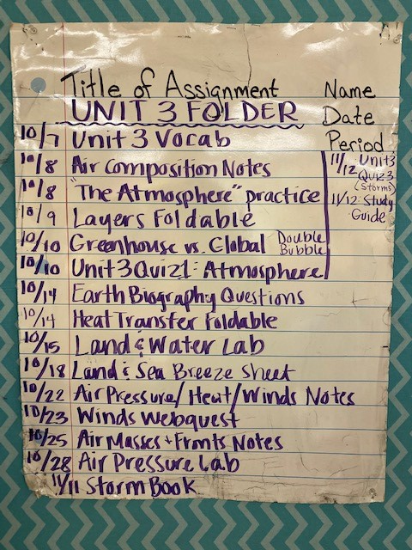
Do Now 11.13.19
As you were looking through your Unit 3 assignments last night to get your folder in order, what questions do you have?
Why do we have wind?
What are you thankful for today?
Have your Unit 3 Folder out on your desk

Slide 134
Do Now 11.14.19
What concepts were difficult to you on the Unit 3 test?
What concepts did you feel confident about going into the test?
Why do you think Unit 3 is one of the most difficult?
What sort of information could you have used to study?
Turn in your COMPLETED word search to your period’s IN box

Slide 135
Brain teaser
(T+H+A+N+K)³=THANK
T=?
H=?
A=?
N=?
K=?

Slide 136
Do Now 11.18.19
Have your vocabulary out on your desk for Mrs. Dwills to check
What vocabulary words did you already know?
What vocabulary words are you excited to learn about?
There was a lot of fog this morning, why do you think that happens?
Explain how you think a hot air balloon works.
Remember you are turning in your Do Now Journal Friday

Slide 137
Do Now 11.19.19
Write a letter to one of your teachers/staff members that you are thankful for. DO THIS ON A SEPARATE SHEET OF PAPER. Be sure to address them, and sign your name at the end. They will be receiving these right before thanksgiving break so please make them sweet! (You can write more than one)
Mrs. Katz
Mrs. Stanhope
Mr. Coffelt
Mr. Wood
Mrs. Kelley
Mr. Shaw
Ms. Shaw
Mrs. Maniscalco
Mrs. Hart
Mrs. Ledesma
Mrs. Bothers
Mrs. Brown
Mr. Petrillo
Mrs. Cortes
Mrs. Boyer
Mrs. Jenkins
Mr. Hinsley
Mrs. Standifer
Mr. Haywood
Mrs. Ventresca
Mr. Denson
Mrs. Stoney
Ms. Encisco
Ms. Lazaro
Mrs. Watkins
Mrs. Frutoz
Ms. Helms
Coach Dang
Coach Carchio
Coach White
Coach Ray
Coach Vatzakas
Ms. King
Mr. Tallent
Ms. Cruz
Mrs. Gardnier
Mrs. Leach
Ms. Gary-Robinson
Mrs. Young
Mrs. Would
Mr. Tory (custodian)

Slide 138
Do Now 11.20.19
Get out on sheet of paper that will be turned in at the end of class. Write your name at the top right corner and wait for further instructions. I will know your ready when the piece of paper is on your head ☺ Shhhhhhh, don’t tell anyone what you’re doing!

Slide 139
Do Now 11.21.19
Writing Wednesday (on a Thursday):
Suppose you were in a hot air balloon that could fly up through the atmosphere while feeling the temperature and air pressure change around you. Describe your trip in a paragraph, naming the four main atmospheric layers and telling how the temperature and air pressure change as you pass through each.

Slide 140
Maker Bus Jobs
Caine’s Arcade- https://www.youtube.com/watch?v=faIFNkdq96U
Explainer Video: https://youtu.be/L8wg-sm9r6o
Jobs-
Team Captain makes sure everyone understands their job and helping stay on schedule (Team captain will also work on design and build)
Materials Wrangler- Makes sure the list of materials is filled and replenishes supplies as needed- Materials Wrangler will also work on design and build)
Quality Control Captain- Makes sure the project is being built well and meets constraints. The quality control captain helps the team recognize when they have to change the design.

Slide 141
Maker Bus
-Draw your design and give plenty of details.
-Provide dimensions (measurements)
-Provide information about how you will connect pieces, especially moving pieces
-Make a list of supplies that you will need
-Create a schedule for the day the bus comes so you will be able to complete your project in time.
Need ideas: https://www.pinterest.com/leighmlibrarian/cardboard-projects/?sender=415527640527538244&invite_code=169cee2dbafe47fb94a1d724bcb3dd20
Sample Schedule:
5 minutes- Greeting and Find supplies and materials to be used for the project
5 Minutes- Group Scrum- Make Sure everyone has a job to do and that they are ready to get started.
50 Minutes- Build- During this time you’ll have to iterate (change) your design quickly as needed. Make sure everyone is working together.
Minutes- Share

Slide 142
Do Now 11.15.19
Pick up this week’s article from the iPad cart
What did you find interesting or surprising in this week’s article?
What topic(s) relate to what we have learned in class?
What section(s) would you like to do further research on? Why?
Count your neighbor’s “Do Nows” (they should have 4!)
Turn in completed enrichment to your period’s IN box
KEEP remediation on your desk for you to retake your test today
*You will be turning in your DO NOW journal next Friday*

Slide 143
6th grade teachers
Mrs. Katz
Ms. Colacicco
Mr. Coffelt
Mr. Wood
Mrs. Maher
Mr. Shaw
Ms. Shaw
Mrs. Hosford
Mrs. Smith
Mrs. Ledesma
Mrs. Bothers
Mrs. Brown
Mr. Petrillo
Mrs. Cortes
Mrs. Boyer
Mrs. Jenkins
Mr. Hinsley
Mrs. Jenkins
Mrs. Standifer
Mr. Haywood
Mrs. Ventresca
Mr. Denson
Mrs. Stoney
Ms. Encisco
Ms. Peebles
Mrs. Watkins
Mrs. Frutoz
Ms. Helms
Coach Young
Coach Carchio
Coach Ray
Coach Vatzakas
Ms. King
Mr. Tallent
Ms. Cruz
Mrs. Gardnier
Mrs. Leach
Ms. Gary-Robinson
Mrs. Young
Mrs. Would
Mr. Tory (custodian)

Slide 144
Do Now 12.2.19
Remember to pick up your ‘Do Now’ journal from the front bins
Why do you think leaves change color?
During the break, we had very low temperatures. DO you think the water cycle still happened?
What is the difference between condensation and evaporation?
What is infiltration?

Slide 145
Do Now 12.6.19
Pick up a copy of this week’s article from the side table
Have out your watery pies on your desk with your name on it
What did you find interesting or surprising in this week’s article?
What topics relate to what we have learned in class?
What section(s) would you like to do further research on? Why?
What are you thankful for today?
Count your neighbor’s “Do Nows” for this week (they should have 3).
Make sure to copy down your homework

Slide 146
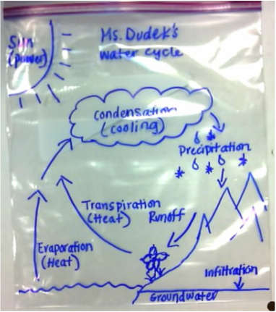
TODAY!
Quiz
Write a letter to a staff member or
teacher telling them why you’re thankful
for them (you can do more than 1)
Water Cycle Baggie
HW: Share at least one picture of
Your baggie over the break
Bill Nye bro

Slide 147
Do Now 12.9.19
Why does evaporation happen? Explain the phase change by drawing a model.
How much of our Earth is water? How much of it is salt water?
Where is most of the fresh water on our world located? Why would it be dangerous to get that water?
THINKING MONDAY: What is this question ACTUALLY asking you?
Compare and contrast Hamburgers and Hotdogs by creating a diagram.
Interested in going to Ecuador?? Check the blog for further information
Hope you got your TWO edpuzzles done that were due today. Be sure to write down your homework today.

Slide 148
Do Now 12.11.19
What is an aquifer?
What are two differences between the zone of saturation and the zone of aeration?
If something is very PERMEABLE, does it have high or low porosity? Draw a picture to help you
If something is IMPERMEABLE, does it have high or low porosity? Draw a picture to help you
How do sinkholes form?
Make sure you write down your homework in your agenda
Textbook needs to be in your cabinet to get points for your work from yesterday

Slide 149
Intro to Wind Mills-STEAM
Why not fossil fuels:
https://www.youtube.com/watch?v=v2aShVTMMNc
What is Wind Power:
https://www.youtube.com/watch?v=Q3JzgSnW_EE&feature=youtu.be
Example:
https://www.exploratorium.edu/snacks/light-wind

Slide 150
Design Brief
In your group, you will need the following group members with the jobs below:
Team Captain makes sure everyone understands their job and helping stay on schedule (Team captain will also work on design and build)
Materials Wrangler- Makes sure the list of materials is filled and replenishes supplies as needed- Materials Wrangler will also work on design and build)
Quality Control Captain- Makes sure the project is being built well and meets constraints. The quality control captain helps the team recognize when they have to change the design.

Slide 151
Do Now 12.12.19
In order to run a community, we must have enough energy for everyone. Most of the energy we currently use comes from fossil fuels. Some common fossil fuels are oil, coal, and natural gas. These energy sources are not always good for the environment. Burning fossil fuels can send toxins into the environment, which can cause problems like global warming. Additionally, burning fossil fuels can cause air pollution and harmful smog in many urban communities. Pollution is not the only problem caused by fossil fuels. Fossil fuels are a non-renewable resource, which means once we run out, Earth will not produce more. Eventually, all the fossil fuels will be used, if we do not change our current energy habits.

Slide 152
Continued Do Now 12.12.19
Write a paragraph (4-5 sentences) letter explaining to an elected official which type of renewable energy you think should be better developed in the United States. Pick one of the prompts below:
Explain the reason we need a renewable energy source.
Choose a renewable energy source. Explain the positive attributes (characteristics) of the source you chose.
Choose a renewable energy source. Explain why it is better than the other options (fossil fuels AND other sources of renewable energy).
Explain the implications it would have on your community if this type of energy source was implemented.

Slide 153
Do Now 12.13.19
Pick up a copy of this week’s article from the side table
What did you find interesting or surprising in this week’s article?
What topic(s) relate to what we have learned in class?
What section(s) would you like to do further research on? Why?
Count your neighbor’s Do Nows (they should have 4!)

Slide 154
Do Now 12.16.19
1. Water Cycle Haiku
A haiku is a short descriptive poem that is only three lines long.
The first line has words totaling five syllables; the second line has seven syllables; the third line has five syllables.
Example:
Lacey white snowflakes
Drifting slowly to our Earth
Silent as they fall.
Include a simple illustration with your haiku.

Slide 155
Do Now 12.17.19
Draw a picture of ground water and the different levels it must go through.
When does water gain and lose energy during the water cycle?
How would salinity change in oceans after evaporation has taken place?
Any additional questions that you have before we take the test tomorrow?
Have your Water Cycle brochure on your desk

Slide 156
Do Now 11.28.18
Have your ‘Cloud in a Jar Lab’ and ‘Morning Glories’ sheet out on your desk
Now that you have looked at articles, readings, vocabulary, notes, and even completed a lab. What things MUST your new model of Morning Glories include?
WRITING WEDNESDAY: Write a letter to your parents/guardians on why it is important to conserve water and how you plan to do this in your household.

Slide 157
Do Now 11.29.18
What do you think is causing the water crisis?
What defines something as ‘natural’?
What process changes water into a gaseous state?
What do you think a watershed is? Explain.
Throw back Thursday: Mars has about the same gravity as Earth. What can you assume about Mars?

Slide 158
Do Now 11.30.18
Have a seat near where you normally sit in class
Review the rules for the debate on the blue sheet of paper. Write down any questions you have.
Count your neighbor’s Do Nows (they should have 5!)
Pick up a copy of the Philosophical Chairs Report from the front desk

Slide 159
Do Now 12.4.18
There is no Do Now ☺
Get out a sheet of paper and make two sections.
Title the first section “NEW INFORMATION” and number it 1-10
Title the second section “QUESTIONS” and number it 1-5
REMINDER (write in your agenda): You have two edpuzzles due TOMORROW!
Bring markers, a poster if you have one, and other coloring items on Thursday

Slide 160
Do Now 12.5.18
What is an aquifer?
What are two differences between the zone of saturation and the zone of aeration?
If something is very PERMEABLE, does it have high or low porosity? Draw a picture to help you
If something is IMPERMEABLE, does it have high or low porosity? Draw a picture to help you
How do sinkholes form?
Make sure you write down your homework in your agenda

Slide 161
Do Now 12.10.18
Have your textbook open to page 189 for Mrs. Dwills to check
What is the main difference between evaporation and transpiration?
If we have the same amount of water on Earth from a billion years ago, why do we need to conserve?
What does ‘median age’ mean when you are looking at information for your country for the Water Crisis?
Explain convection in your own words.

Slide 162
Do Now 12.11.18
Why was school delayed this morning?
What would have made us stay out the entire day?
Make a tree map about the 4 main types of precipitation (add FREEZING RAIN as a 5th one) Make sure to include a description and picture for each
The test has been moved to THURSDAY, what sort of information do you think you need to study?
Have your ‘case of the missing renters’ out on your desk

Slide 163
Do Now 12.12.18
Have your study guide out on your desk
There was a small earthquake North of Chattanooga, TN last night. What do you think causes earthquakes?
Imagine a water droplet is evaporated from the ocean. Explain it’s path all the way to it becoming ground water.
Think back to this water droplet evaporating from the ocean. Does the salt evaporate with it? If so, add this to your story, if not, why doesn’t it?
______ % of Earth is water. Of that water _____% is salt water and ______ % is fresh water. Of that freshwater, ________ % is frozen, and ________% is underground. Leaving ______ % of freshwater for us to use.

Slide 164
Do Now 12.18.18
Have your vocab out and ready for Mrs. Dwills to check
What vocab words were you not familiar with before you looked them up?
How are you feeling about the midterm tomorrow?
What can you do to make sure you are prepared?
A solution to the Global Water Crisis is to make more desalination plants. What sort of difficulties might we face if we did this?

Slide 165
Do Now 12.19.18
What are you looking forward to in the Ocean Unit?
What questions do you have before we take our Midterm?
What concepts do you know you’re going to ROCK on the midterm?
What unit has been your favorite thus far?

Slide 166
MIDTERM
Go to www.socrative.com
Room Code MRSDWILLS

Slide 167
Do Now 12.20.18
Turn in your crossword/word searches to your period’s inbox
Look at your progress sheet. In what areas could you improve?
Where can you find missing assignments for science?
What can you do to prevent missing assignments or late assignments?

Slide 168
Do Now 12.21.18
Get out your ‘Finding Nemo’ sheet with a writing utensil and clear EVERYTHING ELSE OFF!
☺ #easiestDoNowever

Slide 169
Do Now 1.6.20
WELCOME BACK!!!!
#NewYearWhoDis : What new and good habit are you going to start in 2020?
We’ve been on break for a long time, what type of Earth Science did you experience?
What percentage of Earth is water? How much of that water is salt water?
Name the 5 main oceans we have on our Earth.
Make sure you write down your homework in your agenda

Slide 170
Do Now 1.7.20
Turn in your enrichment to your period’s IN box
(all that matters is that you TRIED)
HANG ON to remediation if you have it
What did you do well on for the Unit 4 test?
What did you not do well on for the Unit 4 test?
Given the information you learned in Unit 4, how could you “change the world”?
What unit has been your favorite thus far? Why?

Slide 171
Reminder
You have two edpuzzles due WEDESDAY!
Go to www.edpuzzle.com and you should already have an account from the beginning of the year
(If not, make a log in that you will remember)
1st period: icimehi
2nd period: joslebe
3rd period: ariifet
4th period: mebakuf

Slide 172
Do Now 1.8.20
Have your Unit 5 Vocab out on your desk for Mrs. Dwills to check
Writing Wednesday: Suppose you take a journey from the coast of Georgia, to Brazil by boat. You then go to Antarctica, then India and then to Japan. You end your trip by taking the same boat to California. Write a journal entry describing the oceans that you have traveled through and what different characteristics each might have.

Slide 173
Do Now 1.9.20
Copy down the following learning target for today:
Students will be able to ask questions about subsurface topography in order to identify and communicate using graphs and maps that will explain the composition and location of the world’s oceans.
2. Define the following words on your own: subsurface topography, identify, communicate, composition, location.
3. Rewrite the learning target in your own words.

Slide 174
Definitions
subsurface topography: below the surface elevation
identify: establish what something is
Communicate: share ideas
Composition: what something is made of
Location: where something is

Slide 175
Learning Target
Students will be able to ask questions about below sea level elevations in order to establish share ideas using graphs and maps that will explain what oceans are made of and where they are located.

Slide 176
Answer According to your graphs
Which ocean is the biggest? Pacific
Which ocean is the smallest? Arctic
at two oceans are about the same in depth? Southern and Indian
Which ocean is the deepest? Pacific
Which ocean is the shallowest? Arctic
What is the main salt in our oceans? Chlorine
The further you travel down into the ocean, temperature tends to ________________ (increase or decrease). Decrease
Why do you think it is coldest at the bottom of the ocean? Sun’s energy cannot reach the bottom
How many Arctic Oceans could you fit inside of the Pacific Ocean? 11
What is the area of ALL 5 oceans combined? 336 km

Slide 177
Do Now 1.13.20
Have your desalination HW sheet out on your desk
As you go deeper into the ocean, what happens to temperature?
Sea surface temperature changes because of two reasons. Describe both.
Where would you find saltier water? Explain why
What is the gulf stream? Do you think it is a warm or a cold current if it comes along the east coast of the United States and goes towards Europe?

Slide 178
Do Now 1.9.19
Order the 5 oceans from biggest to smallest
What is the most abundant dissolved substance in our oceans?
Compare and contrast the arctic and southern oceans.
Suppose you take a journey from the coast of Georgia, to Brazil by boat. You then go to Antarctica, then India, and then to Japan. You end your trip by taking the same boat to California. Write a journal entry describing the oceans that you have traveled through and what different characteristics each might have.

Slide 179
Do Now 1.14.20
What is a trench and how is it formed?
What is a mid-ocean ridge and how is it formed?
How do we know what the ocean floor looks like if we cannot physically go to the bottom?
A ping is sent from a ship down to the ocean floor. It takes 20 seconds to get back to the ship. How deep is the ocean below the ship?

Slide 180
After your Foldable
Read p. 192 – 203 in your textbook
Complete the following problems in your book or on a separate sheet of paper by looking at a neighbor’s book:
p. 193 #1-3
P. 195 #6
p. 196 #7-8
p. 198 #10
p. 199 #11
p. 200 #12
p. 202 #15-18
p. 203 #1-13

Slide 181
Do Now 1.16.20
Come up with an analogy for the continental margin and how it changes from the shelf, to the slope, to the rise. (example: The outer planets are married because they all have rings)
How are mid ocean ridges and trenches different?
Is the Atlantic Ocean getting bigger or smaller? How do scientists know this?
Is the Pacific Ocean getting bigger or smaller? How do scientists know this?
Have your textbook open to p. 203 on your desk

Slide 182
Do Now 1.17.20
Pick up a copy of this week’s article from the side table
What did you find interesting or surprising in this week’s article?
What topics relate to what we have learned in class?
What sections would you like to do further research on? Why?
Count your neighbor’s Do Nows (they should have 4!)
Did you get your two edpuzzles done last night? If not, write it down in your agenda to remind yourself!

Slide 183
Practice
Make sure you have the following done: Desalination Sheet, Foldable, Textbook p. 192-203
Make your own crossword using the following words: trench, island, abyssal plain, mid ocean ridge, continental shelf, continental rise, continental slope, seamount, guyout, divergent, convergent
Google Map Activity: you may use your phone or an iPad to look at Google Maps. Some do not have the app
Fortune Teller: fill in the definition of each word FIRST. Then you can cut it out and fold it to help you study for your 3D Model tomorrow

Slide 184
Do Now 1.21.20
Make sure you got your edpuzzles done for this unit
What ocean floor features are you still struggling to understand?
What is the difference between a guyout, seamount, and a mid-ocean ridge?
If you had to explain to someone where the Southern Ocean was without looking at a map, how would you explain it to them?
Write down the learning target for this week: SWBAT create graphic representations of the causes and effects of waves, currents, and tides in Earth’s systems in order to analyze and interpret data. Write this in your own words.

Slide 185
Learning Target
Graphic representations: diagrams, thinking maps, pictures with labels
Causes: what makes something happen
Effects: what happens after
Earth’s systems: oceans
Analyze: look at in detail
Interpret: explain the meaning of
Data: facts and statistics collected

Slide 186
Learning Target
SWBAT create pictures with labels of what makes and what happens after waves, currents, and tides in Earth’s oceans in order to look at in detail and explain the meaning of facts and statistics collected.

Slide 187
Do Now 1.22.20
After completing your play-dough lab, what ocean features were more difficult to make?
Why do you think we learn about the ocean floor?
What are the two types of currents?
Why do you think ocean currents are important?
TBT: What is an air mass? What are the four main types?

Slide 188
Do Now 1.23.20
Have your salinity lab AND EL Nino article out on your desk
Surface currents are caused by ____________ . Deep ocean currents are caused by ________________ .
If salty water is placed into fresh, what will happen to the salty water? Why?
If fresh water is placed into salt water, what will happen to the fresh water?
If cold water is placed into warm water, what will happen to the cold water?
If warm water is placed into cold water, what will happen to the warm water?

Slide 189
Do Now 1.24.20
What did you find interesting or surprising in this week’s article?
What topic(s) relate to what we have learned in class?
What section(s) would you like to do further research on? Why?
Count your neighbor’s “Do Nows” (they should have 4) Have your waves, tides notes out on your desk

Slide 190
Do Now 1.27.20
What moves through a wave, and what moves in small circles? Draw a picture to show this.
Why are ocean currents important?
Create a double bubble comparing and contrasting SPRING and NEAP tide.
What sort of information will be on your Unit 5 Test?
What resources can you use to study for your Unit 5 Test?

Slide 191
Do Now 1.28.20
What is the main difference between surface currents and deep currents?
What is the main dissolved solid in our oceans? How does it get into our oceans?
What are the 5 main oceans? Order them from biggest to smallest.
What are two differences between mid ocean ridges and trenches?

Slide 192
Do Now 1.29.20
Put your study guide as the last page in your folder
What is the mid-atlantic-ridge?
How do you feel you will do on the test? Why?
What have you already done to prepare for the test?
What was your favorite part of Unit 5?
Now that you have learned information from Unit 5, how could you “change the world”?

Slide 193
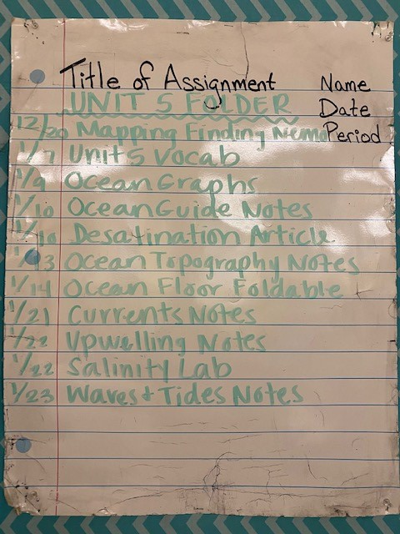
Do Now 1.30.20
Have your Unit 5 Folder out on your desk
What last minute questions do you have before we take our test?
Write down the following: I am confident, kind, capable, and deserving of an education. Write down why this is true next to this statement in your Do Now Journal.

Slide 194
Do Now 1.31.20
Pick up this week’s article from on top of the iPads
What did you find interesting or surprising?
What topic(s) relate to what we have learned in class?
What section(s) would you like to do further research on? Why?
Count your neighbor’s “Do Nows” (they should have 5!)
Turn in your wordsearch your period’s IN box.

Slide 195
Do Now 2.3.20
How can you improve your grades in your classes?
Why do you think we learn the information in Unit 5 (Oceans, floor features, currents, waves, tides, etc.) ?
What is one thing you wonder about when thinking about plate tectonics and inside the earth?
What are the four main layers of the Earth?
Make sure you have written down your homework

Slide 196
Do Now 2.4.20
1. Pick up an article from the iPad cart and read it (yes, actually read it). Answer the four questions at the end in your Do Now by writing the question and the answer down.
2. Write down the learning target and then write it in your own words: SWBAT create a model of Earth’s layers including temperature, density, thickness and composition in order to ask questions and compare and contrast the layers.
Turn in your enrichment to your period’s IN box. KEEP your remediation if you have it.

Slide 197
Do Now 2.5.20
Have your Vocabulary out on your desk for Mrs. Dwills to check (put a #1 on the top since it is the first thing in your Unit 6 Folder)
Pick up an article from the iPad cart and read it (yes, actually read it). Answer the four questions at the end in your Do Now by writing the question and the answer down.

Slide 198
Do Now 2.6.20
How do you think scientists came up with the division of the different layers of the Earth? (Why do we have 4 layers and not just one?)
How do we know what it is inside of the earth?
Why are iron and nickel in the middle of the earth and not mostly on the Earth’s crust?
Writing Thursday: Explain how Earth’s layers are like another every day object (example: how bread has thin crust like the earth). Try to think of an object that you could compare that has 4 different layers like the Earth.

Slide 199
Do Now 2.7.20
If your paper plate is finished, turn it into the front counter with your name on the back
What did you find interesting or surprising in week’s article?
What topic(s) relate to what we have learned in class?
What section(s) would you like to do further research on? Why?
Count your neighbor’s DO NOWs from week (they should have 5)

Slide 200
Do Now 2.10.20
What are the two different types of crust and how are they different?
Why does the Earth have layers?
Do you think that other planets have layers? Why or why not?
Throw Back: Today’s weather consists of a high temperature of 46 degrees Fahrenheit and rain for many days with a possibility of flooding. What front could we be experiencing and how does this front form? Draw a picture of the front’s symbol on your paper.
https://www.youtube.com/watch?v=p-vNSqUy0l4
Study your notes, we have a quick quiz that we didn’t take Friday

Slide 201
Quiz
CERT: -(item is an image)
  ANSWER: physical properties
Question: Which labeled part is thought to be composed of primarily iron and nickel?
  1: the oceanic crust
  2: the continental crust
  3: the mantle
  4: the core

Slide 202
Do Now 2.11.20
Have your Pangaea puzzle out on your desk for Mrs. Dwills to check
What causes plate tectonics to move? Draw a picture of this happening.
What pieces of evidence did Alfred Wegner have to support his hypothesis of Continental Drift?
Explain sea-floor spreading and how it happens.
List what each layer of the earth is made of.
https://www.youtube.com/watch?v=Wq9kLzm36h0
https://www.youtube.com/watch?v=_5q8hzF9VVE&t=4s

Slide 203
Density Layers of Earth Lab
Earth Material | Mass (g) | Volume (cm) | Plug into Density formula | Density
Basalt | 9 g | 3
Granite |  | 4 |  | 2.75
Iron |  | 6 |  | 7.87
Nickel | 20.47 g |  |  | 8.9
Quartz | 13.26 g | 5.1
Aluminum | 11.475 g |  |  | 2.7

Slide 204
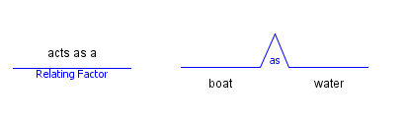
Do Now 2.12.20
Why do we have different layers of the Earth? Explain.
Fill in the bridge map
Why do plate tectonics move?
Writing Wednesday: You have been asked to speak at a conference. Write a speech about continental drift. Make sure you include the following words: convection, plates, time, fossils, puzzle, sea-floor spreading.
Turn in your density lab to your period’s IN box if you didn’t turn it in yesterday

Slide 205
Read p. 525 – 537.
Complete p. 526 #5,
p. 529 #8-9,
p. 532#14-15,
p. 536 #18-20,
p. 537 #1-10.
Then Complete p. 583-588

Slide 206
Do Now 2.13.20
When two continental plates converge, what forms? Draw a picture to show this
When two oceanic plates diverge, what forms? Draw a picture to show this
When one continental and one oceanic converge, what forms? Draw a picture to show this
What is a real world example of a transform boundary? Explain what happens there.
Have your snack tectonics lab sheet out on your desk from yesterday

Slide 207
Do Now 2.15.19
Grab this week’s article from the top of the iPad cart
What did you find interesting or surprising in this week’s article?
What topic(s) relate to what we have learned in class?
What section(s) would you like to do further research on? Why?
Count your neighbor’s “Do Nows” (They should have 5!)
If you still have your snack tectonic lab sheet, turn it into your period’s IN box

Slide 208
Do Now 2.25.19
Have your post cards out on your desk for your neighbor to see
There was a 4.4 earthquake in Napa Valley, California over the break. What most likely caused this?
How would you describe how the Red Sea formed?
The layers of the Earth are made of many different elements. Where would you expect to find the most dense materials? Why?
Iron and Nickel only have a density of about 8-9g/cm. The density of the inner core is around 13 g/cm. Why is this?
Read your neighbor’s Post Cards. Indicate what type of boundary each post card is from by writing it on their paper off to the side of each post card.

Slide 209
Your To-Do List for Unit 6 Test
Post cards
Read p. 525 – 537
  Complete p. 526 #5, p. 529 #8-9, p. 532#14-15, p. 536 #18-20, p. 537 #1-10
Unit 6 Study Guide
Complete p. 583-588
Get Unit 6 Folder in order

Slide 210
Do Now 2.26.19
Have your study guide out on your desk for Mrs. Dwills to check
Order the layers of the Earth by thinnest to thickest.
Why is the Atlantic Ocean getting bigger and the Pacific getting smaller? Draw a picture to show this.
What do you feel confident about in Unit 6?
What do you still have questions about for Unit 6?

Slide 211
Do Now 2.27.19
Have your Unit 6 Folder out on your desk
What proof did Alfred Wegner have of continental drift?
What makes plate tectonics move?
Writing Wednesday: Write a letter to a rising 6th grader preparing them for Unit 6. Explain the best, most challenging, and assignments they might complete. Include the things they will learn and WHY they are learning them.
Any last minute questions before the test?

Slide 212
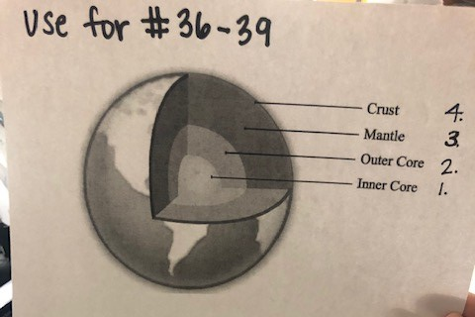
Unit 6 Test

Slide 213
Do Now 2.28.19
Turn in your word searches to your period’s IN box
What did you think you did well on for the Unit 6 Test?
What questions were you not too confident about?
How could you have prepared for yesterday’s test? How much studying did you ACTUALLY do on a scale of 1-10?
How could you “change the world” knowing the information you now know about Unit 6?

Slide 214
Do Now 3.1.19
Pick up a copy of this week’s article from the iPad cart
What did you find interesting or surprising in this week’s article?
What section(s) relate to what we have learned in class?
What section(s) would you like to do further research on? Why?
Count your neighbor’s “Do Nows” (They should have 5!)
Turn in your enrichment to your period’s IN box. KEEP your remediation if you have it

Slide 215
After your Vocab (due Friday)
Read p. 593 – 603
  P. 593 #1-3
  P. 594 #5
  P. 595 #7
  P. 597 #10
  P. 600 #14
  P. 601 # 15
  P. 602 # 16-21
  P. 603 # 1-10

Slide 216
Do Now 3.4.19
Have your Unit 7 Vocab out on your desk for Mrs. Dwills to check
Over the weekend there were many tornadoes in south Georgia. What type of front most likely came through? What other evidence do you have to support your theory?
What is the difference between inorganic and organic?
What is the difference between renewable and nonrenewable resources?
What makes something natural?

Slide 217
Do Now 3.5.19
Have your lab from yesterday out if you didn’t turn it in yesterday
Explain what type of resource sugar is and why. (natural or unnatural, renewable or nonrenewable)
Explain what type of resource water is and why.
Explain if plastic is renewable or nonrenewable.
Why are fossil fuels nonrenewable?

Slide 218
Do Now 3.6.19
Write your homework in your agenda
Leave everything packed up! We are going to the computer lab!

Slide 219
Do Now 3.7.19
Turn in your station sheet to your period’s IN box if you didn’t yesterday
If you had to explain to a kindergartener what renewable and nonrenewable resources were, what would you say?
How can you conserve paper?
What type of resource is soil? Why?
TBT: What are the phases of the moon starting with NEW moon? Draw a picture of each.

Slide 220
Do Now 3.8.19
Read p. 593 – 603
  P. 593 #1-3
  P. 594 #5
  P. 595 #7
  P. 597 #10
  P. 600 #14
  P. 601 # 15
  P. 602 # 16-21
  P. 603 # 1-10
Have your mineral uses sheet out on your desk
Make sure your textbook work is complete, if not, now is the time to get it done
When you are done grab an article for this week and answer the following questions
  What did you find interesting or surprising
  What topics relate to what we have learned in class?
  What section would you like to do further research on? Why?

Slide 221
Do Now 3.11.19
What are the 5 characteristics of all minerals?
How are rocks and minerals related?
What are the 8 different tests you can do to identify minerals?
Why isn’t color a good test to identify minerals?
If you didn’t turn in your Rock/Mineral Lab turn it into your period’s IN box

Slide 222
FLT
Log onto StudentVue
Write down your grades for each class
For each class, click on the actual number grade to get an assignment breakdown
Write down any missing assignments you have for each class
Show it to Mrs. Dwills and you may get free time

Slide 223
Do Now 3.12.19
During your research on your project, what interesting information did you find out about your mineral?
The special property that some minerals show when they come in contact with acids is called __________________ .
What can change and vary according to the impurities in that mineral as well as other factors ?
Are you content with your grades? What do you have in each class?
Reminder: tomorrow is early release!

Slide 224
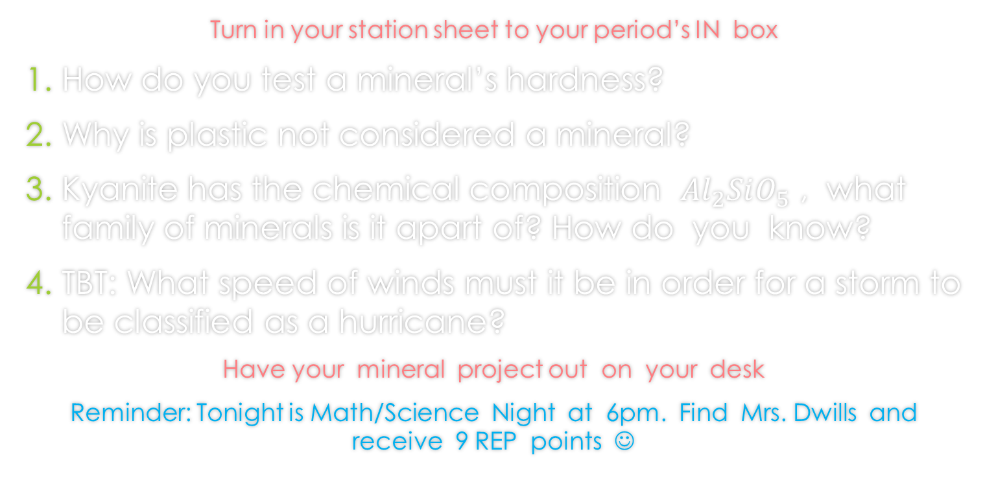
Do Now 3.14.19

Slide 225
Do Now 3.15.19
Grab textbook from the back cabinet and open to p. 440
If you don’t have a textbook, get out a blank sheet of paper
Do you need to turn in your mineral project?? Turn it into Mrs. Dwills desk

Slide 226
Do Now 3.18.19
Make a chart like the one below on a BLANK SHEET of paper
Mineral | Crystal Shape | Color/Luster | Density | Cleavage/Fracture | Hardness | Streak | Fizzes in Acid?
1.
2.
3.
4.
5.

Slide 227
Do Now 3.19.19
Make a double bubble comparing and contrasting renewable and nonrenewable resources.
How can you determine if a mineral is a silicate?
The way light bounces off a mineral’s surface is described by the mineral’s ____________________.
Leo picked up a white mineral and said it was calcite. Zack, found another mineral that was white and said it must be calcite too. What can the boys do to determine what their minerals are?

Slide 228
CHALLENGE
*Challenge: if it takes $3,500 per acre to ‘reclaim’ the land after mining, how many maximum acres could the land be?

Slide 229
Do Now 3.20.19
Have your study guide out on your desk
Is ice a mineral? Explain.
What do you feel confident about going into the Unit 7 test tomorrow?
What do you still have questions about or are confused on?
How many minutes are you going to set aside tonight to study? Who can hold you accountable for this time limit? Write this in your agenda

Slide 230
Do Now 3.21.19
What scale do we use to measure hardness?
If a mineral scratches a penny, what does that tell you?
What type of resource is paper?
Any last minute questions before the test?
Have your Unit 7 Folder out on your desk

Slide 231
Do Now 3.22.19
Grab an article from the top of the iPad cart
What did you find interesting or surprising in this week’s article?
What topic(s) relate to what we have learned in class?
What section(s) would you like to do further research on? Why?
Count your neighbor’s “Do Nows” (they should have 4)

Slide 232
Do Now 3.25.19
Turn in your enrichment to your period’s IN box, hold onto your remediation
After looking at your test analysis, what concepts did you struggle with in Unit 7?
What was your favorite part about Unit 7?
How could you “Change the World” given the information you now know from Unit 7?
TBM: Last Wednesday was the first day of Spring. What does this tell you about the Earth’s revolution, tilt, and direct/indirect sunlight?

Slide 233
Items to bring or not to bring
BRING IF NEEDED
PENCIL
Small CLEAR purses
Lunch from home in a throw away bag
Water bottle
Phone/Camera
DO NOT BRING
Book Bag
Money
Books/Binders
Anything you wouldn’t bring to school

Slide 234
FIELD TRIP DAY
Please read ENTIRELY
If you need a sack lunch from the cafeteria, go pick it up in the correct lunch line
Put your name on your lunch then put it into a box
Make sure you have all your stuff for 5th and 6th in the classroom, you will not go to your locker when we get back.
At 9:15 Miguel and Nico will go to Mr. Shaw’s room
Also at 9:15 we will line up alphabetically to head to Bus 1

Slide 235
Do Now 3.27.19
Have your Vocab out on your desk for Mrs. Dwills to check
What do you already know about rocks?
How do rocks relate to minerals?
What do you think the difference is between magma and lava?
Writing Wednesday: You discovered a new mineral! Write a story about how you found it. Describe its color, break, density, streak, luster, hardness, and special properties. Give it a name and decide what group of minerals it might be apart of.

Slide 236
Do Now 3.28.19
1. Turn

Slide 237
Do Now 3.29.19
Pick up a copy of this week’s article from the computer cart
What did you find interesting or surprising in this week’s article?
What topics relate to what we have learned in class?
What sections would you like to do further research on? Why?
Count your neighbor’s “Do Nows” (They should have 4!)
Write down your homework in your agenda

Slide 238
Do Now 4.8.19
What are the three main types of rocks?
How do scientists classify rocks? (hint: three things)
If you traveled over Spring Break, what types of rocks do you think were in those areas? If you stayed in Marietta, what types of rocks do you think are here? Why do you think this?
What do you plan to do in order to be successful in the last 6.5 weeks of school?
Reminder: did you watch your Sedimentary and Metamorphic edupuzzles over the break?

Slide 239
Do Now 4.9.19
Have your igneous rock lab out on your desk for Mrs. Dwills to check (if you put it in the inbox, get it back out to have on your desk)
Make a double bubble comparing and contrasting intrusive and extrusive igneous rocks.
Why do you think there are three different types of rocks?
Why do you think igneous rocks are the most abundant on the Earth’s crust?
Describe how igneous rocks are formed.

Slide 240
Do Now 4.10.19
Have your sedimentary rock lab out on your desk for Mrs. Dwills to check
What are the three types of sedimentary rocks?
Explain how a random rock becomes a sedimentary rock.
Give an example of each type of sedimentary rock.
Writing Wednesday: You are new crust being pushed up from the mid-atlantic ridge. Tell a story how you were formed and how you ended up a piece of sand on the beach near Savannah, GA.

Slide 241
Do Now 4.11.19
Have your metamorphic rock lab out on your desk for Mrs. Dwills to check
Make a tree map organizing the main types of each rock along with their subgroups and an example for each.
If you were a rock, which one would you be? Why?
Metamorphic rocks are formed by heat and pressure. Where does this pressure come from?
If you pick up a rock from outside and it has holes, what type of rock would it most likely be?

Slide 242
Do Now 4.12.19
Pick up a copy of this week’s article from the iPad cart
What did you find interesting or surprising in this week’s article?
What topics relate to what we have learned in class?
What section(s) would you like to do further research on? Why?
Count your neighbor’s “Do Nows” (they should have 5)
Be sure to get your edpuzzle done this weekend!

Slide 243
Do Now 4.15.19
If you brought your station sheet home, turn it into your period’s IN box
How can an igneous rock change into a metamorphic?
How can a sedimentary rock change into an igneous rock?
Why are rocks nonrenewable?
Make the tree map about the 3 different types of rocks, their subgroups, and an example. Try not to look at your notes!
Make sure you completed your edpuzzle and know your test is on Wednesday

Slide 244
Do Now 4.16.19
Why isn’t the word ‘cycle’ the best fit for the concept of the ‘Rock Cycle’ that we have been learning about?
How do we classify rocks?
Would location in which the rock was found be an important piece of evidence in identifying a rock? Why or why not?
What information and concepts are you going to study this evening for your test?
What materials can you use to study for your test?

Slide 245
Agenda
Rock Cycle Visual/Brainpops
Finish rock cycle journey
Comic: needs to be colored
Crossword puzzle/Taken for Granite sheet
Review for test using notes, make flash cards, kahoot if enough students are done and have devices available

Slide 246
Do Now 4.17.19
Have your crossword/taken for granite questions out on your desk
(Turn in your comic to the front counter if you still have it)
If an igneous rock contains silicon or aluminum and is light in color, how can we describe this rock?
If an igneous rock contains calcium, iron, or magnesium and is dark in color, how was we describe this rock?
Make the rock tree map one more time WITHOUT looking at your notes.
Any last minute questions before we take the test?
You will need a PENCIL for the test

Slide 247
Do Now 4.18.19
Turn in completed word searches to your period’s IN box
What questions stick out to you from the test that you didn’t feel 100% confident about?
What questions did you feel good about and know you got right?
Although weathering is a destructive force, it does make something. What does it make?
How do you think weathering can happen?

Slide 248
Do Now 4.19.19
Have your vocab out on your desk for Mrs. DWills to check
What did you find interesting or surprising in this week’s article?
What topic(s) relate to what we have learned in class?
What section(s) would you like to do further research on? Why?
Review: what kind of front moved through Marietta last night? How do you know? Draw what it would look like on a weather map.
Count your neighbor’s “Do Nows” (they should have 5)

Slide 249
Do Now 4.22.19
Compare and contrast weathering and erosion.
Does weathering have to take place in order for igneous rocks to form? Why or why not?
Make the weathering tree map ☺

Slide 250
Do Now 4.23.19
What is the difference between mechanical and chemical weathering?
Why do you think we learn about weathering, erosion, and deposition?
What’s your favorite example of weathering (can be a mechanical or chemical example)? Why is it your favorite?
Make the erosion tree map, add pictures this time.
Study for your weathering tree map quiz when finished

Slide 251
Do Now 4.29.19
Have your WED Inquiry Station sheet out on your desk for Mrs. Dwills to check
Draw a picture showing weathering, erosion, then deposition.
How are erosion and deposition different? List at least three differences.
Describe how deltas are formed.
Describe how till deposits are formed.

Slide 252
Do Now 4.30.19
Have your buying the farm sheet out on your desk
Why is soil important?
Why are there different layers of soil?
What do humans do to speed up erosion? (Hint: 4 things)
If a farmer was having problems with wind erosion, what would you recommend he or she do?

Slide 253
Do Now 5.1.19 (it’s gonna be May)
Turn in your “Diamond Del” form to Mrs. Dwills desk (Do this by FRIDAY!)
A farmer is having trouble with his seeds washing away in the rain, what do you recommend he/she do?
Draw a picture showing the soil horizons. Label them with their name and their composition.
What are the ingredients for the perfect soil? What is this perfect soil called?
Writing Wednesday: Write a letter to a dust bowl family as if you were writing it to them right when it started. Give them advice, explain to them the effects they may face, and give them a solution.

Slide 254
Do Now 5.2.19
Remember your Unit 8 Part 2 Test is Wednesday
Explain how a sandbar is made.
Explain how a barrier spit is made.
What soil conservation technique did you choose to help prevent the Dust Bowl? Explain in detail why you chose this technique and not others.
Ms. Colacicco has planted tomatoes in her garden for years. Recently, she’s noticed that she has puddles in her garden, but even where there aren’t puddles, her tomatoes still aren’t growing. What is your advice to her?

Slide 255
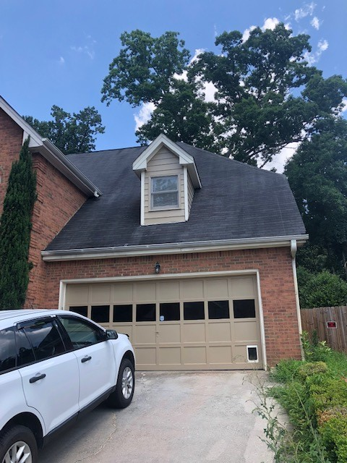
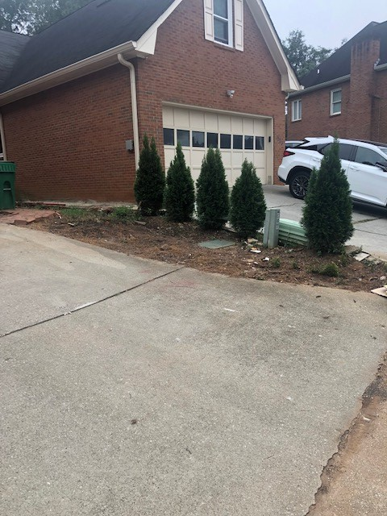
Mrs. Dwills dilemma

Slide 256
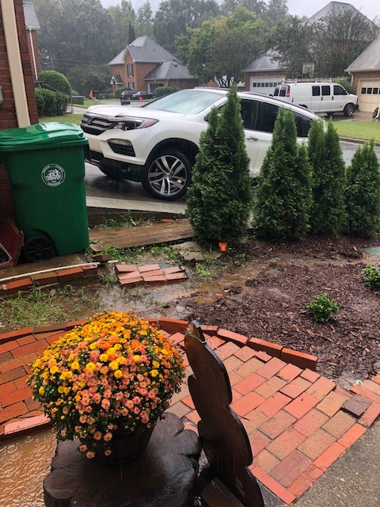
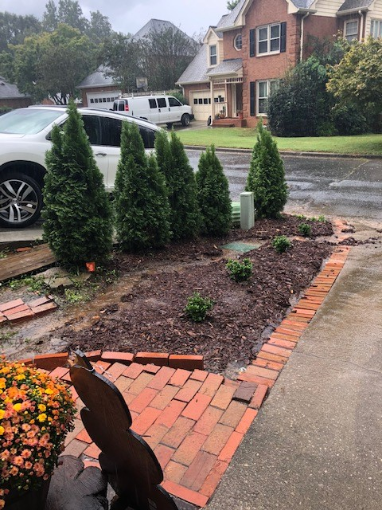
Mrs. Dwills dilemma

Slide 257
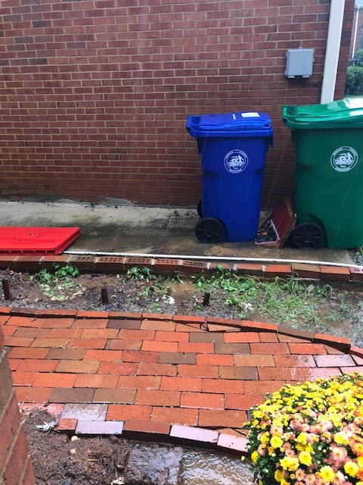
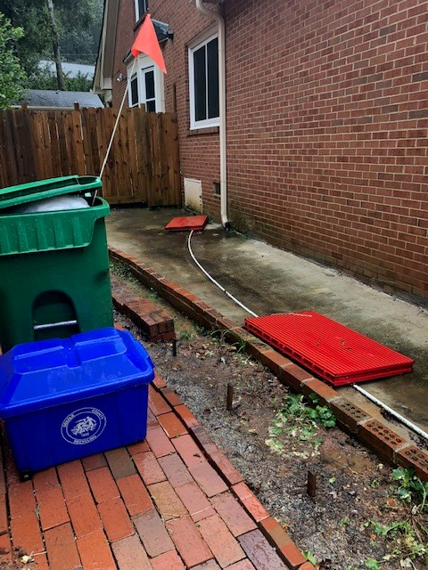
Mrs. Dwills dilemma

Slide 258
Do Now 5.3.19
Turn in your WED inquiry stations to your periods’ IN box
Pick up a copy of this week’s article from Mrs. Dwills desk
What did you find interesting or surprising in this week’s article?
What topics relate to what we have learned in class?
What section would you like to do further research on? Why?
Count your neighbor’s “Do Nows” they should have 5!

Slide 259
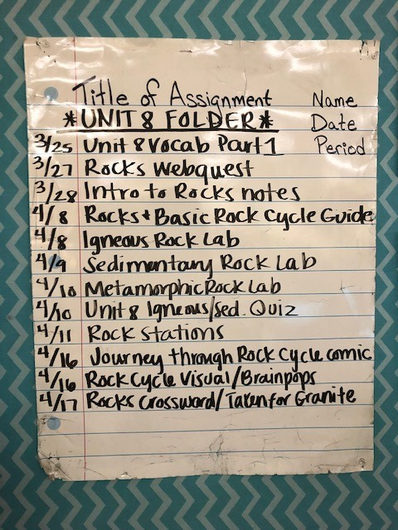
Do Now 5.8.19
Have your Unit 8 Folder out on your desk along with your milestone review booklet
What makes up soil?
What are the layers of soil starting from the surface?
Make the erosion tree map.
What last minute questions do you have before we take our test?

Slide 260
Agenda
Study Guide
Test
Booklet (if not done, will be graded for accuracy)
Sign up for one unit in the back that you think you need the most help with before the final
  Unit 1: Astronomy
  Unit 2: Earth, Moon, Sun
  Unit 3: Meteorology
  Unit 4: Water Distribution, Water Cycle
  Unit 5: Oceans, Currents, Waves, Tides
  Unit 6: Layers of Earth, Plates, Boundaries
  Unit 7: Natural Resources, Minerals
  Unit 8: Rocks, Rock Cycle, Soil

Slide 261
Do Now 5.9.19
Have your science booklet out on your desk
What do you feel you struggled with on the Unit 8 part 2 test?
What do you think you did well on?
How could you “change the world” based on what you learned in Unit 8 Part 2?
What Unit did you chose to focus on during our review? Why?

Slide 262
Do Now 5.10.19
Grab an article from the front counter
What did you find interesting or surprising in this week’s article?
What sections relate to what we have learned in class?
What section(s) would you like to do further research on? Why?
Count your neighbor’s Do Nows. They should have 5!
Your science booklet is your ticket INTO the door when we go to the lab, so have it ready.

