Slide 1
Do Now 2019-2020
Thanksgiving Break Check

Slide 2
Do Now
Write your FIRST and LAST name on the lined side of your index card
Write three words describing how you would like to be remembered when you leave 6th grade ON THE BLANK SIDE
Write a goal you’d like to achieve by the end of 6th grade on the LINED SIDE
Color it, decorate it with pictures :)
DON’T SHARE IT WITH YOUR NEIGHBORS
Example: Ms. Dudek #inspiring #thoughtprovoking #challenging

Slide 3
DO NOW Identify the unsafe behaviors in the chemistry lab. In your Do Now Journal, or on a separate piece of paper, make a list of each safety infraction that is found and explain why it is an unsafe behavior in the lab.

Slide 4
Do Now
Have your circle map out on your desk for Mrs. Dwills to check
Come up with an idea to CHANGE THE WORLD!!
1. Come up with a problem that you see that you feel strongly about
2. Come up with one solution that you think would work
3. Now come up with two other solutions that may work too

Slide 5
Do Now
1. What do you think the most important lab safety rule is? Why?
2. What rule do you think is going to be hardest for you to follow? Why?
3. What sort of rules do you think we should have for using technology at school? Try to come up with at least 5
4. What are you looking forward to most in 6th grade?

Slide 6
Do Now
Have your Lab Safety Scientist out on your desk
When can you use your locker?
When can you use the restroom?
When you use the restroom, what must you have with you?
What do you think a triple beam balance is? What do you think it’s used for?
THINK: What is different between the metric and customary systems?

Slide 7
Do Now 8.9.19
Pick up a copy of this week’s article from the side table
What did you find interesting or surprising in this week’s article?
What topics relate to what we have learned in class?
What section(s) would you like to do further research on? Why?
Count your neighbor’s “Do Nows”, they should have 5! (8/5, 8/6, 8/7, 8/8, 8/9)

Slide 8
Do Now 8.12.19
What did you do over the weekend?
Now take what you did over the weekend and condense it to ONE word (only ONE!!)
Name at least 5 other people in this class except yourself (without talking to anyone)
Write down your neighbor’s favorite food (without talking to them)
What do you think the purpose of pre-tests are?
Did you complete your edpuzzles from last week? If so, make sure your work is in your science folder.

Slide 9
Do Now 8.13.19
If you have a COMPLETED Bubble Gum Lab, place it on the counter up front
What did you already know on the SGM pre-test?
What did you not know on the SGM pre-test?
Now that you have taken, the SGM, what are you most excited about in 6th grade Science to learn?
What is an important rule in the Cafeteria that you might want to remember?

Slide 10
Do Now 8.14.19
If you didn’t turn in your bubble gum lab, turn it into the front now!
What do you think is going to be your biggest challenge this year?
What days are Science Tutoring sessions held?
Why do you need 9 folders for the year in Science?
What is occurring tomorrow evening at East Cobb Middle?
If you’re in here during a fire drill, where do you go and where do we line up and wait for Mrs. Dwills?

Slide 11
Do Now 8.15.19
Writing Wednesday (even though it’s Thursday):
Write a letter to your future self for the last day of school. What do you want them to know? What do you hope to accomplish by then? What are you currently excited about? What are you curious about?

Slide 12
Do Now 8.16.19
Pick up a copy of this week’s article from the side table
Have your vocab out on your desk for Mrs. Dwills to check
What did you find interesting or surprising in this week’s article?
What topic(s) relate to what we have learned in class?
What section(s) would you like to do further research on? Why?
Count your neighbor’s “Do Nows”, make sure they have their writing Wednesday (8/12, 8/13, 8/14, 8/15, 8/16)

Slide 13
Do Now 8.19.19
After looking at the vocabulary for Unit 1, what are you most excited to learn more about?
Explain heliocentric and geocentric theories in your own words.
Draw a picture of each model in your ‘Do Now’ journal.
Explain the big bang theory in your own words
Be sure to write your homework in your agenda for today!
When you are done, grab a copy of the notes from the front desk and turn in your Origin of the Solar System Performance Task (from Friday)

Slide 14
Do Now 8.20.19
What is the main difference between Geocentric and Heliocentric?
Why do you think people believed in theories that were completely incorrect during early cultures?
What is the name of the galaxy that we live in?
Why is it important to use Science and Engineering practices instead of “thought” and “wisdom”?
Be sure to write your homework in your agenda for today!
When you are done, grab a copy of the notes from the front desk

Slide 15
Do Now 8.21.19
What are the three types of galaxies?
What determines the shape of a galaxy?
Order the following from BIGGEST to SMALLEST: Plant Cell, The Universe, Atlanta, Milky Way Galaxy, Solar System, Earth, Jupiter
Explain redshift in your own words
Writing Wednesday: Create your own story about how the universe and our solar system were formed
Be sure to write down the HOMEWORK in your agenda

Slide 16
Do Now 8.22.19
Why is gravity important?
Does Earth just need gravity in order to stay in orbit? Explain
How can gravity decrease between the Sun and Earth? List the ways
Do you think Mercury has more or less gravity than the Earth? Explain
Be sure to write down your homework in your agenda

Slide 17
Do Now 8.23.19
Pick up a copy of this week’s article from the side table
What did you find interesting or surprising?
What topic(s) relate to what we have learned in class?
What section(s) would you like to do further research on? Why?
Count your neighbor’s Do Nows and put the number on their paper (they should have 5!)
Turn in your Virtual Lab sheet from yesterday if you haven’t already

Slide 18
Do Now 8.26.19
Explain how to increase gravity on a planet.
If we moved Earth closer to the Sun, what would change?
Compare Neptune’s year with Earth’s year. Which is longer, which is shorter and why?
Compare Venus’ gravity with Jupiter’s gravity. Which is stronger, which is weaker and why?
Be sure to write down your homework in your agenda!
Turn in your Gravity and Orbit lab sheet to the front counter if you did not turn it in last week
http://joshworth.com/dev/pixelspace/pixelspace_solarsystem.html

Slide 19
Do Now 8.27.19
List the planets in order starting from the Sun
What are the requirements for being a gas giant?
Why is Venus the hottest planet?
Which planets have no moons?
Thinking Tuesday: Is there gravity in space? Explain.
Write down your homework ☺
https://www.youtube.com/watch?v=qnzquEOMLGU

Slide 20
Do Now 8.28.19
Pick up a copy of the sheet for today on the front counter and put your name on it!
Leave everything else packed. You will need to bring a pencil and a clipboard along with your sheet.

Slide 21
Do Now 8.29.19
Have your ‘Stepping into the Solar System’ sheet on your desk
What is the difference between heliocentric and geocentric? Draw a picture of each to show your understanding
What is the difference between gravity and inertia?
What is a theory?
What is a piece of evidence that supports the Big Bang Theory?
Grab a copy of the notes from the front counter

Slide 22
Do Now 8.30.19
Pick up a copy of this week’s article from the side table
What did you find interesting or surprising?
What topic(s) relate to what we have learned in class?
What section(s) would you like to do further research on? Why?
Count your neighbor’s Do Nows and put the number on their paper (they should have 4!)
1st and 3rd Period: Have your comic strip out on your desk with your name on it

Slide 23
Do Now 9.3.19
What is the difference between meteors, meteoroids, and meteorites?
What are Saturn’s rings made of?
Uranus is different from most planets because why?
Aside from Earth, which other inner planet had water on its surface?
Order the planets from biggest to smallest

Slide 24
Do Now 9.4.19
1. Make a double bubble comparing and contrasting the inner and outer planets
2. What do you still need help with in Unit 1?
3. What makes Earth able to sustain life? Try to list as many characteristics as you can.
4. What are you going to do this evening to prepare for the test tomorrow?

Slide 25
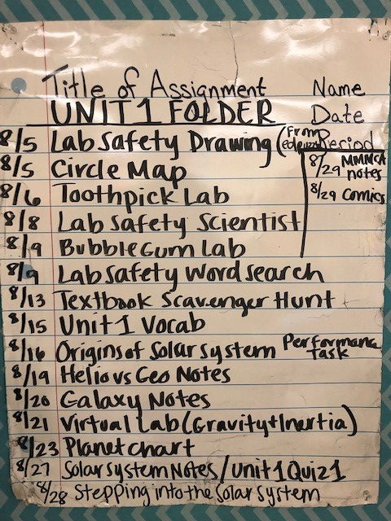
Do Now 9.5.19
Write down any last minute questions you have before we take the test.
Get out your science folder and make sure it is organized. If you are missing something, that is okay. Skip it and go on to the next one.
Be ready to turn in your folder that should have your FIRST AND LAST NAME on the front along with ‘Unit 1’. Sharpies are on the front counter if you need them
Have your planet booklet out and ready

Slide 26
Do Now 9.6.19
Pick up a copy of this week’s article from the side table
What did you find interesting or surprising?
What topic(s) relate to what we have learned in class?
What section(s) would you like to do further research on? Why?
Count your neighbor’s Do Nows and put the number on their paper (they should have 3 or 4!)
Turn in your completed word search to your period’s IN box to get house points

Slide 27
Do Now 9.9.19
Turn in your Math Connections (enrichment) sheet to your period’s IN box. If you have remediation KEEP IT!
What do you think you did well on in Unit 1?
What do you think you had difficulty with in Unit 1?
Now that you have finished a Unit in 6th grade Science, what do you think you’ll do differently in Unit 2?

Slide 28
Do Now 9.10.19
Have your vocabulary out on your desk for Mrs. Dwills to check
1. Name the moon phases starting with ‘new moon’ (hint: there are 8)
2. Why do you think we have seasons?
3. What vocabulary term did you have the hardest time with?
4. What are you looking forward to in Unit 2 since you have already previewed the vocabulary?

Slide 29
Do Now 9.11.19
If you didn’t turn in your Vocab yesterday, turn it in to Mrs. Dwills desk
Writing Wednesday: Write a story about a trip to explore either the North Pole or the South Pole. Describe conditions such as the amount of sunlight and the temperature, and include an explanation for why those conditions exist.

Slide 30
Do Now 9.16.19
So the tilt of the Earth causes seasons… so when do we have summer? Explain why.
What causes a day on Earth?
What causes a year on Earth?
If we experience Summer in June in the United States, what do you think Australians experience in June? Explain. Draw a picture if you need to
Grab your seasons chart from the back of the room and make sure it is filled in.

Slide 31
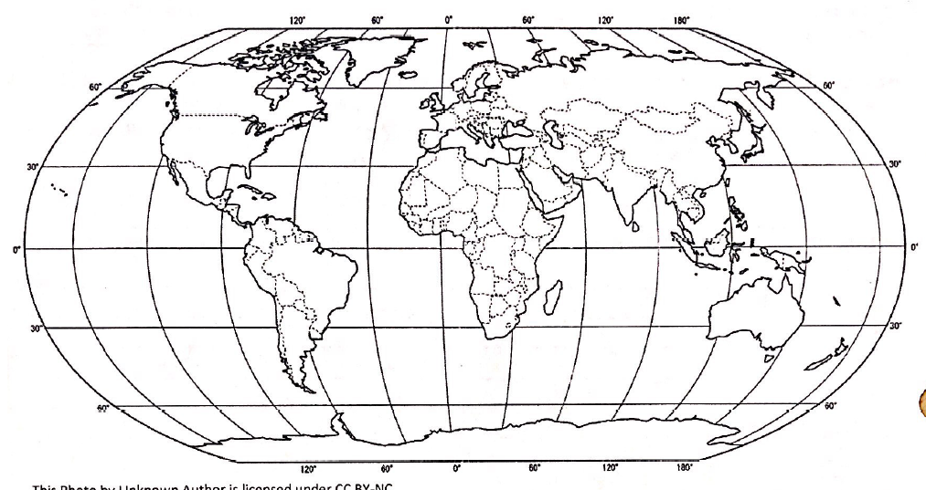
Do Now 9.17.19
Get out your graphs and your Seasons lab sheet. Complete the analysis questions on the back
Conclusion: What affects the temperature of an area the most? Use R.A.C.E (restate the question, answer, cite the evidence, explain the evidence) to write your conclusion. DO THIS ON A SEPARATE SHEET OF PAPER.
A C
Q
M
When you are done, turn it in to get your next assignment

Slide 32
Do Now 9.18.19
Writing Wednesday: Your family decides they are moving across the world! Choose one of the following cities below to move to and describe their seasons, and what you expect to experience when you move (daylight, seasons, temperature)
Paris, France 48.8 degrees NORTH
Cape Town, South Africa 33.9 degrees SOUTH
Moscow, Russia 55.7 degrees NORTH
Singapore, Malaysia 1.4 degrees NORTH
***Decide what months would be best to use solar panels in your new country in order to power your new home

Slide 33
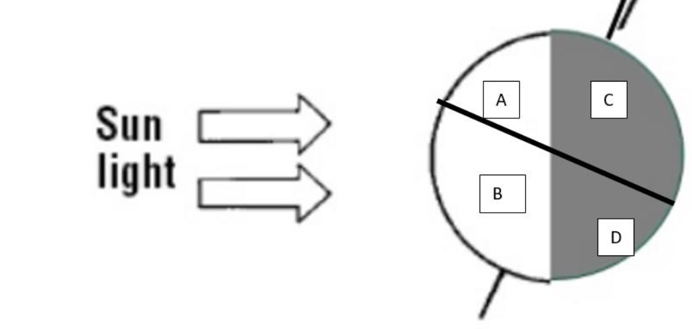
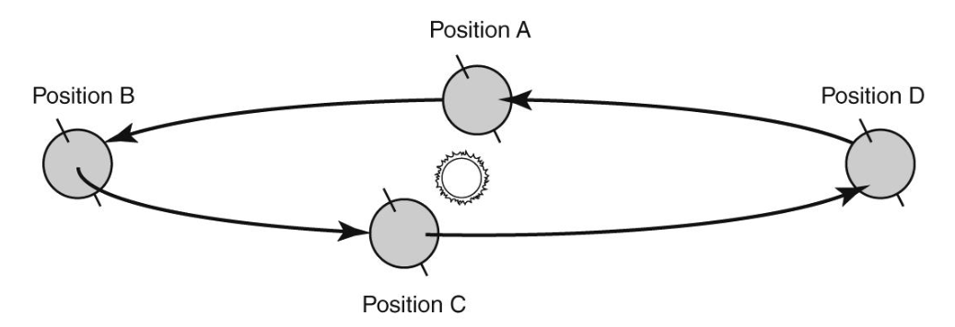
Do Now 9.19.19
Which two letters represent winter? Explain
2. The tilt of Earth at four different times throughout the year is shown in the diagram. At which point would the United States receive the fewest hours of daylight?
3. Why do we see different phases of the moon throughout the month?
4. Draw a picture showing how you think the sun, moon and earth are aligned for NEW MOON to be seen
*Are you keeping up with your moon calendar?? Be sure to write it in your agenda to remind yourself

Slide 34
Do Now 9.20.19
Grab an article from the side table
What did you find interesting or surprising in this week’s article?
What topic(s) relate to what we have learned in class?
What section(s) would you like to do further research on and why?
Count your neighbor’s “Do Nows” (They should have 4)

Slide 35
Do Now 9.30.19
Have your Oreo Lab Sheet out on your desk
Create a double bubble comparing and contrasting solar and lunar eclipses
Why does a solar eclipse rarely happen?
What is the difference between a penumbra and an umbra when talking about eclipses?
When do spring and neap tides happen? (hint: look at your vocabulary)
Mrs. Dwills was on the lake on Saturday and driving a boat at night back from dinner. It was SO dark she had to use cell phones to see where the boat was going. Why was it so dark?
*Write your homework in your agenda
*Reminder: Bring empty toilet paper rolls to Mrs. Brown’s room this week if you have any

Slide 36
Do Now 10.1.19
What causes seasons? Explain how this works.
What is tidal range? (hint: look at your vocab)
What is the main difference between Spring and Neap tides?
Draw a picture of 4 different phases of the moon. Switch with your neighbor and have them write down what they think each phase is.

Slide 37
Do Now 10.2.19
How many high tides do we have a day? How many low tides?
How often do Spring and Neap Tide occur?
If the United States is having Fall, what season is happening in Brazil?
When is the Fall equinox? What does this mean?
What items are you going to use to study for tomorrow’s test?

Slide 38
Do Now 10.3.19
Write down any last minute questions you have before we take the test.
Get out your science folder and make sure it is organized. If you are missing something, that is okay. Skip it and go on to the next one.
Be ready to turn in your folder that should have your FIRST AND LAST NAME on the front along with ‘Unit 2’. Sharpies are on the front counter if you need them

Slide 39
Do Now 10.4.19
Grab an article from the side table for this week
What did you find interesting or surprising?
What topics relate to what we have learned in class?
What section(s) would you like to do further research on? Why?
Count your neighbor’s Do Nows, they should have 4!
Turn in your completed word search into your period’s IN box for house points
*Write down your homework in your agenda

Slide 40
Do Now 10.7.19
Have your completed MOON CALENDAR out on your desk
Think back to the Unit 2 Test on Thursday, what do you think you struggled with?
Name one thing you did over the weekend to better yourself for school?
What is one goal you have for October?
Our next Unit is over Meteorology, what do you think that means?
If you have remediation, have it ready and completed on your desk. If you have enrichment (math connections), turn it into your period’s IN box
*Be sure to write your HW down in your agenda

Slide 41
Do Now 10.8.19
Have your Vocabulary out on your desk for Mrs. Dwills to check
What vocabulary terms did you already know on your list?
What term gave you the hardest time?
What gases make up the air we breathe?
How do you think the air we have on Earth stays on Earth and doesn’t float away?
Remember to regularly check your REP Points. Most students received points today because they watched their Edpuzzle on time.

Slide 42
Do Now 10.9.19
Have your atmosphere practice sheet out on your desk from yesterday
Besides nitrogen, oxygen, carbon dioxide and argon, what else is in our air?
Why is our atmosphere important?
How does Earth still have an atmosphere?
What is the greenhouse effect?

Slide 43
Do Now 10.10.19
The atmosphere is divided into 4 main layers. Which one contains the most mass? Why?
Atmospheres in our solar system are different for each planet. If a planet had a THICK atmosphere, what would you expect the temperature and gravity to be like? (Cold, Hot, Strong, Weak)
Out of the following choices, which molecules would trap the MOST heat? Why?
Oxygen
Nitrogen
Carbon dioxide
Ozone Layer (three oxygen atoms)
What do you think humans do that speed up Global Warming?
How do we get more greenhouse gases into our atmosphere? Is this good or bad?

Slide 44
Do Now 10.11.19
Grab an article from Mrs. Dwills Chair, return it when you are done
What did you find interesting or surprising in this week’s article?
What topic(s) relate to what we have learned in class?
What section(s) would you like to do further research on? Why?
Count your neighbor’s Do Nows (They should have 5!)
Have your double bubble out on your desk for Mrs. Dwills to check

Slide 45
Do Now 10.14.19
After heat is radiated from the Sun, where does it go after?
Explain how convection works in a lava lamp.
Why do you think the “heart” of all weather is HEAT?
Name the four layers of the atmosphere starting from the bottom. Which ones get warmer the higher you go in altitude?

Slide 46
Do Now 10.15.19
Have your heat transfer foldable out on your desk
Why is our atmosphere important? (Try not to look at previous Do Nows)
How is conduction different than convection?
Besides the atmosphere, where else do you think convection occurs?
Pick up a Lab sheet from the front counter and read through the first page. Get ready to make your hypothesis!

Slide 47
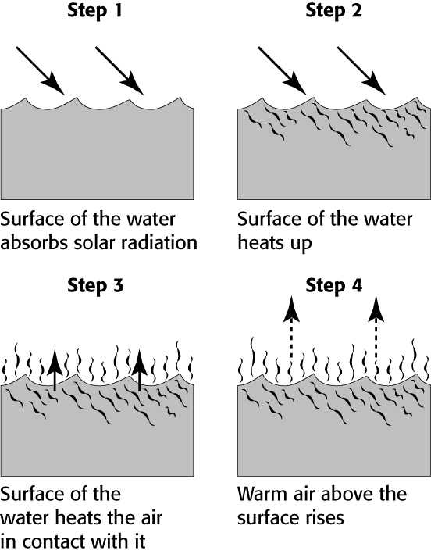
Do Now 10.16.19
As water is heated by the sun, it becomes less dense and rises. What causes the decrease in the density of warming water?
Leanne created the following diagram to show the process that warms the air above a lake. She decided to label each step with the energy transfer that is happening. Which step represents CONDUCTION?
As altitude increases, what happens to the
pressure of the air? Why?
4. What happens when two objects of
different temperatures touch? How does the
temperature change? (Hot particles move
to cold, or cold particles move to warm)

Slide 48
Do Now 10.17.19
Which substance has higher specific heat: sand or water? Explain.
What is the difference between a coastal and inland region? Give an example of each.
Which object would you expect to be warmer during the day: the beach, or the ocean?
Which object would you expect to be warmer during the night: the beach or the ocean?
Remember: you have a WINDS EDPUZZLE due tomorrow!

Slide 49
Do Now 10.18.19
Grab this week’s article from Mrs. Dwills chair
What did you find interesting or surprising in this week’s article?
What topic(s) relate to what we have learned about in class?
What section(s) would you like to do further research on? Why?
Count your neighbor’s Do Nows (they should have 5!)
Have your Land and Water Sheet out on our desk for Mrs. Dwills to check

Slide 50
Do Now 10.22.19
Draw a picture of a land breeze. Be sure to include arrows, high and low pressure, and if it is day or night.
Draw a picture of a sea breeze. Be sure to include arrows, high and low pressure, and if it is day or night.
Make a double bubble comparing and contrasting Land and Sea Breezes.
How do you think land and sea breezes effect the overall climate of an area?
Points for completing the edpuzzle on time will be added today! Good job guys ☺

Slide 51
Do Now 10.23.19
What global wind is located between 60 degrees and 30 degrees latitude?
If the world stopped spinning, how would winds be effected?
What three things effect air pressure (look at your study jams from yesterday if you cannot remember)?
Why does air rise over the land at the beach during the day?
Compare and contrast high and low pressure systems? (You don’t need to make a double bubble, but you need at least two differences and two similarities)

Slide 52
Do Now 10.24.19
The air above the Earth’s surface is at different temperatures. What is responsible for the difference in temperature?
What is the jet stream and where is it located? How do you think this influences weather?
Because of the Coriolis effect, how to winds tend to move in the northern hemisphere? How is this different in the southern hemisphere?
How would you describe the winds near the equator?

Slide 53
Do Now 10.25.19
Grab an article from the side table for this week
What did you find interesting or surprising in this week’s article?
What topic(s) relate to what we have learned in class?
What section would you like to do further research on? Why?
Count your neighbor’s ‘Do Now’s’ (they should have 4!)

Slide 54
Do Now 10.28.19
If we were able to survive on another planet, what would it’s atmosphere have to be composed of?
A pot is on the stove and the handle is heated. What type of heat transfer is happening?
Name the four main layers of the atmosphere and describe each in one word
Throw back: Order the planets from biggest to smallest ☺

Slide 55
Do Now 10.29.19
Have your air pressure lab out on your desk for Mrs. Dwills to check
What is the difference between a warm and a cold front?
Where do continental tropical air masses originate from?
Air always moves from _______ pressure to ______ pressure.
Yesterday was extremely foggy in the morning. How would you describe the air pressure?
If a cold front moves in and it is below 32 degrees Fahrenheit, what will most likely happen?
What always happens at a front?

Slide 56
Do Now 10.30.19
Have your storm planning sheet out on your desk
Which type of heat transfer do you think is most important? Why?
A barometer measures air pressure. Imagine that the barometer in Miami is falling. What does this indicate about the weather?
Condensation is part of the water cycle. During condensation, water vapor cools and changes from a gas to a liquid. What happens when this process occurs near Earth’s surface?
What global winds are located 30 degrees N latitude and 30 degrees S latitude?
Why do weather systems usually move from west to east across the United States?

Slide 57
Do Now 10.31.19
Make a diagram of a land breeze WITHOUT looking back at your notes
Make a diagram of a sea breeze WITHOUT looking back at your notes
What is air made of?
What is the purpose of the ozone layer?
WRITING WEDNESDAY (on a Thursday): Write a story starting with the following: “Today the sun burned out…”
This Photo by Unknown Author is licensed under CC BY-SA-NC

Slide 58
Do Now 11.1.19
4th period: have your storm planning sheet out on your desk. Once you have this on your desk, grab a laptop.
Group 4 & 5: grab from Cart B
Group 1, 2 & 3: grab from Cart A

Slide 59
Do Now 11.1.19
Pick up this week’s article from the side table
What did you find interesting or surprising?
What topic(s) relate to what we have learned in class?
What section(s) would you like to do further research on? Why?
Count your neighbor’s “Do Nows” (They should have 5!)

Slide 60
Do Now 11.4.19
What type of air pressure is associated with tornadoes? Hurricanes? Blizzards? Thunderstorms?
Why do we have wind?
What type of air masses are needed for a cold front?
What type of front do you think causes a blizzard? What about a hurricane?

Slide 61
Do Now 11.6.19
What is an air mass?
What two air masses do you think we experience the most in Atlanta?
The jet stream is formed by two air masses colliding. What kind of air masses do you think they are?
It’s getting colder outside, why do you think that is happening?
Why do winds tend to curve?
How is distance away from the equator and temperature related?

Slide 62
Do Now 11.7.19
What is a front?
Name all the global winds starting from the North pole and ending at the South pole.
Describe an occluded front
A storm surge is an effect of what type of severe weather event? Describe what this is.
Describe the eye of a hurricane.
Water vapor is an important part of all storms. How can you add more water vapor to the air? (Hint: increase or decrease the temperature?)

Slide 63
Do Now 11.8.19
Pick up a copy of this week’s article from Mrs. Dwills desk
What did you find interesting or surprising?
What topic(s) relate to what we have learned in class?
What section(s) would you like to do further research on? Why?
Count your neighbor’s “Do Nows” (They should have 4!)

Slide 64
Do Now 11.11.19
Now that we are about done with presentations, what questions do you have about severe weather events?
What type of air masses are needed for each severe weather event?
Where do tornadoes happen the most? Why?
Where do hurricanes happen the most? Why?
What is so devastating about blizzards?

Slide 65
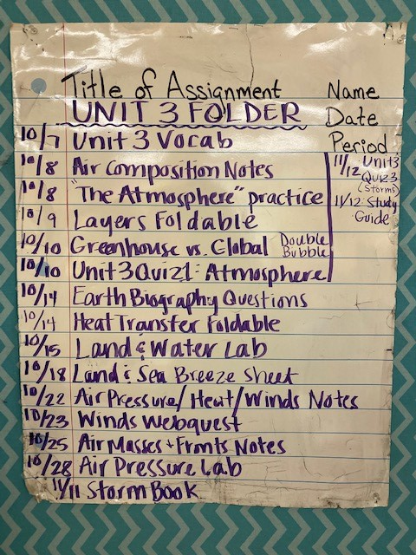
Do Now 11.13.19
As you were looking through your Unit 3 assignments last night to get your folder in order, what questions do you have?
Why do we have wind?
What are you thankful for today?
Have your Unit 3 Folder out on your desk

Slide 66
Do Now 11.14.19
What concepts were difficult to you on the Unit 3 test?
What concepts did you feel confident about going into the test?
Why do you think Unit 3 is one of the most difficult?
What sort of information could you have used to study?
Turn in your COMPLETED word search to your period’s IN box

Slide 67
Do Now 11.18.19
Have your vocabulary out on your desk for Mrs. Dwills to check
What vocabulary words did you already know?
What vocabulary words are you excited to learn about?
There was a lot of fog this morning, why do you think that happens?
Explain how you think a hot air balloon works.
Remember you are turning in your Do Now Journal Friday

Slide 68
Do Now 11.21.19
Writing Wednesday (on a Thursday):
Suppose you were in a hot air balloon that could fly up through the atmosphere while feeling the temperature and air pressure change around you. Describe your trip in a paragraph, naming the four main atmospheric layers and telling how the temperature and air pressure change as you pass through each.

