Slide 1
Groundwater

Slide 2
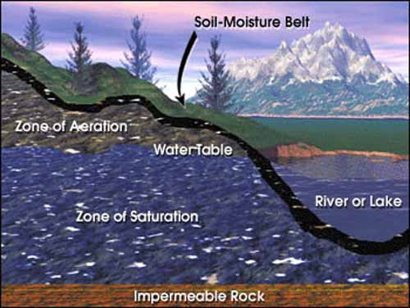

Slide 3
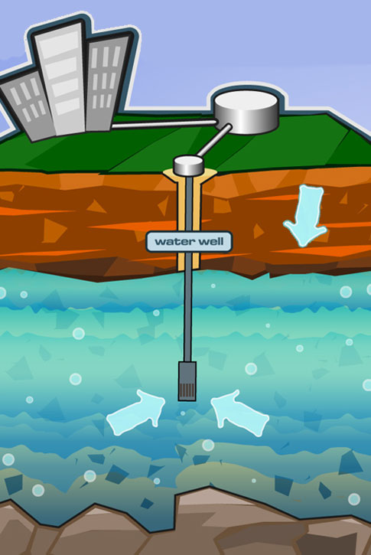
Label:
aquifer
water table
impermeable layer
zone of saturation
zone of aeration,
recharge area

Slide 4
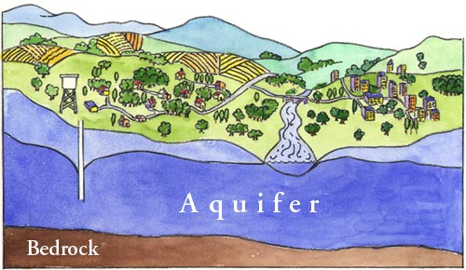
What are aquifers, and why are they important?
Part of the saturation zone where water can be pulled out for
Drinking (50% in U.S.)
Farming (40% in U.S.)

Slide 5
How do aquifers get their water?
Aquifers are replenished naturally by precipitation that percolates/infiltrates downward through the soil and rock in what is called a natural recharge.
Ex: our fields and parks are recharge areas
Parking lots and building are not recharge areas

Slide 6
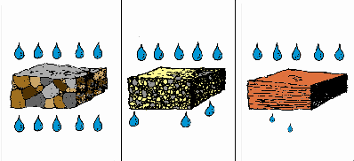
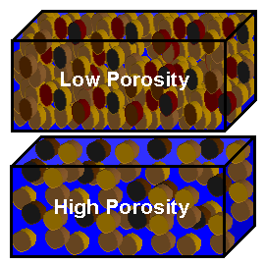
Porosity
amount of open spaces (pores) between the rock particles
due to size of particles
Permeability
rock’s ability to let water pass through
impermeable=rocks that stop the flow of water
very
permeable
Almost
impermeable

Slide 7
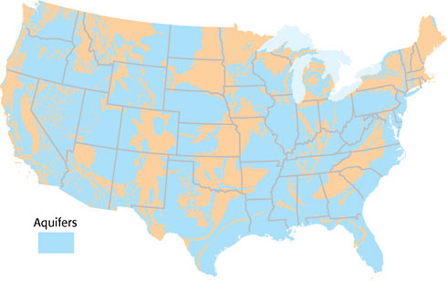
Currently groundwater in the United States is being withdrawn at four times its replacement rate. Some aquifers get very little (if any) recharge.
U.S.
aquifers

Slide 8
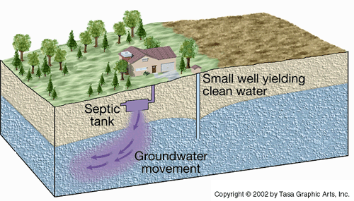
Pollution of groundwater (leaching)

Slide 9
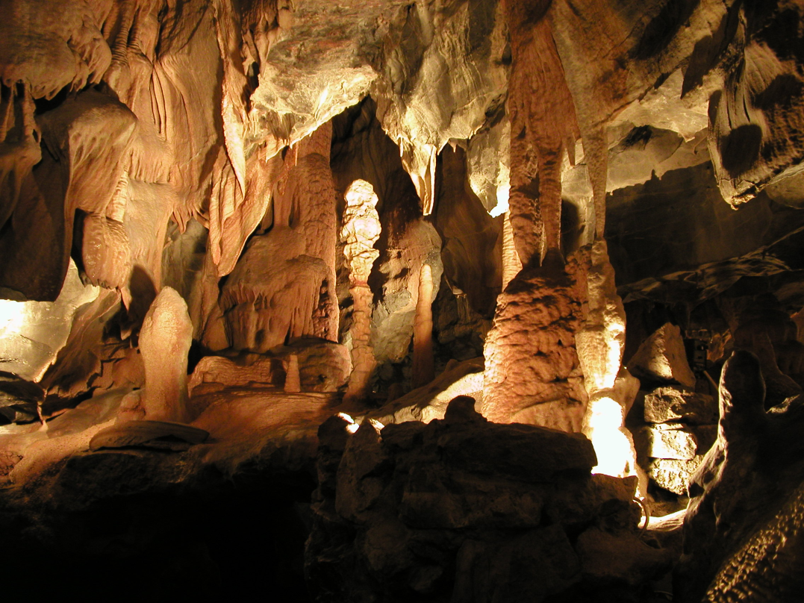
Caves (also called caverns):
many formed by chemical weathering (acid in groundwater) of rocks like limestone
Others are created by:
>volcanic action
>ocean waves
>erosion from streams
>glaciers

Slide 10
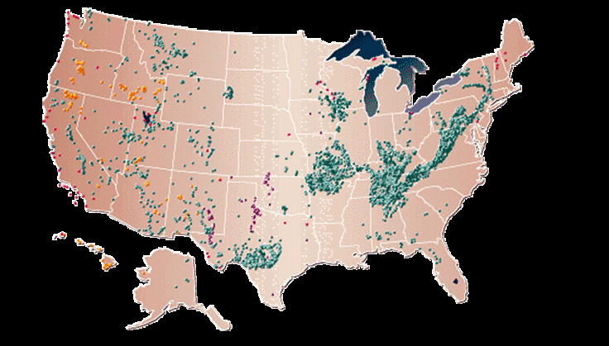
Cave locations (over 500 in GA):

Slide 11
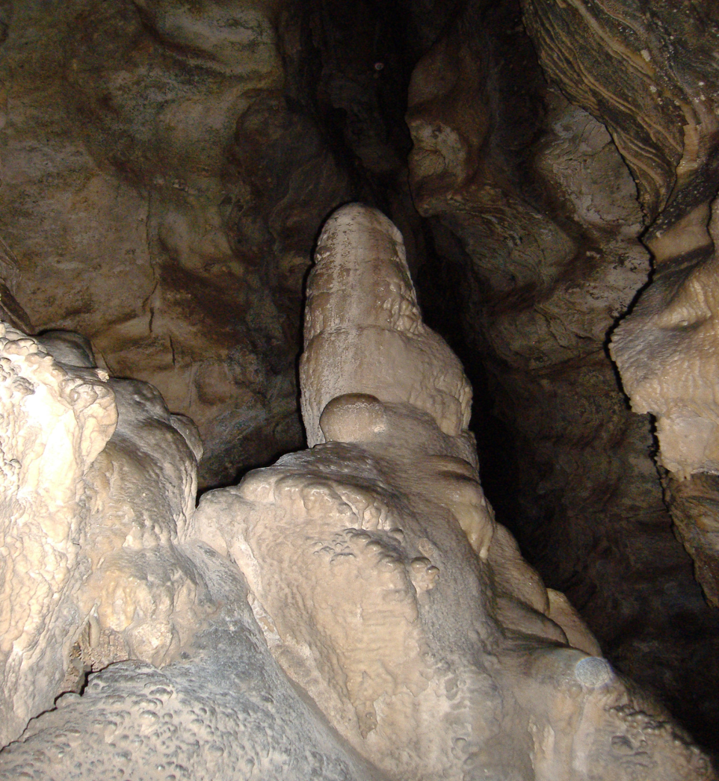
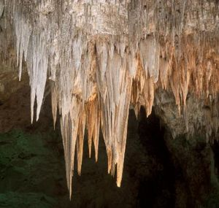
Cave Formations
stalagmite
stalactites

Slide 12
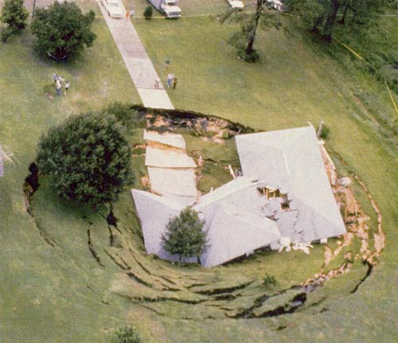
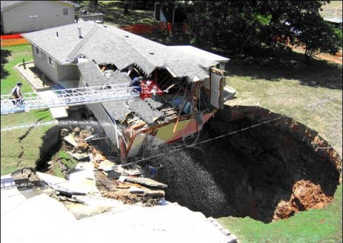
Sinkholes
the roof of the cave collapses
Because the water table lowers in the cave
common in Florida

Slide 13
Which of the following describes an aquifer’s ability to allow water to flow through?
A. porosity
B. permeability
C. geology
D. recharge zone

Slide 14
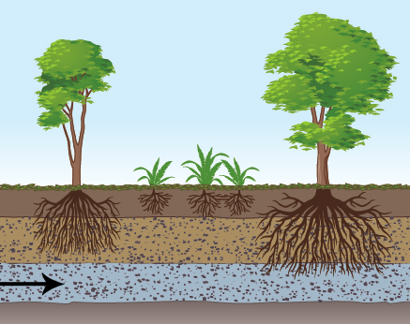
The arrow is pointing to
A. zone of aeration
B. zone of saturation
C. the water table
D. topsoil
What else could we call this area?

Slide 15
A _____________ is the upper surface of the zone of saturation.
A. water table
B. zone of aeration
C. well
D. cave

Slide 16
Caves are mainly made by
A. deposition of rivers.
B. water pollution.
C. erosion by groundwater.
D. transpiration.

Slide 17
A watershed is a region of land
A. that is drained by a river system.
B. where rainwater accumulates.
C. where the water table extends above Earth’s surface.
D. where the river water from tributaries accumulates.

Slide 18
The water table is found at the boundary of what?
A. the base of the river and the start of a delta
B. the zones of aeration and saturation
C. between the artesian formation and spring
D. between the zones of percolation and evaporation

Slide 19
When does a sinkhole form?
A. When there is too much runoff from a river?
B. When a floodplain is too small
C. When the water table is lower than a cave
D. When there is a lot of rain and snow in one year

