Slide 1
Ch 14, sections 3-4
Waves and Tides

Slide 2
Waves
most caused by WINDS
but can also be caused by earthquakes or landslides
wave size depends on
1. wind speed
2. length of time the wind blows
3. the distance over which the wind blows

Slide 3
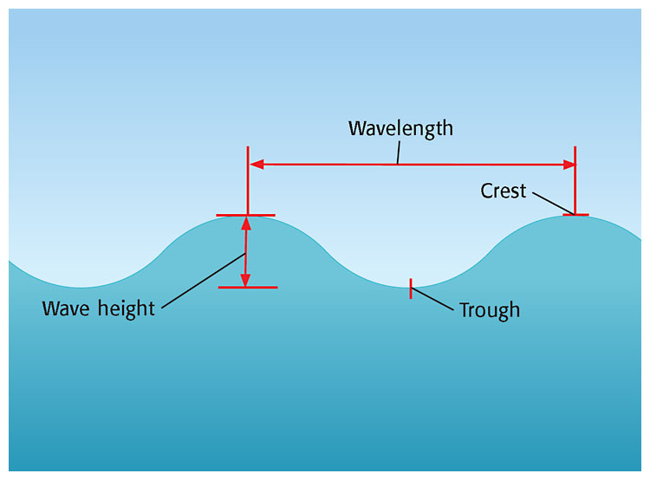
Parts of a Wave

Slide 4
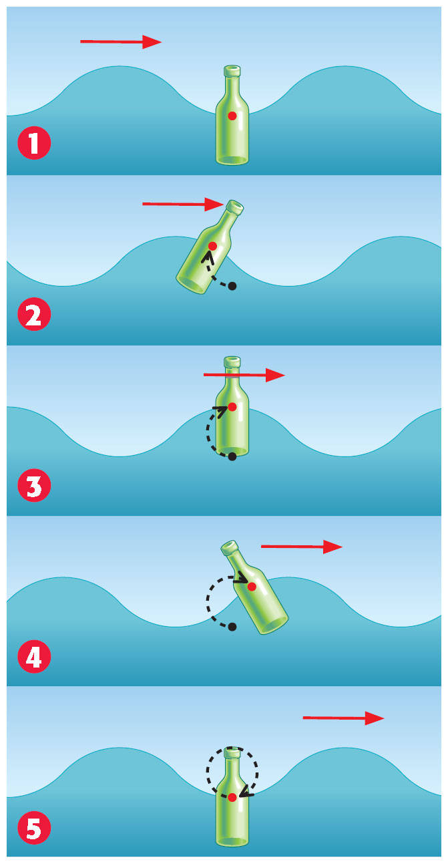
Wave movement
energy moves forward
But water molecules move in a small circle

Slide 5
A wave will get bigger (higher) when the distance over which the wind blows over the sea
A. increases (blows over a longer distance).
B. decreases (blows over a shorter distance).
C. stays the same.
D. is 0 kilometers (the wind does not blow).

Slide 6
Wave motion (animated website)

Slide 7
AC: Wave Speed (in m/s)
Wave period (sec)—time it takes for the next wave to pass
Wave speed= wavelength (m)
wave period (s)

Slide 8
{enrich}
undertow=after the wave crashes, the water (with sand) returns to the ocean underneath the new incoming waves
longshore current --formed when waves hit the shore at an angle (redeposits sand along the shore)—transports most of the sediments in beach environments
rip current —forms when a sandbar breaks; you should swim parallel to the shore (can be very dangerous)

Slide 9
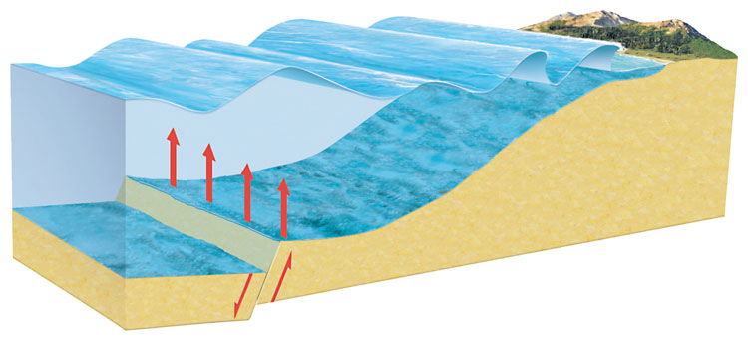
Tsunami (NOT tidal wave!)
GIANT WAVE----Japanese for “harbor wave”
caused by underwater earthquakes (6.5 or above on the Richter Scale), volcanoes, landslides, underwater explosions, or even the impact of a meteor or comet
most occur in the Pacific ocean (more earthquakes)
moves at about
500 km/h

Slide 10
On a clear day, a tsunami suddenly hits the beach of an island in the South Pacific. What was the likely cause of the wave?
A.offshore hurricane
B.undersea earthquake
C.continental deflection
D.wind in the open ocean

Slide 11
Name 5 things that can cause a tsunami…
Underwater earthquake
Underwater volcanic eruption
Underwater landslide
Underwater explosion
Impact of a meteorite or comet

Slide 12
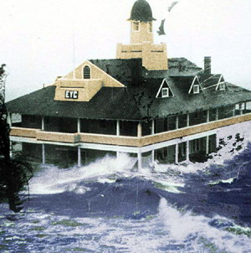
AC: Hurricane Storm Surge
sea level rises as a hurricane approaches
mainly caused by high winds
worse if hurricane hits at high tide

Slide 13
Ch 14-4

Slide 14
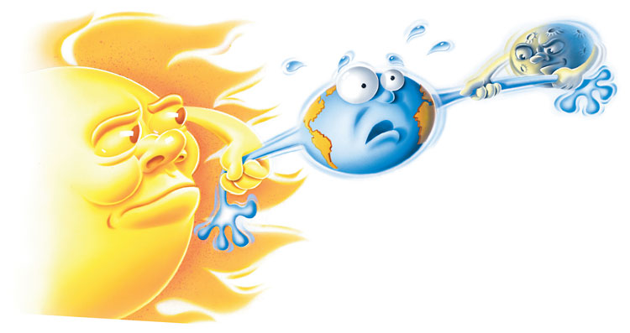
Tides
DYK: even the Great Lakes
have small tides
--due to gravitational pull of
the moon (the sun plays a
minor role because it’s so far
away from Earth)

Slide 15
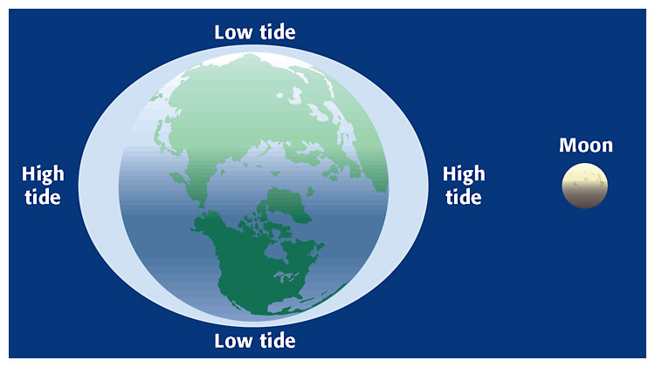
High and Low Tide
usually 2 high tides (if in line with the moon) a day and
2 low tides (if earth perpendicular to the moon) each day

Slide 16
Tidal Range (animated website)

Slide 17
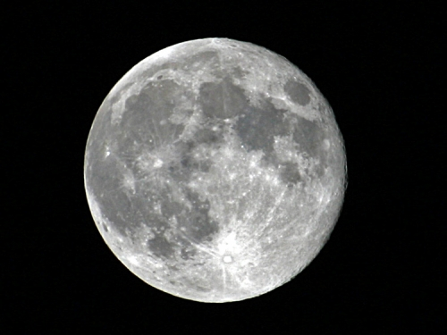
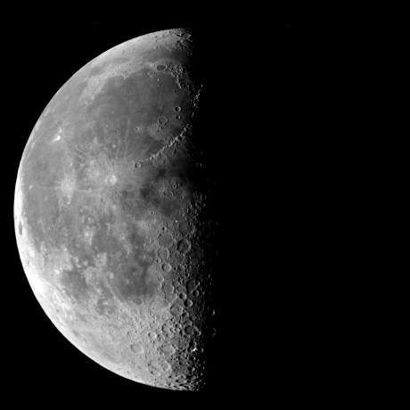
Spring and Neap Tides
Spring tides
largest tidal range
sun, earth, moon in line
happens twice a month
full
new moon
Neap tides
smallest tidal range
sun, earth, moon perpendicular
happens twice a month
first quarter
last quarter

Slide 18
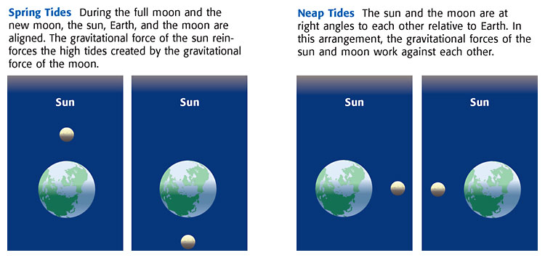
Spring and Neap Tide (each once a month)

Slide 19
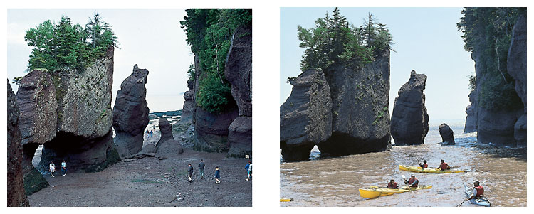
Tidal Range=difference between high and low tide
Low Tide
High Tide

Slide 20
Spring and Neap Tide (animated website)

Slide 21
WEBSITES---if time permits:
Destructive Power of Nature

Slide 22
Questions
What causes tides but NOT waves and currents?
…moon’s (sun’s) gravity
A wave will increase in height when the distance over which the wind blows over the sea ___________.
increases

Slide 23
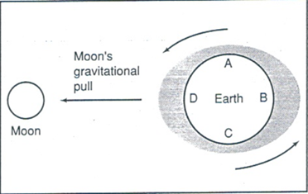
If the first high tide of the day occurs at 1:00am, the next high tide will occur close to _________________.
approximately 1:00pm (1/2 day or 12 hours)
What is the alignment of the moon and earth for a high tide to occur?
Points B & D will be having high tides

Slide 24
A wave will increase in height when the speed of the wind _______.
increases
What is a cause of waves and currents and NOT tides?
….wind

Slide 25
Which of the following statements describes the relative positions of Earth, the sun, and the moon when the smallest difference between high tide and low tide occurs?
A.The sun and Earth were at right angles to each other relative to the moon.
B.The sun and moon were at right angles to each other relative to Earth.
C.The sun, moon, and Earth were aligned, with the moon between the sun and Earth.
D.The sun, moon, and Earth were aligned, with the Earth between the sun and moon.

Slide 26
What combination of tides is occurring when you see the full moon directly overhead?
A.high tide during a neap tide
B.low tide during a neap tide
C.high tide during a spring tide
D.low tide during a spring tide

