Slide 1
Air Pressure
Ch 15-1b

Slide 2
Air Pressure (fill in visual organizer)
As you increase altitude/elevation, air pressure, density, and temperature DECREASES (ex: ears pop due to pressure change)

Slide 3
Air Pressure
High Pressure
Low Pressure

Slide 4
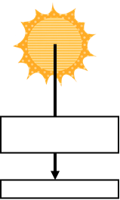
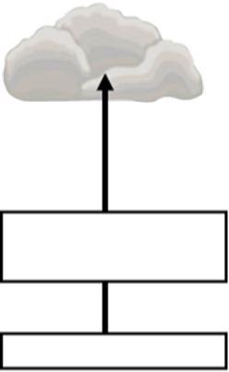
Warm air rises, creating LOW PRESSURE (clouds form if enough moisture)
Cool air sinks, creating HIGH PRESSURE (results in few or no clouds)
Low Pressure
High Pressure
Warm air rises
Cold air sinks

Slide 5
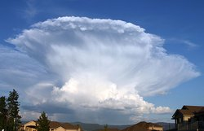
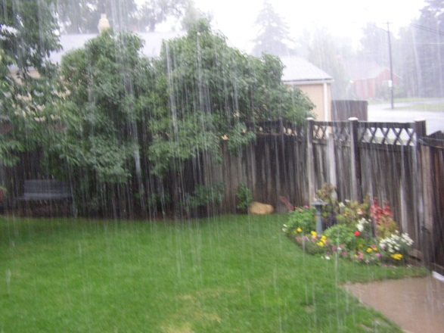
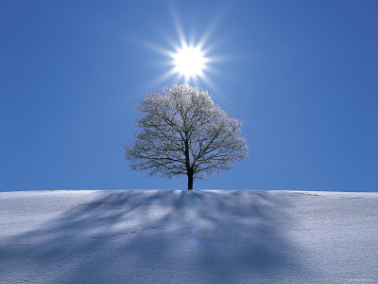
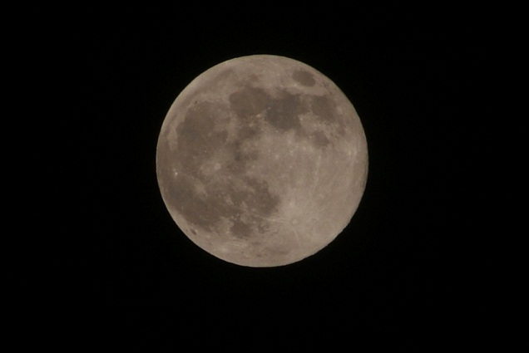
Weather and air pressure
Low pressure= “lousy” weather
(unless we’re in a drought)
High pressure= “happy” weather

Slide 6
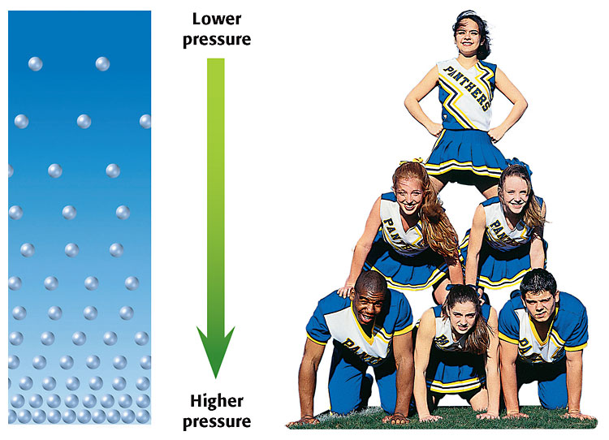
Stand up and sit down in your chair =rising and sinking air

Slide 7
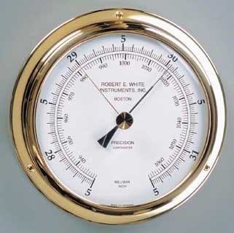
Units & Instrument of pressure
Instrument= barometer
(2 types)—aneroid*
and mercury
inches of mercury (avg= 29.92")
metrics= millibars (avg= 1013 mB)
**air pressure is mainly influenced
by air temperature and elevation

Slide 8
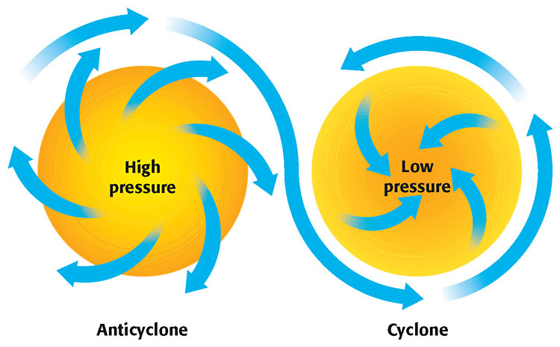
high pressure
anticyclone (air sinks)
usually fair weather
winds spin CW
low pressure
cyclone (air rises)
usually clouds/precip.
winds spin CCW
Average air pressure is 29.92 inches of Hg (1013 mb)

Slide 9
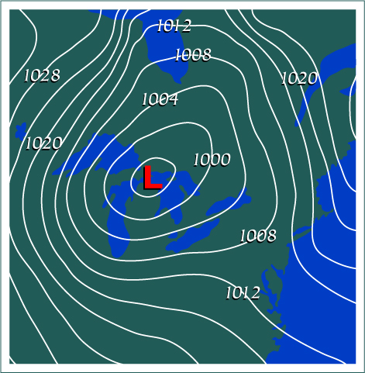
Isobars {enrich} (lines of equal air pressure)

