Slide 1
Wind—part 1

Slide 2
Did you know…
Alaska is the
windiest state.
The fastest “regular” wind was 231 mph (372 kph), recorded at Mount Washington (NH), on April 12, 1934.
During a May 1999 tornado in Oklahoma, researchers clocked the wind at 318 mph (513 kph).

Slide 3
Why air moves…
**wind is the horizontal movement of air from HIGH pressure (sinking air) to LOW pressure (rising air)—convection box
unequal heating creates unequal air pressure
the greater the pressure/temperature difference, the faster the wind moves
winds are named for the direction they come FROM

Slide 4
Question:
Would there be winds if the Earth’s surface were the same temperature everywhere? Explain.
NO—air moves from high to low pressure

Slide 5
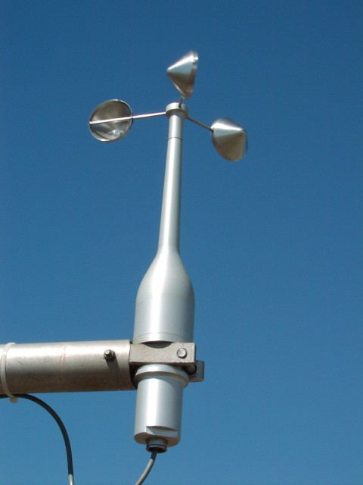
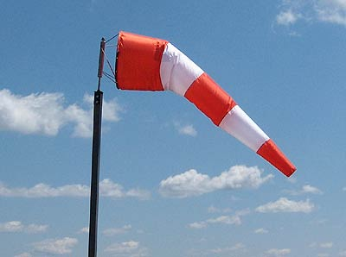
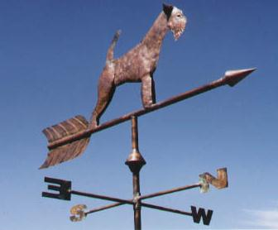
**Measuring Winds
anemometer=wind speed
windsock=wind direction & speed (not as accurate)
wind vane= wind direction
(enrich) Beaufort Scale of Wind Strength (chart) and Wind Chill --practice

Slide 6
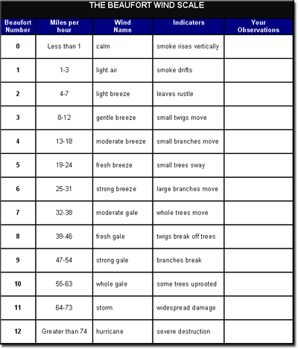
Beaufort Scale (don’t memorize)

Slide 7
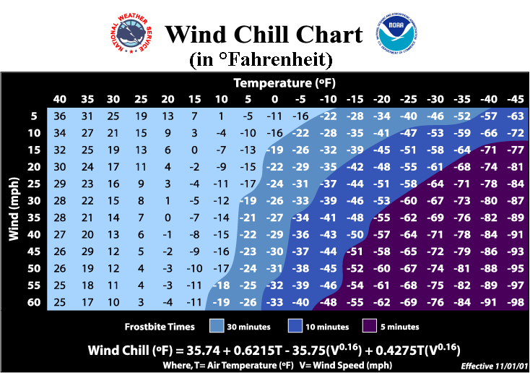
Wind Chill Chart
Cooling effect
of wind

Slide 8
Pressure Belts and Convection Currents
the equator receives more direct sunlight/heat so low pressure is created (warm air rises), which moves toward cold poles
the poles receive a lot less sunlight/heat so high pressure is created (denser), which moves toward the equator
convection cells every 30° latitude

Slide 9
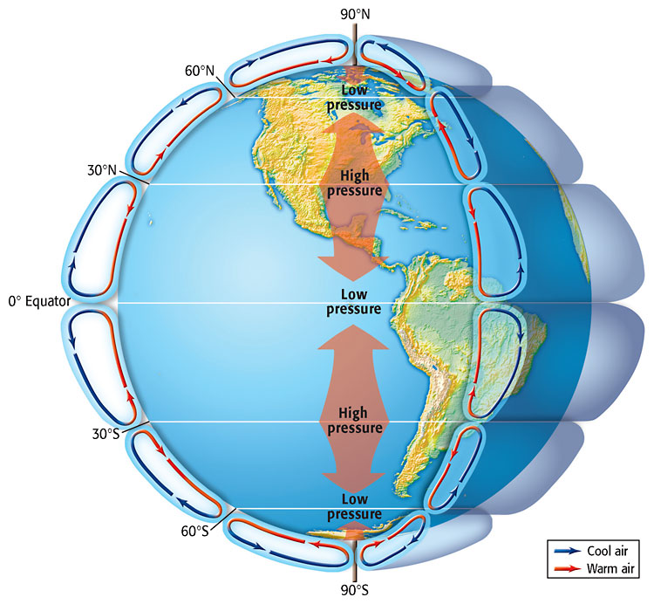

Slide 10
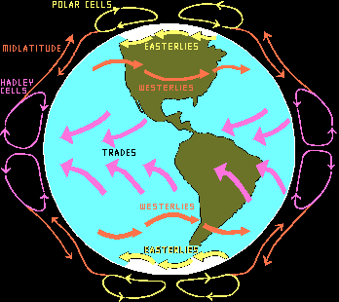
Global Winds
See next powerpoint…

