Slide 1
Earth’s Natural Resources

Slide 2
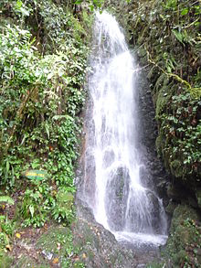
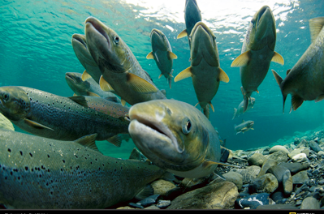
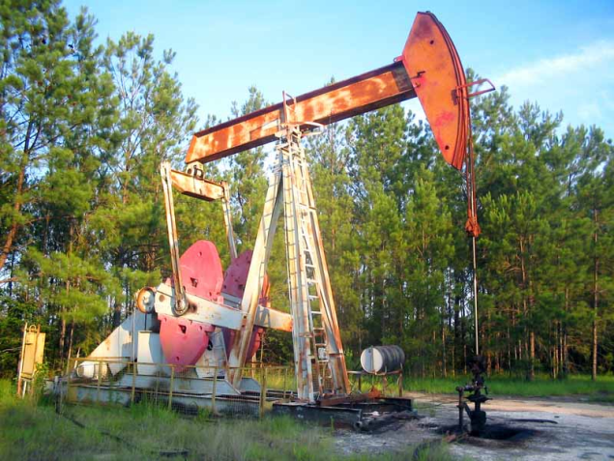
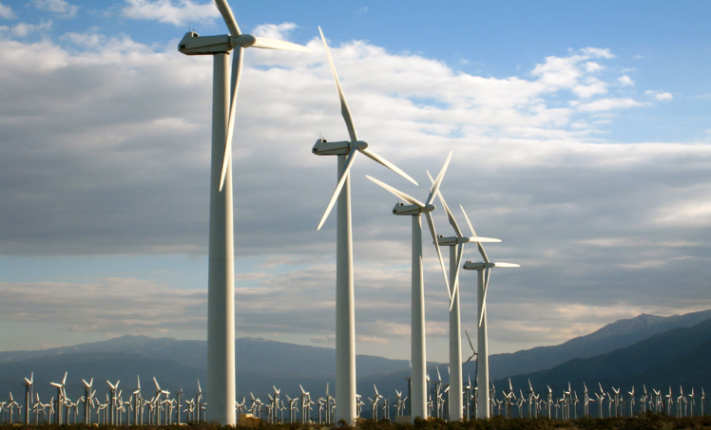
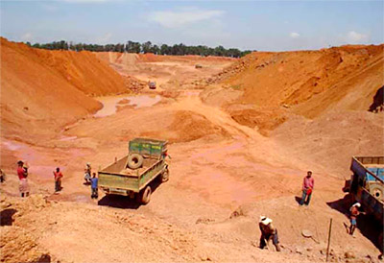
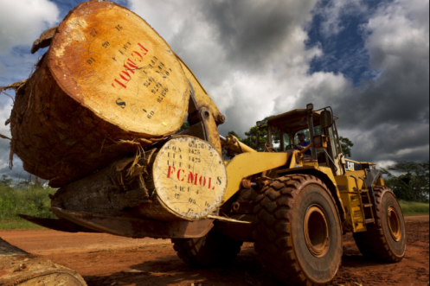
What do you think of when you hear “natural resources?”

Slide 3
The American Heritage® Science Dictionary
natural resource Something, such as a forest, a mineral deposit, or fresh water, that is found in nature and is necessary or useful to humans.

Slide 4
Two types of Natural Resources
Renewable
(can replenish itself naturally in 100 years or less)
trees/wood (paper)
solar energy
wildlife
water
solar, wind, geothermal energy
Nonrenewable
(cannot be replaced if it is used up)
(used up faster than nature can replace it)
rocks & minerals
oil (petroleum)
coal
nuclear energy (uranium)

Slide 5
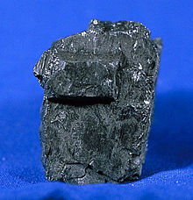
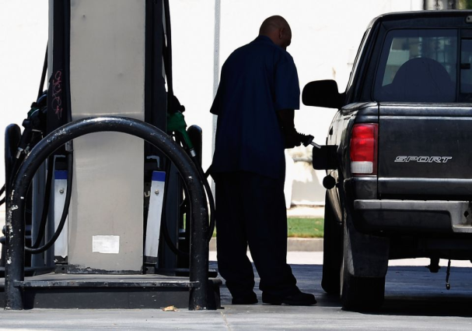
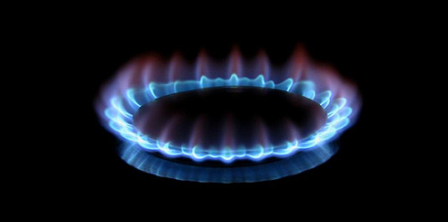
Fossil Fuels (nonrenewable) --3 types--
Solid: coal
Liquid: oil (petroleum)—used to make plastics and gasoline
Gas: natural gas (like methane, butane and propane)

Slide 6
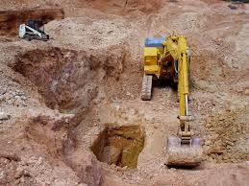
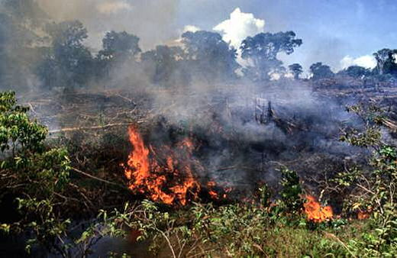
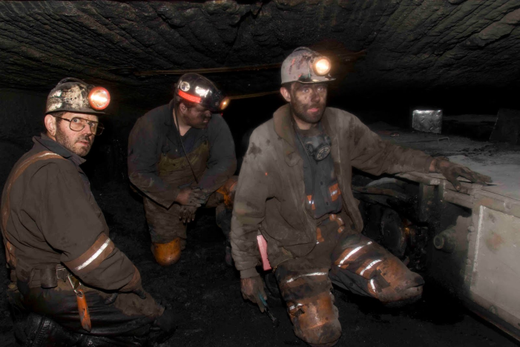
How do we get rocks/minerals (nonrenewable) from the earth?
This is expensive, dangerous, and bad for the environment (deforestation, for example)…
Mining (digging in the earth)
So reduce, reuse, recycle!

Slide 7
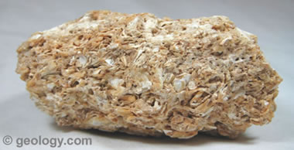
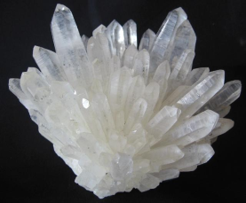
What’s the difference between rocks and minerals?
Minerals
Rocks
elements (like copper)
or compounds (like quartz, SiO₂)
cannot contain organic material (things that are/were living)
mixtures of minerals
may contain organic matter (like coal and limestone)

Slide 8
Extra Info (enrich)

Slide 9
3-3 Uses of Minerals

Slide 10
Mining
land must be reclaimed when mining is finished (law since 1970’s)
reduce need for more mining by reducing and recycling

Slide 11
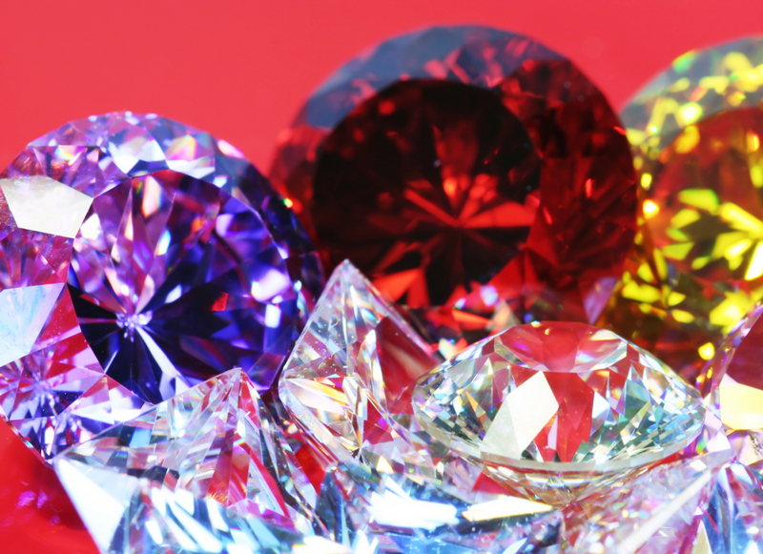
GEMSTONES
Ex: rubies and sapphires
hard, colorful minerals with brilliant or glassy luster
rare
mainly used for jewelry and decorations

Slide 12
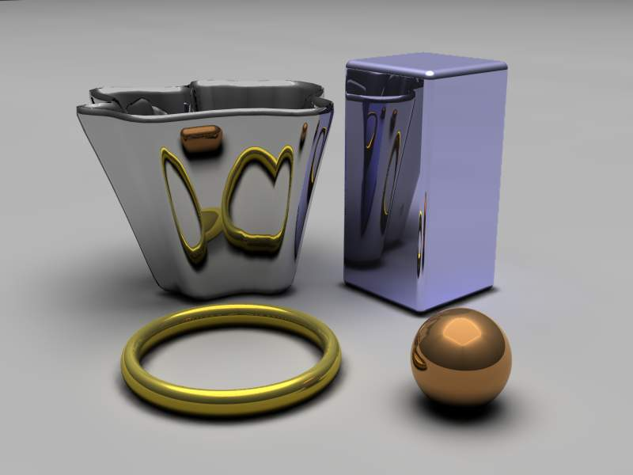
Some minerals are metals
aluminum, iron, copper, silver
stretched into wire
flattened into sheets
hammered or molded without breaking
steel (from iron ore) for framing

Slide 13
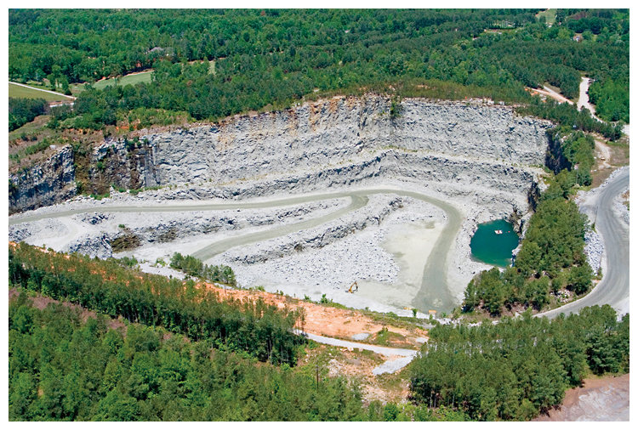
Quarry in north GA—surface mining

Slide 14
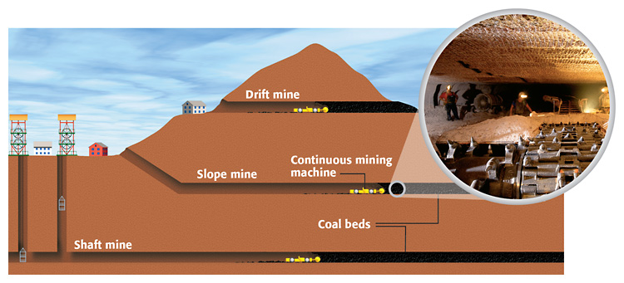
Subsurface Mining

