Slide 1
Pick A Ride!
Finding volume has NEVER been so much fun… it will blow your mind!!

Slide 2
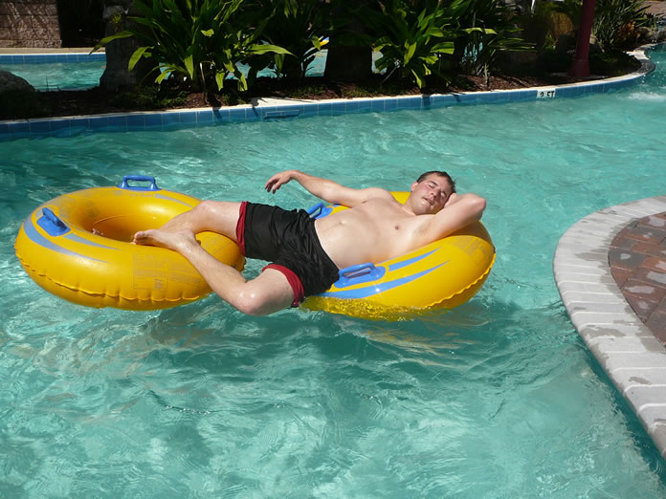
Here are your choices…..
You may choose to work the Lazy River problems if you’re in the mood for a slower, easier option….

Slide 3
The Mutiny Chute may be more your speed if you’re ready for a little thrill…

Slide 4
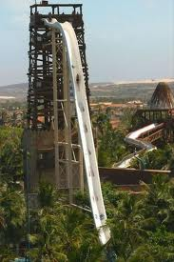
Or try the Cliffhanger if you’re ready for something more challenging!

Slide 5
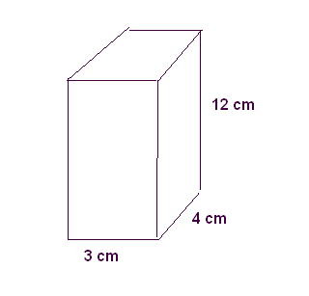
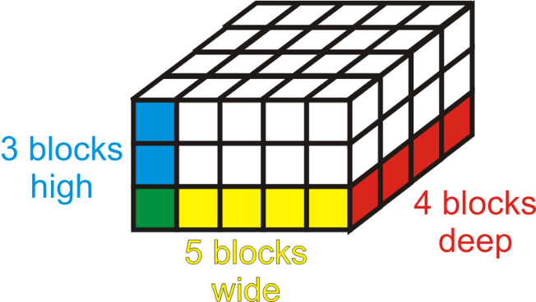
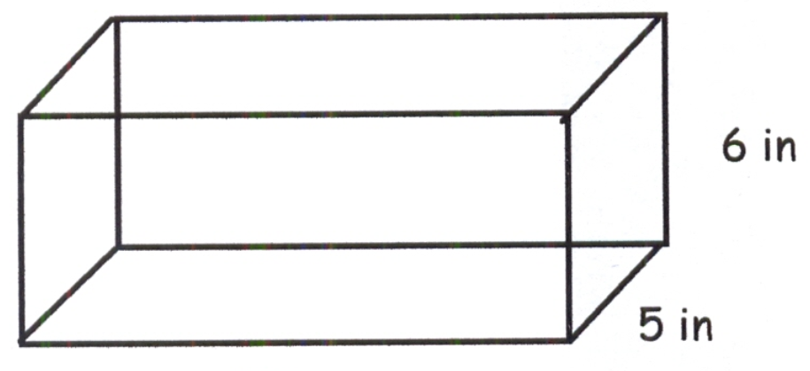
Determine the volume:
Determine the volume:
If the volume of the rectangular prism is 120 cubic inches, what is its length?

Slide 6
Lazy River
3 • 5 • 4 =
15 • 4 =
Mutiny Chute
3 • 4 • 12
12 • 12 =
Cliff Hanger

Slide 7
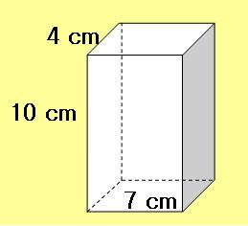
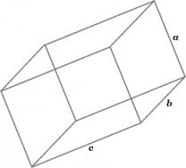
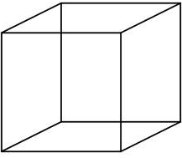
Determine the volume:
Determine the volume:
a = 6 in b = 3 ½ in c = 7 in
Determine the volume:

Slide 8
Lazy River
7 ⦁ 4 ⦁ 10 =
Mutiny Chute
6 ⦁ 3 ½ ⦁ 7 =
21 ⦁ 7 =
Cliff Hanger
=
=
=

Slide 9
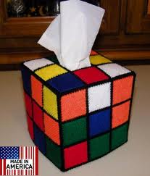
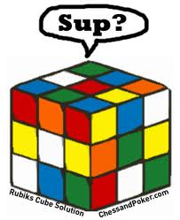
Determine the volume of a Rubik’s Cube that is 10 cm wide.
Determine the volume of the cubic tissue box below. It is 1 ½ in tall. (Give your answer as a fraction!!)
Determine the volume of a cube that is 2 ¼ in. tall. (Give your answer as a fraction!!)

Slide 10
Lazy River
10 ⦁ 10 ⦁ 10=
100 ⦁ 10 =
Mutiny Chute
1½ x 1½ x 1½ =
=
Cliff Hanger

Slide 11
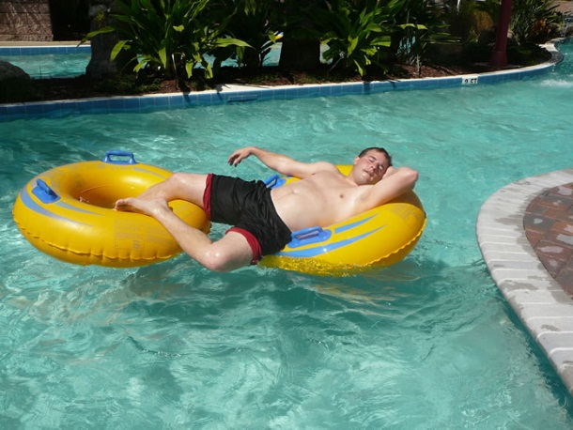
Determine the volume of a box that is ¼ cm x 2/3 cm x ¾ cm.
If you have 16 of the boxes from the “Lazy River,” what is their total combined volume?
A rectangular box has a length of 8 ½ inches and a width of 4 inches.
If the box contains 68 cubic inches in volume, what is its height?

Slide 12
Lazy River
Mutiny Chute
Cliff Hanger

Slide 13
Determine the volume of a box that is 2 ft tall, 6 feet long, and 3/8 feet wide.
Determine the volume of a box that is 4 cm tall, 5.5 cm wide, and ½ cm long.
If you have a box with only half the volume of the one listed in “Mutiny Chute,” what is its volume?

Slide 14
Lazy River
Mutiny Chute
Cliff Hanger

Slide 15
Sally’s Bakery needs to determine the volume of a box that is ½ foot long, ½ foot wide, and ¾ foot tall. What is the volume of the box?
Pepe’s Pizza boxes are 1/6 foot tall, 9/10 feet long, and 9/10 feet wide. What is the volume of a pizza box?
A cereal box is 12 inches tall, 2 ½ inches wide, and 10 ½ inches long. What is its volume?

Slide 16
Lazy River
Mutiny Chute
Cliff Hanger

